Slide 1
Learning and Teaching Resources on English Language (S1 - 3)
Developed by English Language Education Section
Curriculum Development Institute
Education Bureau

Slide 2
An Overview of the Learning Task
Content Objectives
To understand different ways to prevent the spread of COVID-19
To design a poster to promote effective measures to prevent the spread of infectious diseases on the school campus
To develop values and attitudes related to “responsibility” and “care for others”
Language Focuses
To understand the features of a poster
To understand the use of imperatives to give advice

Slide 3
What do you know about COVID-19, a coronavirus disease? Please put your answers in the left column.
What do you Know? | What do you Want to Know? | What have you Learnt?

Slide 4
COVID-19 (Coronavirus Disease)
Part 1: Pre-reading
Take a closer look at the virus. What does it look like?
1) What is a “corona”?
Corn on the cob
A cross which is made of gold
A circle of light which looks like a crown
2) How did “coronavirus” get its name?
_____________________________
3) What are the symptoms of COVID-19 (Coronavirus Disease)?
__________________________________
( Answers)

Slide 5
What do you want to know about COVID-19, a coronavirus disease? Please put your answers in the middle column.
What do you Know? | What do you Want to Know? | What have you Learnt?

Slide 6
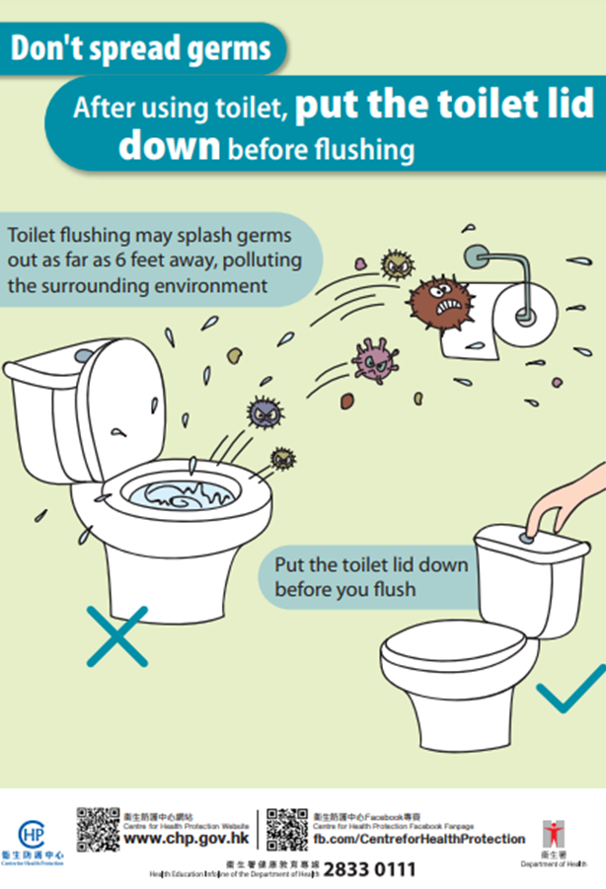
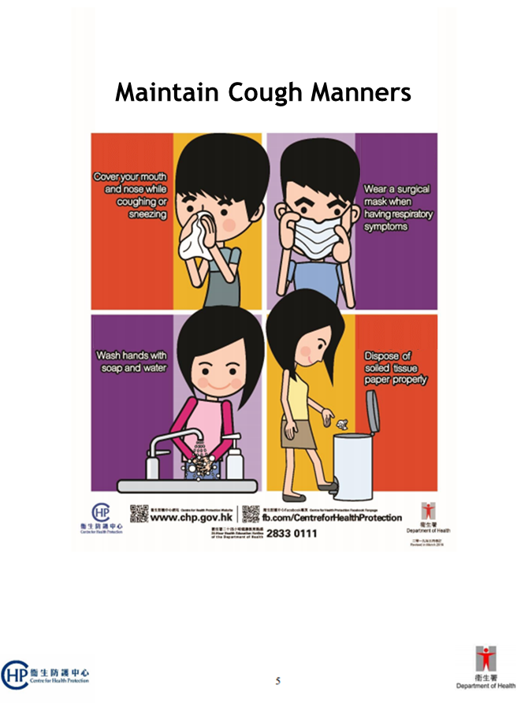
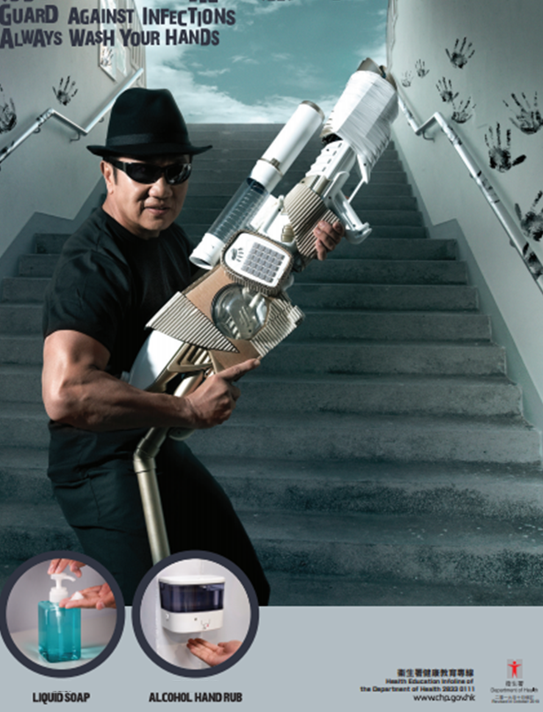
Prevention of COVID-19
Part 2: Text Features of a Poster
Study the features of the following posters and complete the table on the following slide:
View the poster using the following link:
View the poster using the following link:
View the poster using the following link:
https://www.chp.gov.hk/files/pdf/healthmessagesseries_2_en.pdf
https://www.chp.gov.hk/files/her/maintain_cough_manners.pdf
https://www.chp.gov.hk/files/pdf/hand_hygiene_poster.pdf

Slide 7
Prevention of COVID-19
4) Features of a Poster
 |  | Features (What?) | Purpose (Why?)
a) | Title/Slogan (e.g. fonts, use of language)
b) | Images (e.g. use of colours, pictures)
c) | Messages (e.g. what the authors want to tell us)
( Answers)

Slide 8
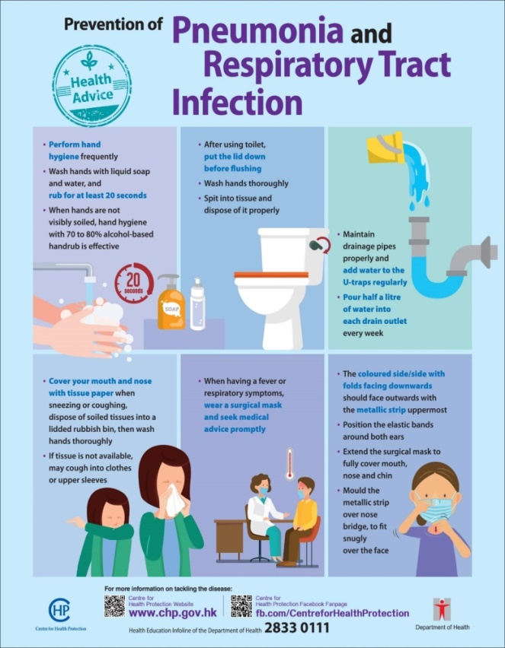
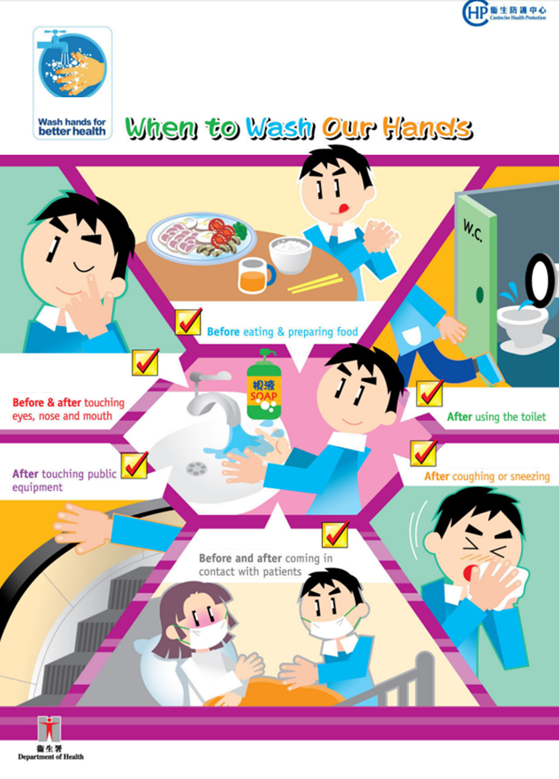
Prevention of COVID-19
Part 3: Reading
Your classmate, James, has asked you for advice on how to prevent infection of COVID-19. Study the posters below and give him advice by evaluating whether the precautions taken by him (on the following slide) are effective or not.
View the poster using the following link:
View the poster using the following link:
View the poster using the following link:
https://www.chp.gov.hk/files/pdf/pneumonia_respiratory_health_advice_en.pdf
https://www.chp.gov.hk/files/pdf/pneumonia_travel_advice.pdf
https://www.chp.gov.hk/files/pdf/08657-doh-pr2-r05.pdf

Slide 9
Prevention of COVID-19
5) Evaluate the precautions taken by James and give him advice for those which you think are ineffective.
 | Precautions Taken by Jamie | Please tick (✓). |  | Your Advice
 |  | Effective | Ineffective
a) | I pour half a litre of water into the drain outlet of the washrooms every month.
b) | I cough into my clothes when I forgot to bring my tissue paper with me.
c) | Before meals, I rub my hands for 25 seconds while washing them with water and liquid soap.
d) | I mould the metallic strip of my mask over my chin.
( Answers)

Slide 10
Prevention of COVID-19
6) Evaluate your own precautions by completing the reflection sheet below:
My Refection
Effective Precautions | My Plan for Improvement

Slide 11
Prevention of COVID-19
Part 4: Writing
To ensure that the campus provides a safe and healthy learning environment, your school is organising a poster design competition to promote effective measures to prevent the spread of infectious diseases. The poster should include the following:
An attractive title/slogan;
Images/drawings to illustrate key messages; and
Advice on the importance of personal hygiene, the measures to be taken in classrooms and school activities, and how to keep the campus safe and hygienic
Effective Measures
Personal Hygiene
School Activities
Classrooms
Campus
Environment

Slide 12
What have you learnt about COVID-19, a coronavirus disease? Please put your answers in the right column.
What do you Know? | What do you Want to Know? | What have you Learnt?

Slide 13
For more information on combatting COVID-19, please visit the website of the Centre for Health Protection, Department of Health:
https://www.chp.gov.hk/en/index.html

Slide 14
Suggested Answers
Part 1: Pre-reading
1) What is a “corona”?
c) A circle of light which looks like a crown
2) How did “coronavirus” get its name?
The virus looks like a crown.
3) What are the symptoms of COVID-19 (Coronavirus Disease)?
Fever, cough, shortness of breath, diarrhoea

Slide 15
Suggested Answers
4) Features of a Poster
 |  | Features (What?) | Purpose (Why?)
a) | Title/Slogan (e.g. fonts, use of language) | Bigger font size Use of imperatives Key message of the poster embedded | To draw readers’ attention To give advice (e.g. “Guard against infections; “Maintain cough manners”) To keep the key message concise and memorable
b) | Images (e.g. use of colours, pictures) | Use of different colours Use of photos/pictures | To imply something bad/negative through the use of the black colour in the third poster To facilitate readers’ understanding of the content of the poster
c) | Messages (e.g. what the authors want to tell us) | Advice about the prevention of infectious diseases provided | To remind readers of the importance of hygiene, or To provide readers with suggestions related to the prevention of infectious diseases

Slide 16
Suggested Answers
5) Evaluate the precautions taken by James and give him advice for those which you think are ineffective.
 | Precautions Taken by Jamie | Please tick (✓). |  | Your Advice
 |  | Effective | Ineffective
a) | I pour half a litre of water into the drain outlet of the washrooms every month. |  | ✓ | Pour half a litre of water into the drain outlet of the washrooms every week.
b) | I cough into my clothes when I forgot to bring my tissue paper with me. | ✓
c) | Before meals, I rub my hands for 25 seconds while washing them with water and liquid soap. | ✓
d) | I mould the metallic strip of my mask over my chin. |  | ✓ | Mould the metallic strip of your mask over your nose bridge, to fit snugly over your face.

