Slide 1
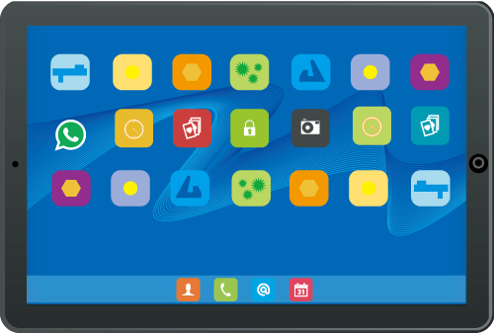
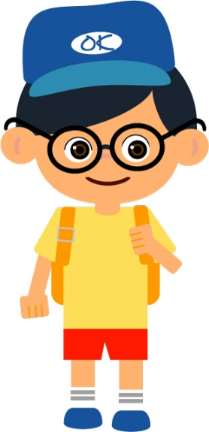
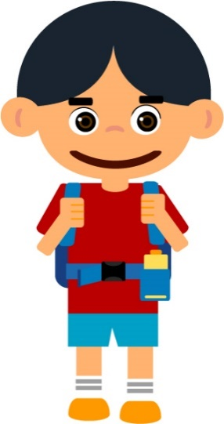
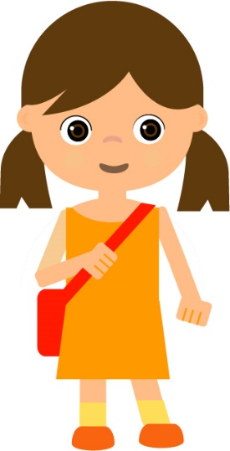
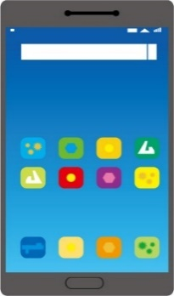
Life-wide Learning
during the Fight against the Epidemic
Virtual Tours in Museums

Slide 2
Life-wide Learning
LWL refers to student learning in real contexts and authentic settings to achieve targets that are more difficult to attain through classroom learning. In the process of experiential learning, students have the opportunity to make meaning of their own direct, first-hand experiences. Along with quality self-reflection, the knowledge constructed, the skills acquired and the positive values and attitudes developed through LWL can be transferred to accomplish tasks and solve problems in new contexts.
Curriculum Development Council. (2002). Basic education curriculum guide: Building on strengths (Primary 1 –Curriculum Development Council. (2017). Secondary Education Curriculum Guide. Hong Kong: Author.

Slide 3
Life-wide Learning
This is genuine learning which helps students achieve the aims of whole-person development and enables them to develop the lifelong learning capabilities that are needed in our ever-changing society. (e.g. in response to challenges arising from the COVID-19 epidemic.)
Curriculum Development Council. (2017). Secondary Education Curriculum Guide. Hong Kong: Author.

Slide 4
Life-wide Learning : Five Essential Learning Experiences
Moral and Civic Education
Intellectual Development
Physical and Aesthetic Development
Career-related Experiences
Community Service
Five Essential Learning Experiences
Curriculum Development Council. (2017). Secondary Education Curriculum Guide. Hong Kong: Author.

Slide 5
Life-wide Learning : Five Essential Learning Experiences
The five essential learning experiences are interlinked. Students can acquire more than one essential learning experiences in a life-wide learning activity. For example, during a visit to a museum, students can know more about history and culture (intellectual development), architectural art (physical and aesthetic development), stories of people serving others (community service), work of archaeologist (career-related experiences) and learn how to appreciate and respect multi-cultures (moral and civic education).
To facilitate reader’s reading, this PowerPoint is presented according to the five essential learning experiences. Students can be flexible and think further how they can acquire various essential learning experiences when they visit different museums.

Slide 6
Virtual Tours in Museums
To prevent the spread of COVID-19, classes in all schools are still suspended for the sake of safeguarding students’ health. Students can make better use of their learning time at home to visit websites of the world’s museums while fighting against the epidemic. Through the online exhibitions/seminars, virtual tours and multi-media learning resources of the museums, students can acquire different kinds of knowledge and broaden their horizons anywhere at any time.

Slide 7
INTELLECTUAL DEVELOPMENT
In schools, students gain intellectual development mainly through classroom learning in Key Learning Area (KLA) studies. LWL could complement KLAs and cross-curricular studies to attain learning goals in areas which are closely linked with the five essential learning experiences but difficult to be acquired through classroom settings. Students can broaden their knowledge in different fields by visiting museums or their websites.

Slide 8
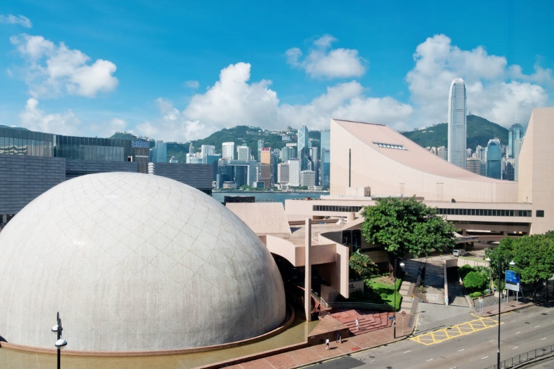
Hong Kong Space Museum
Hong Kong Space Museum https://www.lcsd.gov.hk/CE/Museum/Space/en_US/web/spm/whatsnew.html
Online Lecture https://hk.space.museum/en_US/web/spm/activity/onlinelecture.html
In Hong Kong Space Museum, we can learn about astronomy and enhance our interest in astronomy and space science.
Space Museum Online https://www.lcsd.gov.hk/CE/Museum/Space/en_US/web/spm/onlineresources/spmonline.html

Slide 9
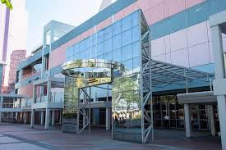
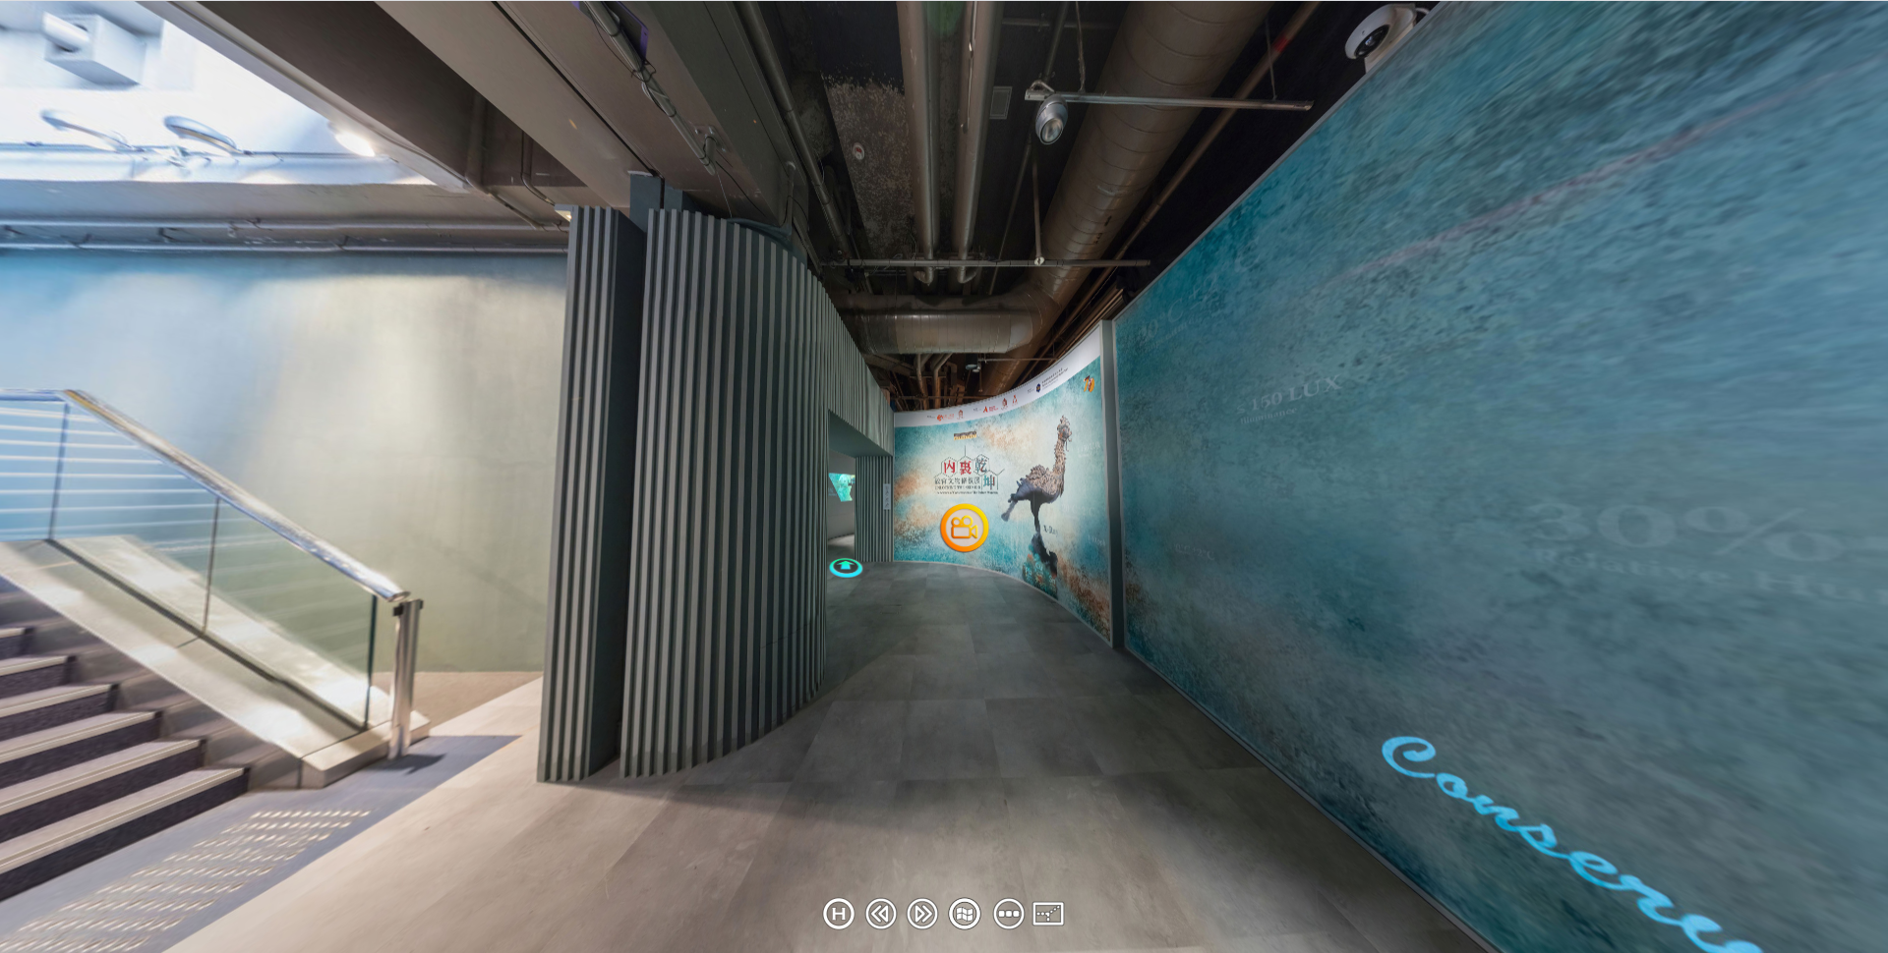
Hong Kong Science Museum
Hong Kong Science Museum https://hk.science.museum/en_US/web/scm/index.html
Virtual Tour https://hk.science.museum/ms/con2019/360/index.html
In Hong Kong Science Museum, we can acquire STEM (Science, Technology, Engineering, Math) related knowledge and understand the relationship between science and technology and our everyday life.

Slide 10
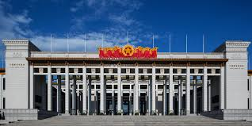
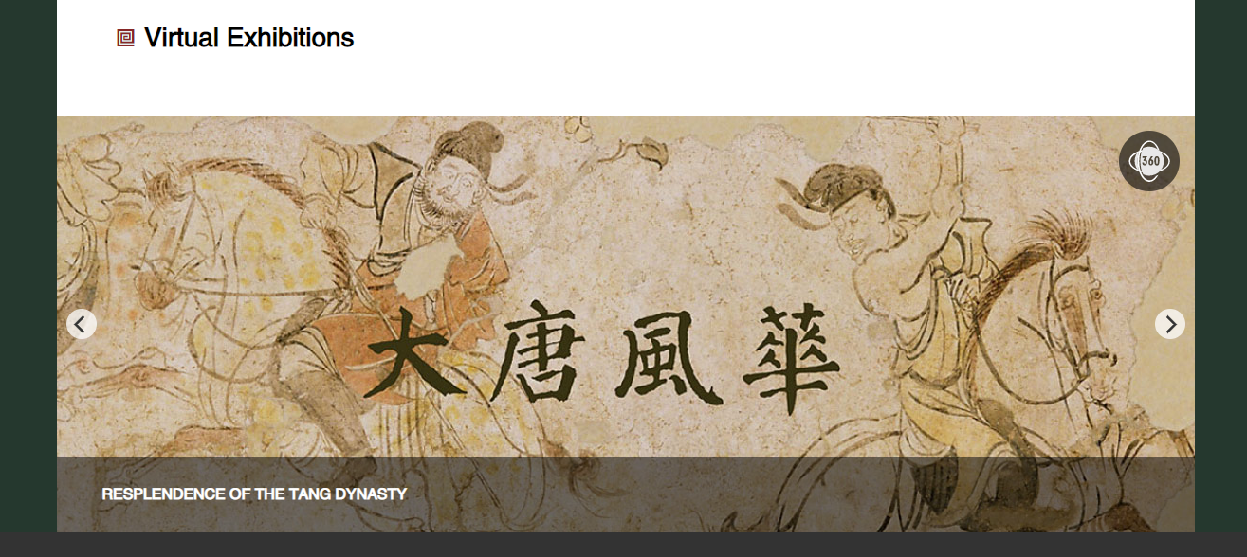
National Museum of China
National Museum of China http://en.chnmuseum.cn/
Virtual Exhibition http://en.chnmuseum.cn/exhibition/#rep_exhibitions
In National Museum of China, we can develop an understanding of Chinese history, Chinese culture, and national development.

Slide 11
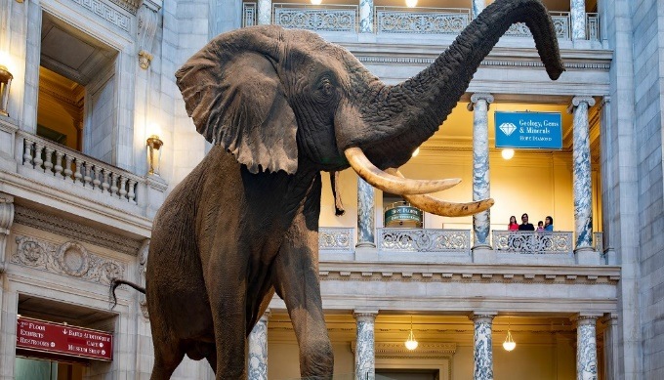
Smithsonian National Museum of Natural History
Smithsonian National Museum of Natural History https://naturalhistory.si.edu/
Virtual Tours https://naturalhistory.si.edu/visit/virtual-tour
In Smithsonian National Museum of History, we can see specimens of plants and animals, and human cultural artefacts. Hence, we can understand the relationship between the natural world and us.

Slide 12
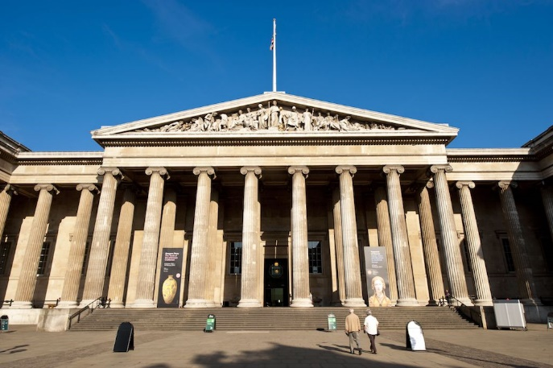
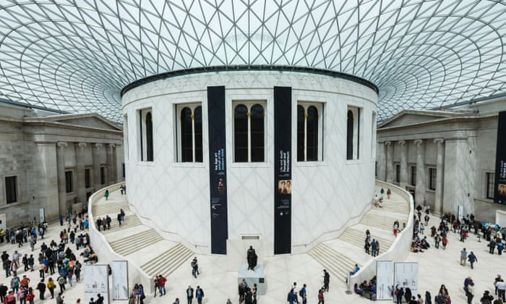
The British Museum
The British Museum https://www.britishmuseum.org/
Virtual Galleries https://www.britishmuseum.org/collection/galleries#virtual-galleries
In the British Museum, we can see specimens of natural history, historical objects , books and so on, which help us understand the world history and different cultures.

Slide 13
Moral and civic education
LWL puts emphasis on student learning in real contexts beyond the classroom, which often enhances the effectiveness of moral and civic education. Visiting museums, libraries, and their websites, students can understand different cultures, cultivate their positive values and attitudes and develop a healthy living style.

Slide 14
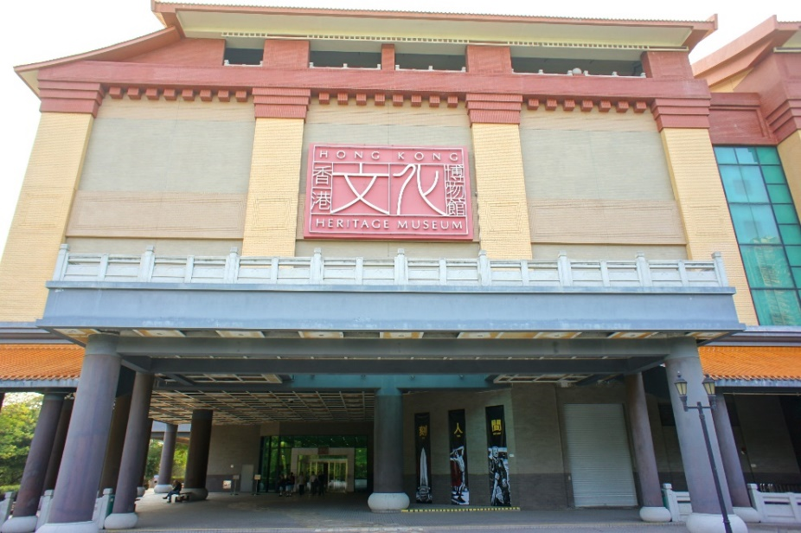
Hong Kong Heritage Museum
Hong Kong Heritage Museum https://hk.heritage.museum/en_US/web/hm/highlights.html
Online programmes
Collections
Art & Culture
HK Memory
Online Resources https://artsandculture.google.com/search/asset/?p=hong-kong-heritage-museum&em=m068jd&categoryId=medium
The collections in Hong Kong Heritage Museum reflect the essence of Hong Kong’s unique culture, which help us understand the multi-cultures in Hong Kong, as well as to appreciate and respect these cultures.

Slide 15
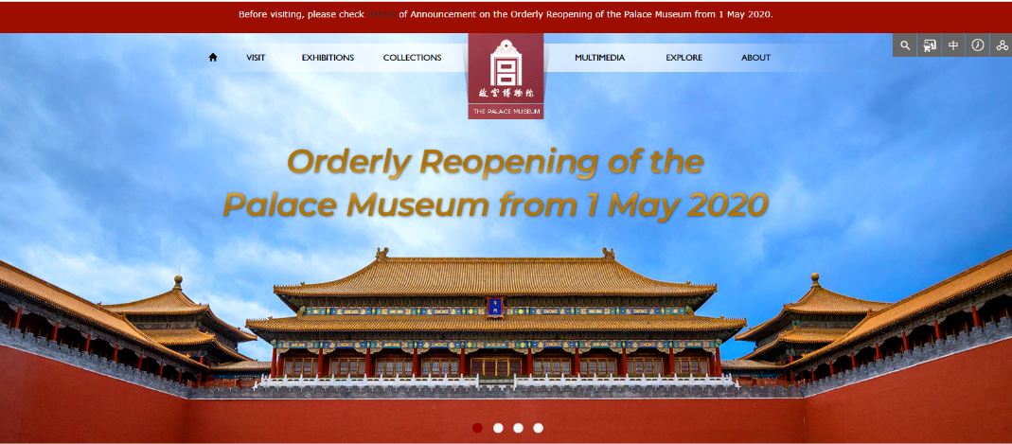
The Palace Museum
Virtual Tours https://en.dpm.org.cn/multimedia/virutual/
The Palace Museum https://en.dpm.org.cn/
Through visiting the Palace Museum, we can know more about the Chinese history and Chinese culture, and appreciate the preservation of historical and cultural heritage.

Slide 16
Hong Kong Public Libraries
Hong Kong Public Libraries https://www.hkpl.gov.hk/en/index.html
e-Books https://www.hkpl.gov.hk/en/e-resources/e-books/home
We can read various books in Hong Kong Public Libraries. We can learn how to maintain physical and mental health and develop a healthy living style.

Slide 17
T．PARK
T．PARK https://www.tpark.hk/en/
Online Videos https://www.tpark.hk/en/news/
In T ．Park, we can understand the advantages and importance of ‘waste-to-energy’ and know more about “waste management”, “resource recovery” and “recycling”. These help us raise our awareness of environmental protection.

Slide 18
Community service
Community service helps students nurture respect and care for others as well as a sense of civic responsibility. Visiting museums and related websites, students can know more about stories of people serving others, so as to cultivate positive values and attitudes.

Slide 19
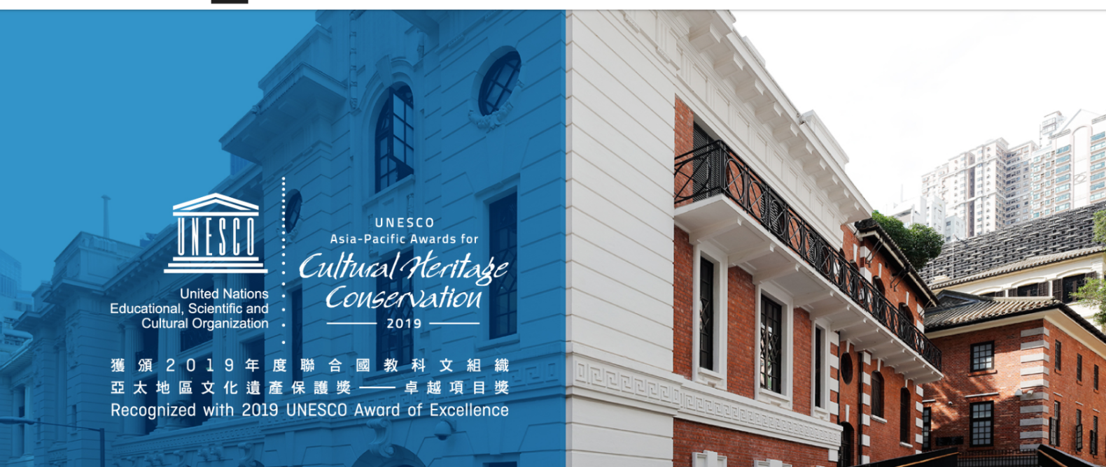
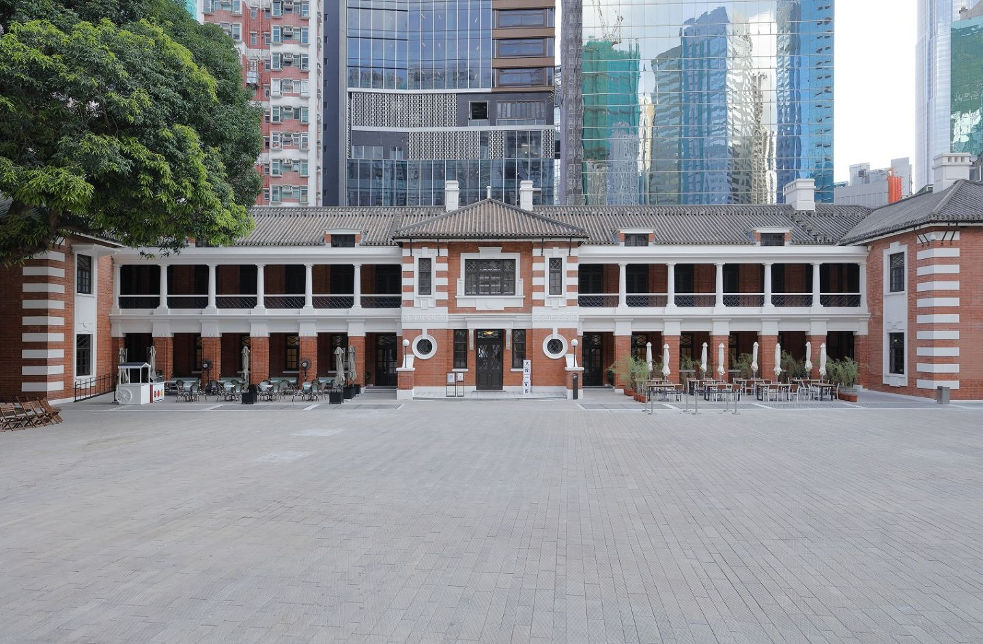
Tai Kwun
Tai Kwun https://www.taikwun.hk/en/
Tai Kwun comprises three declared monuments — the former Central Police Station, Central Magistracy and Victoria Prison. It preserves the importance of law and order as well as prosecution history in Hong Kong. It helps us understand the contributions of people who maintained law and order in Hong Kong.

Slide 20
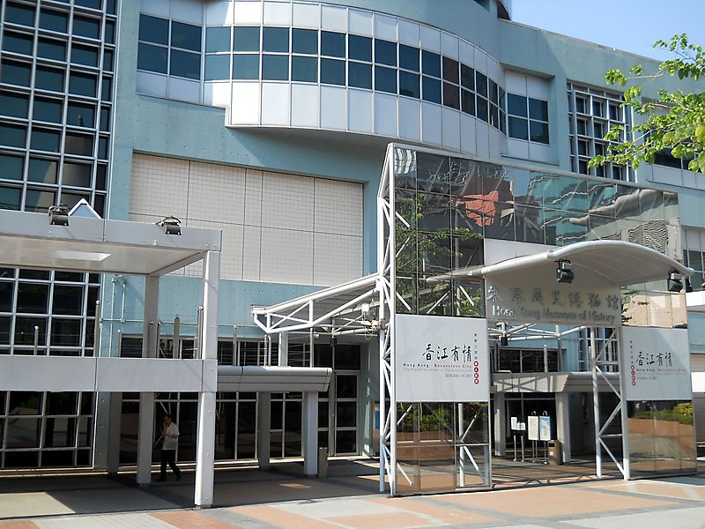
Hong Kong Museum of History
Hong Kong Museum of History https://hk.history.museum/en_US/web/mh/index.html
Online Exhibition https://hk.history.museum/en_US/web/mh/exhibition/virtual.html
In Hong Kong Museum of History, we can know more about Chinese history and the stories of people serving others during different periods of time in Hong Kong.

Slide 21
Aesthetic and physical development
Learning activities in physical and aesthetic development help students develop a healthy lifestyle and a foundation for lifelong learning by nurturing confidence, perseverance, and aesthetic appreciation. Students can cultivate their interest in art and nurture their aesthetic sensitivity by visiting art related museums or websites.

Slide 22
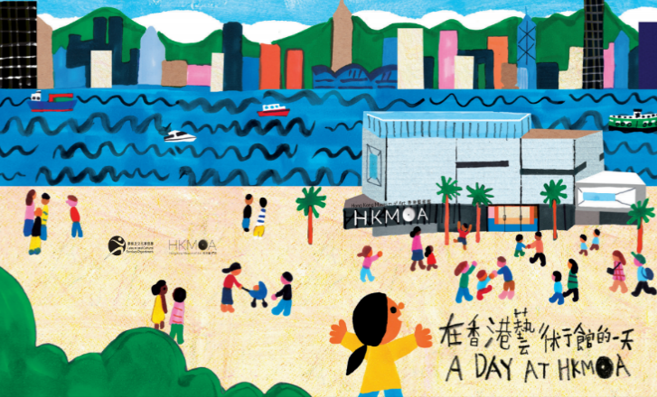
Hong Kong Museum of Art
Hong Kong Museum of Art https://hk.art.museum/en_US/web/ma/home.html
There are pamphlets, audio guides and multi-media programmes on the website of Hong Kong Museum of Art. I can enjoy the collections even I am at home.
virtually@HKMoA https://hk.art.museum/en_US/web/ma/exhibitions-and-events/virtually-at-hkmoa.html
Art Education Documentary
Picture book
Animation

Slide 23
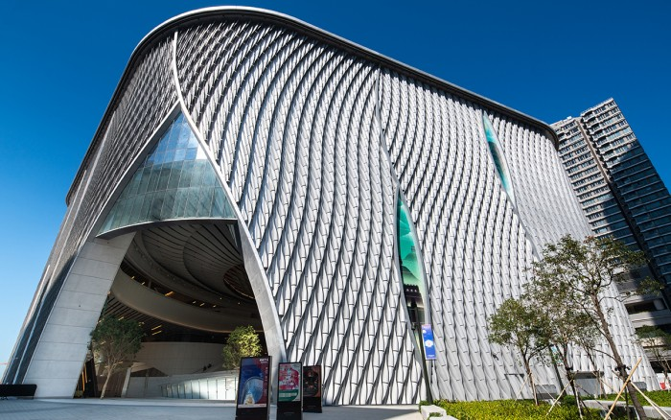
Xiqu Centre
Xiqu Centre https://www.westkowloon.hk/en/xiqu-centre/overview-2572
In Xiqu Centre, we can enjoy xiqu culture and Chinese traditional performing arts. It enhances our understanding of Chinese culture and traditional arts.

Slide 24
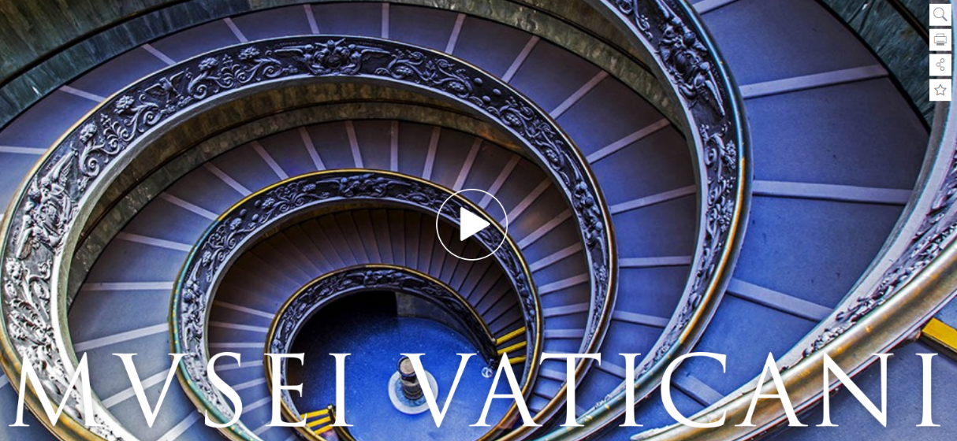
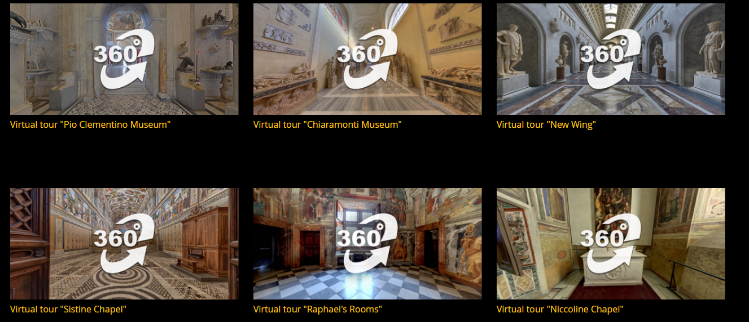
The Vatican Museum
The Vatican Museum http://www.museivaticani.va/content/museivaticani/en.html
Virtual Tours http://www.museivaticani.va/content/museivaticani/en/collezioni/musei/tour-virtuali-elenco.html
In the Vatican Museum, we can see the different art related collections. It can nurture our aesthetic sensitivity and broaden our horizons.

Slide 25
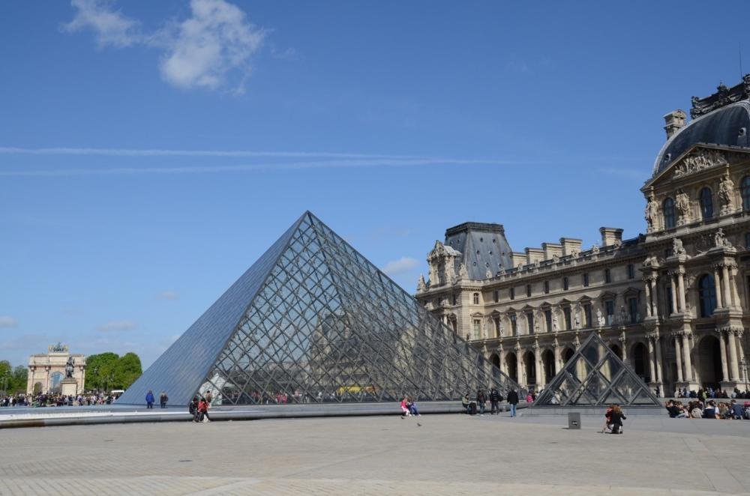
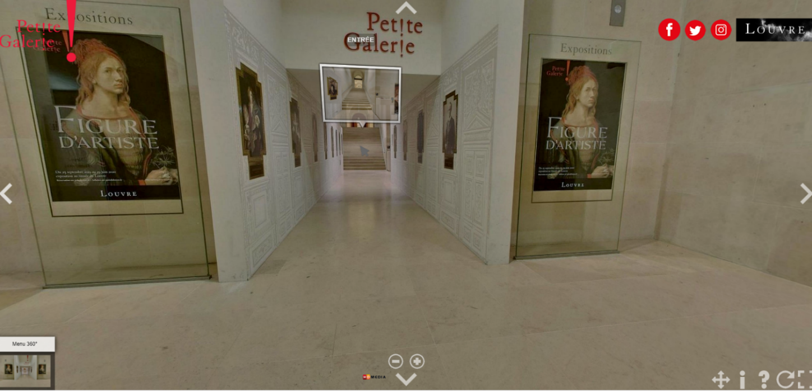
Louvre Museum
Louvre Museum https://www.louvre.fr/en/homepage
Virtual Tours https://www.louvre.fr/en/visites-en-ligne
In Louvre Museum, we can see famous sculptures, paintings, prints and drawings in the world that broaden our horizons and deepen our understanding of art.

Slide 26
Career-related experiences
Career-related activities enable students to obtain up-to-date knowledge about the world of work. Visiting museums or centres relating to difference fields, students’ work ethics such as integrity, commitment and responsibility can be nurtured. Therefore, students can have a good idea of what will be expected of them in their future working life.

Slide 27
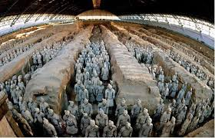
Emperor Qinshihuang’s Mausoleum Site Museum
Emperor Qinshihuang’s Mausoleum Site Museum http://www.bmy.com.cn/2015new/bmyweb/
In Emperor Qinshihuang’s Mausoleum Site Museum, we can learn about Chinese history and Chinese culture. It fosters my interest in being an archaeologist.

Slide 28
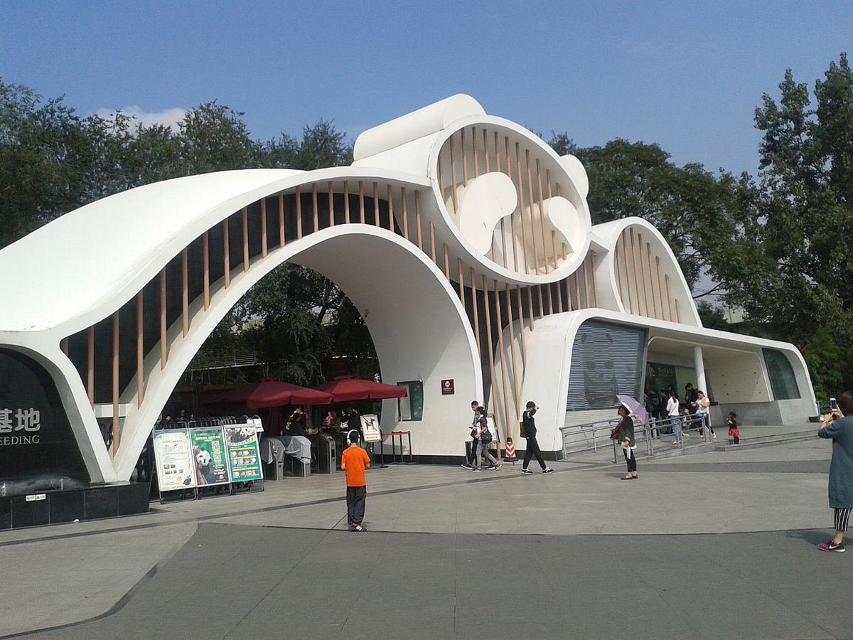
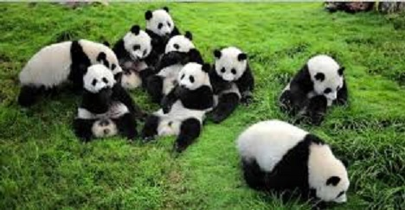
Chengdu Research Base of Giant Panda Breeding
Chengdu Research Base of Giant Panda Breeding http://www.panda.org.cn/english/
In Chengdu Research Base of Giant Panda Breeding, we can learn about the roles, ethics and qualities in the field of work about giant panda breeding and protection.
The Chengdu Research Base of Giant Panda Breeding has 5 departments. They are General Secretary Department, Animal Feeding Management Department, Animal Disease Prevention and Control Department, Animal Protection Research Center and Dujiangyan Wild Fed Breeding Research Center.

Slide 29
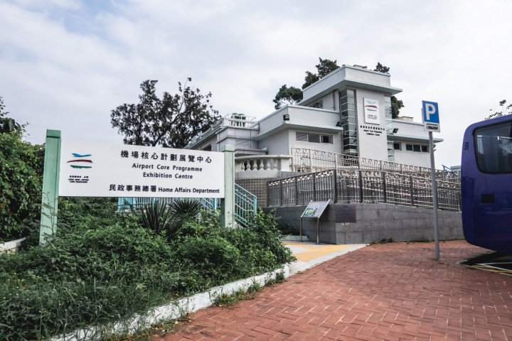
Airport Core Programme Exhibition Centre
Airport Core Programme Exhibition Centre https://web.archive.org/web/20090822205722/http://www.info.gov.hk/archive/napco/index-e.html
In Airport Core Programme Exhibition Centre, we can learn about the planning of transport infrastructure in Hong Kong. It enhances our understanding in transport sector and town planning.

Slide 30
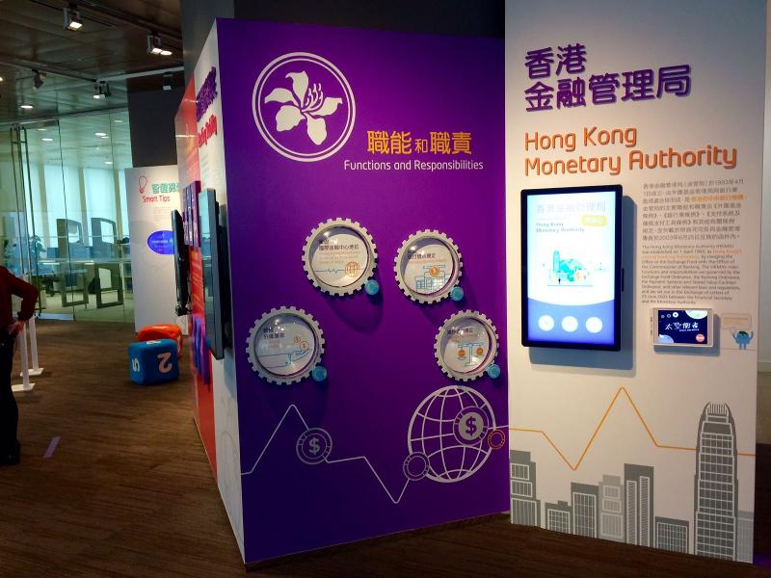
The HKMA Information Centre
The HKMA Information Centre https://www.hkma.gov.hk/eng/about-us/the-hkma-information-centre/
Online Resources https://www.hkma.gov.hk/eng/about-us/the-hkma-information-centre/exhibition-area/
In the HKMA Information Centre, we can recognise the development of money and banking in Hong Kong, and also know more about job duties of different departments of the Hong Kong Monetary Authority.

Slide 31
When we come across some interesting topics, we can acquire further knowledge in the area by reading related books.
Website：
https://www.hkreadingcity.net/en/content/edbookshelf
The Hong Kong Central Library and the six major libraries (namely City Hall, Kowloon, Tsuen Wan, Sha Tin, Tuen Mun and Ping Shan Tin Shui Wai Public Library) have been reopened with limited services since 6 May 2020. For details, please visit their website at https://www.hkpl.gov.hk/en/index.html

Slide 32
The services of public museums have been resumed gradually. We can also visit the museums in person and learn in real contexts.
For details, please visit the website of the Leisure and Cultural Services Department at https://www.lcsd.gov.hk/en/facilities/facilitieslist/museums/lcsdmuseums.html
HK Island & Kowloon
Hong Kong Film Archive
Hong Kong Museum of Art
Hong Kong Space Museum
HK Visual Art Centre
Flagstaff House Museum of Tea Ware
Hong Kong Museum of History
Fireboat Alexander Grantham Exhibition Gallery
Dr Sun Yat-sen Museum
Law Uk Folk Museum
Lei Cheng Uk Han Tomb Museum
Hong Kong Science Museum
Oil!
Hong Kong Museum of Coastal Defence
New Territories
Hong Kong Heritage Museum
Hong Kong Railway Museum
Sheung Yiu Folk Museum
Sam Tung UK Museum

Slide 33
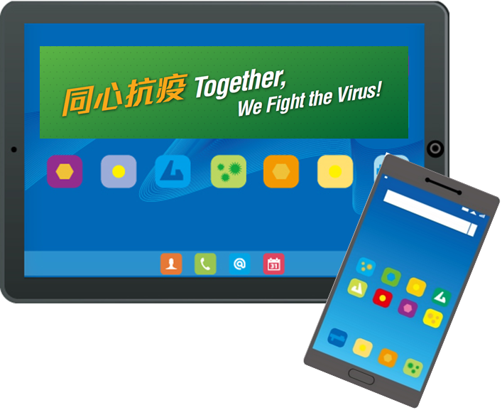
Points to note：
When using electronic products, students should avoid looking at a near screen for too long, which may cause ciliary muscle stain. Regarding ‘Computer use and eye care’, please visit the website of the Department of Health at https://www.studenthealth.gov.hk/english/health/health_ev/health_ev_coep.html
When using electronic products, students should avoid visiting inappropriate websites. Students should consult their teachers if they have any queries. Regarding filtering software, please visit the website of the Office for Film, Newspaper and Article Administration at https://www.ofnaa.gov.hk/eng/publicity/filtering.htm

Slide 34
Thank you

Slide 35
Life-wide Learning Section Contact us: lwl@edb.gov.hk

