Slide 1
Be proactive and optimistic in facing the COVID-19 epidemic
Responsibility
Proactive
Optimistic
Commitment
Perseverance
Cherish
(Secondary)
Gratitude
Respect for others
Care for others
Notes:
Based on school context and needs of students, schools may adjust the content of this PPT in fostering students’ positive values and attitudes effectively and promoting healthy lifestyle.

Slide 2
Background
What is COVID-19?
COVID-19 refers to the cluster of viral pneumonia cases occurring in Wuhan, Hubei Province, since December 2019.
It is a novel coronavirus. The main mode of transmission is through respiratory droplets, the virus can also be transmitted through contact.
Symptoms of the cases include fever, malaise, dry cough and shortness of breath. Most estimates of the incubation period range from 1 to 14 days.

Slide 3
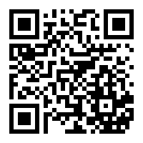
Prevention of COVID-19
There is no vaccine for this infectious disease at the moment.
To prevent pneumonia and respiratory tract infection, the public should maintain good personal hygiene at all times and keep both hands clean.
After returning to Hong Kong from travelling, if you have a fever or other symptoms, wear a surgical mask, consult a doctor promptly and reveal the recent travel history.
Pay attention to the latest news about COVID-19 released from the Centre for Health Protection.

Slide 4
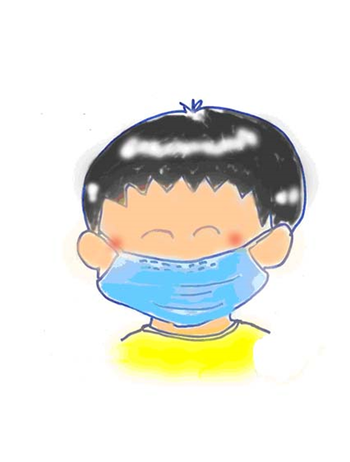
Personal Level
Family Level
School Level
Community Level
What can I do ?

Slide 5
Personal Level
X
(Self-discipline) Adopt healthy habits, including maintain personal hygiene, living routine and stay positive.
(Proactive) Exercise regularly, develop healthy living and eating habits, stay healthy.
(Rational) Learn more from different media and will not believe in hearsay blindly.
Self-discipline
Proactive
Perseverance
Optimistic

Slide 6
Personal Level。。。I Can Do It !
X
Avoid Crowds Wear a surgical mask when taking public transport or staying in crowded places. It is important to wear a mask properly.
Always keep hands clean especially before touching one's mouth, nose or eyes; after touching public installations such as handrails or door knobs, wash hands with liquid soap and water, and rub for at least 20 seconds.
Cover your mouth and nose with tissue paper when sneezing or coughing. Dispose of soiled tissues into a lidded rubbish bin, then wash hands thoroughly.
After using the toilet, put the toilet lid down before flushing to avoid spreading germs.

Slide 8
Personal Level
Family Level
School Level
Community Level
What can I do ?

Slide 9
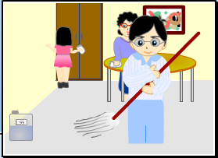
Family Level
(Care for Others) Remind family members to adopt healthy living habits.
(Commitment) Take the initiative to understand and care for the health of family members (grandparents, parents, brothers and sisters) and stay positive.
(Responsibility) Take an active part in keeping the household clean.
X
Care for Others
Proactive
Responsibility

Slide 10
Family Level。。。I Can Do It !
X
Take an active part in helping with the housework to keep home clean and tidy.
When having respiratory symptoms, wear a surgical mask, refrain from close contacts with family members and seek medical advice promptly.
Remind family members to maintain drainage pipes properly and regularly (about once a week) pour about half a liter of water into each drain outlet (U-traps) to ensure environmental hygiene.

Slide 11
Personal Level
Family Level
School Level
Community Level
What can I do ?

Slide 12
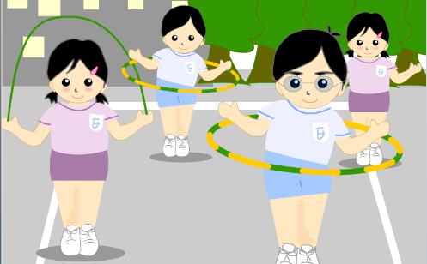
School Level。。。I Can Do It !
X
(Proactive) Learn actively in different modes of learning during the class suspension period.
(Self-discipline) Stay vigilant and keep the school environment clean.
(Care for Others) Take the initiative to express your gratitude to those who have helped us (teachers, janitors, school staff, school bus drivers, etc.).
Gratitude
Proactive
Cherish

Slide 13
Personal Level
Family Level
School Level
Community Level
What can I do ?

Slide 14
Community Level。。。I Can Do It !
X
(Responsibility) Reflect on own behaviour, be responsible for keeping the community clean.
(Care for Others) Take the initiative to show your care and support for the disadvantaged/ needy in the society.
(Rational) Be rational, do not believe/ forward messages with unverified information.

Slide 16
My Pledge to Act

Slide 17
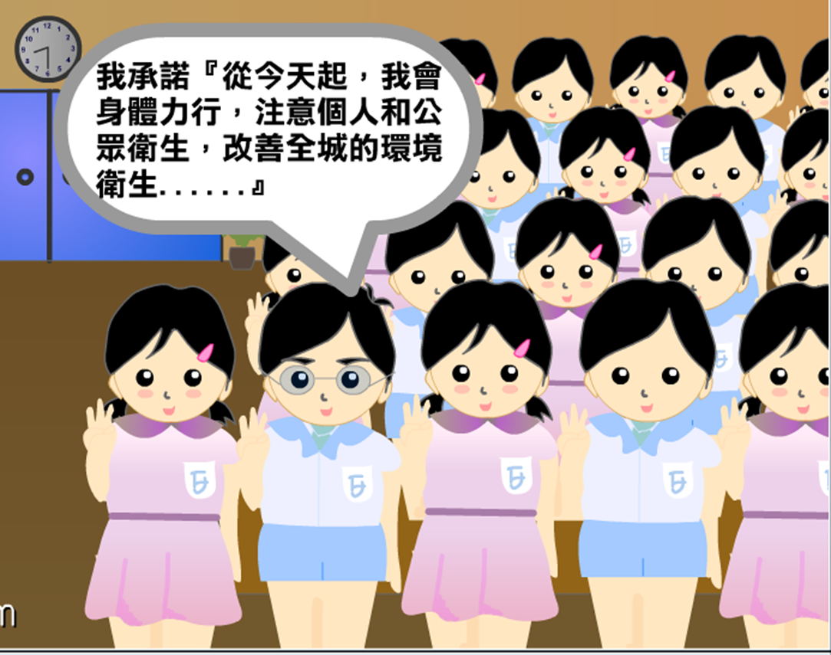
“ I pledge, from now on, to maintain personal, environmental and food hygiene, adopt prevention measures properly in order to fight the virus.”
Pledge Statement
Notes:
Suggested Pledge Statement

Slide 18
Think about it
?
During the outbreak of COVID-19, how would you protect yourself if you have to take public transport?
Notes:
To enhance students' awareness of public health and epidemic prevention.

Slide 19
COVID-19 Social media life event
Learning points: Through discussion of this life event, students can learn to identify the authenticity of online information and be more positive by supporting and encouraging one another in their social and family lives.
?
Think about it!
One day, your relative/friend sent you the following message through social media:
Go get your money from ATMs now. Heard that due to the epidemic, all banks in Hong Kong will be closed very soon.

Slide 20
Reflection
Will you withdraw cash right away? Why?
How would you handle or respond to this message? Why?
Points to note：
How to verify information?
Cherish the care from your friend / relative
Avoid panicking
“The wise does not buy rumours”
Notes:
Encourage students to discuss, share and reflect on their decision and provide a rationale for it.
Reflective questions may be asked to further promote student reflection in order to instil positive values and attitudes in them. For example: “what are the consequences if all Hong Kong people withdraw cash from ATMs together? “
Remind students to verify information received and cherish the care from their friends/relatives. Students should also be encouraged to ask their friends/ relatives to check the source of information. Students will be able learn how to respond to their friends/relatives politely and express their care for one another in facing the COVID-19 epidemic.

Slide 21
Conclusion:
Together, We fight the Virus
Panic
May feel anxious, but no need to panic
Take precautionary measures
Verify information
rationally and calmly
Make reasonable judgement
Caring for those in need
Notes:
Students get to understand that they may receive a large amount of information about the epidemic from unknown sources and feel anxious, but there is no need to panic.
Students should stay calm and be rational to verify online information and to make reasonable judgement.
Students are advised not only to take care of the needs of themselves and their families, but also put themselves in others’ shoes and care for those in need in the community, especially the elderly and disadvantaged groups. If possible, they may give them a hand to fight the virus together.

Slide 22
The End

