Slide 1
Clean your home Live a healthy life
(Primary Mathematics)

Slide 2
The Learning Units and Learning Objectives Involved
Learning Unit | Learning Objective
1M4 Time (I) | tell time to the hour and half hour recognise calendars
2M2 Time (II) | tell time to the nearest minute tell time using “morning”, “afternoon”, “noon” and “midnight” solve simple problems related to time intervals
3M4 Time (IV) | tell time in term of the 24-hour time
3M3 Capacity | recognise litre (L) and millilitre (mL)
5M1 Area (II) | find the areas of polygons
Supplement to Mathematics Education Key Learning Area Curriculum Guide: Learning Content of Primary Mathematics (2017)

Slide 3
Mandy wants to keep her family healthy. She assists to clean the home and pay more attention to personal hygiene. Let's see what she has done in one day.

Slide 4
Time | Activity
Morning Session
7:00 a.m. | Wake up and freshen up
7:15 a.m. | Do morning exercise
7:30 a.m. | Wash hands for 20s and have breakfast
8:15 a.m. | Clean and disinfect the toys and furniture
9:00 a.m. | Reading / real-time lesson
10:30 a.m. | Recess
10:45 a.m. | Real-time lesson
12:00 noon | Wash hands for 20s and have lunch
This is Mandy’s morning timetable.

Slide 5
Time | Activity
Morning Session
7:00 a.m. | Wake up and freshen up
7:15 a.m. | Do morning exercise
7:30 a.m. | Wash hands for 20s and have breakfast
8:15 a.m. | Clean and disinfect the toys and furniture
9:00 a.m. | Reading / real-time lesson
10:30 a.m. | Recess
10:45 a.m. | Real-time lesson
12:00 noon | Wash hands for 20s and have lunch
When does Mandy start to clean and disinfect the toys and furniture？
Answer：
8:15 a.m.

Slide 6
Time | Activity
Morning Session
7:00 a.m. | Wake up and freshen up
7:15 a.m. | Do morning exercise
7:30 a.m. | Wash hands for 20s and have breakfast
8:15 a.m. | Clean and disinfect the toys and furniture
9:00 a.m. | Reading / real-time lesson
10:30 a.m. | Recess
10:45 a.m. | Real-time lesson
12:00 noon | Wash hands for 20s and have lunch
How long does she clean and disinfect the toys and furniture？
Answer：
45 minutes

Slide 7
Time | Activity
Afternoon Session
1:00 p.m. | Real-time lesson
2:15 p.m. | Recess
2:30 p.m. | Real-time lesson
3: 30 p.m. | Wash hands for 20s and have tea time
4:00 p.m. | Do homework and revision
5:30 p.m. | Do housework, e.g. clean the floor and toilet
6:30 p.m. | Bathing
7:00 p.m. | Wash hands for 20s and have dinner
8:30 p.m. | parent-child activities
9:30 p.m. | Go to sleep
This is Mandy’s afternoon timetable. Part of it is covered by dirt.

Slide 8
Time | Activity
Afternoon Session
1:00 p.m. | Real-time lesson
2:15 p.m. | Recess
2:30 p.m. | Real-time lesson
3: 30 p.m. | Wash hands for 20s and have tea time
4:00 p.m. | Do homework and revision
5:30 p.m. | Do housework, e.g. clean the floor and toilet
6:30 p.m. | Bathing
7:00 p.m. | Wash hands for 20s and have dinner
8:30 p.m. | parent-child activities
9:30 p.m. | Go to sleep
When does Mandy start to do housework? (show your answer in 24-hour time)
Answer:
17:30

Slide 9
Time | Activity
Afternoon Session
1:00 p.m. | Real-time lesson
2:15 p.m. | Recess
2:30 p.m. | Real-time lesson
3: 30 p.m. | Wash hands for 20s and have tea time
4:00 p.m. | Do homework and revision
5:30 p.m. | Do housework, e.g. clean the floor and toilet
6:30 p.m. | Bathing
7:00 p.m. | Wash hands for 20s and have dinner
8:30 p.m. | parent-child activities
9:30 p.m. | Go to sleep
Mandy spends 1 hour to do the housework. When does she finish the housework?
Answer：
6:30 p.m.

Slide 10
Time | Activity
Morning Session
7:00 a.m. | Wake up and freshen up
7:15 a.m. | Do morning exercise
7:30 a.m. | Wash hands for 20s and have breakfast
8:15 a.m. | Clean and disinfect the toys and furniture
9:00 a.m. | Reading / real-time lesson
10:30 a.m. | Recess
10:45 a.m. | Real-time lesson
12:00 noon | Wash hands for 20s and have lunch
Afternoon Session
1:00 p.m. | Real-time lesson
2:15 p.m. | Recess
2:30 p.m. | Real-time lesson
3: 30 p.m. | Wash hands for 20s and have tea time
4:00 p.m. | Do homework and revision
5:30 p.m. | Do housework, e.g. clean the floor and toilet
6:30 p.m. | Bathing
7:00 p.m. | Wash hands for 20s and have dinner
8:30 p.m. | parent-child activities
9:30 p.m. | Go to sleep
What time does Mandy wash her hands for 20s? What does she do after washing her hands?
Answer：
7:30 a.m. (or 07:30)
12:00 noon (or 12:00)
3:30 a.m. (or 15:30)
7:00 p.m. (or 19:00)
She eats her meals.

Slide 11
In the afternoon, Mandy cleans the floor at home. The floor plan of sitting room is shown below.
Mandy takes two minutes to clean one square metre of floor. How long does she take to clean the sitting room?
1m
1m

Slide 12
In the afternoon, Mandy cleans the floor at home. The floor plan of sitting room is shown below.
Mandy takes two minutes to clean one square metre of floor. How long does she take to clean the sitting room?
1m
Answer：
28 minutes
1m

Slide 13
The floor plan of Mandy’s bedroom is shown below.
Mandy takes two minutes to clean one square metre of floor. How long does she take to clean her bedroom?
1m
3m
1m
4m

Slide 14
The floor plan of Mandy’s bedroom is shown below.
Mandy takes two minutes to clean one square metre of floor. How long does she take to clean her bedroom?
1m
3m
1m
4m
Answer：
18 minutes

Slide 15
The floor plan of Mandy’s bedroom is shown below.
Mandy and her little brother clean the floor of bedroom together. Each of them takes two minutes to clean one square metre of floor. At least how long do they take to clean the floor of bedroom?
1m
3m
1m
4m

Slide 16
The floor plan of Mandy’s bedroom is shown below.
Mandy and her little brother clean the floor of bedroom together. Each of them takes two minutes to clean one square metre of floor. At least how long do they take to clean the floor of bedroom?
1m
3m
1m
4m
Answer：
9 minutes

Slide 17
Mandy’s home has a rectangular kitchen. Its floor plan is shown below. The length and width of the rectangular cooking table are 2m and 1m respectively. After deducting the area occupied by the cooking table, the rest is the kitchen floor.
Cooking table
2m
3m
Mandy takes two minutes to clean one square metre of floor. How long does she take to clean the kitchen floor?

Slide 18
Mandy’s home has a rectangular kitchen. Its floor plan is shown below. The length and width of the rectangular cooking table are 2m and 1m respectively. After deducting the area occupied by the cooking table, the rest is the kitchen floor.
Cooking table
2m
3m
Mandy takes two minutes to clean one square metre of floor. How long does she take to clean the kitchen floor?
Answer：
8 minutes

Slide 19
Time | Activity
Morning Session
7:00 a.m. | Wake up and freshen up
7:15 a.m. | Do morning exercise
 | Wash hands for 20s and have breakfast
 | Real-time lesson
 | Wash hands for 20s and have lunch
Afternoon Session
1:00 p.m. | Real-time classroom
 | Do homework and revision
 | Do housework, e.g. clean the floor and toilet
 | Go to sleep
You may design a timetable to keep a regular life. Remember to add the timeslots on cleaning your home to make your family healthy.

Slide 20
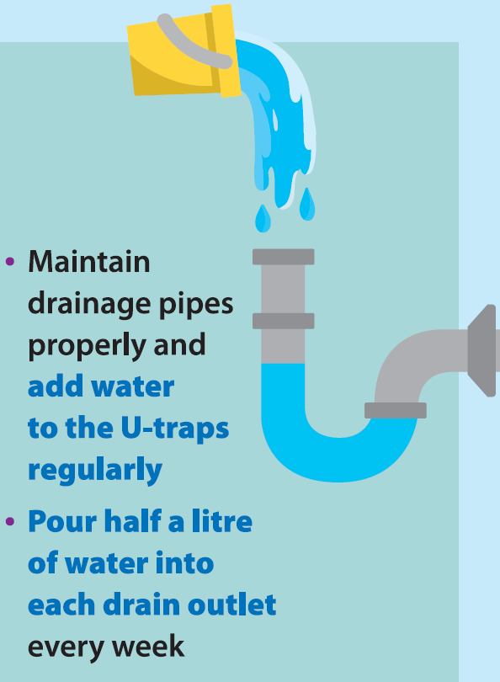
Mandy pours water into the U-traps regularly to follow the advice conveyed in the poster.
April 2020
Mon | Tue | Wed | Thu | Fri | Sat | Sun
 |  | 1 | 2 | 3 | 4 | 5
6 | 7 | 8 | 9 | 10 | 11 | 12
13 | 14 | 15 | 16 | 17 | 18 | 19
20 | 21 | 22 | 23 | 24 | 25 | 26
27 | 28 | 29 | 30
Today is 2nd April 2020. Mandy pours water into the U-traps today.
What is the date and day of the week of next pouring? How many times will Mandy pour water into the U-traps in April?
Answer：9th April, Thursday; 5 times

Slide 21
Mandy pours water into the U-traps regularly to follow the advice conveyed in the poster.
April 2020
Mon | Tue | Wed | Thu | Fri | Sat | Sun
 |  | 1 | 2 | 3 | 4 | 5
6 | 7 | 8 | 9 | 10 | 11 | 12
13 | 14 | 15 | 16 | 17 | 18 | 19
20 | 21 | 22 | 23 | 24 | 25 | 26
27 | 28 | 29 | 30
Today is 2nd April 2020. Mandy pours water into the U-traps today.
What is the date of last pouring?
Mandy cannot pour water on 30th April. If she pours water on the next day, what is the date and day of the week of that day?
Answer：26th March; 1st May, Friday

Slide 22
Mandy’s little brother sees Mandy pours water into the U-traps.
How much is half a litre of water? How to measure it?

Slide 23
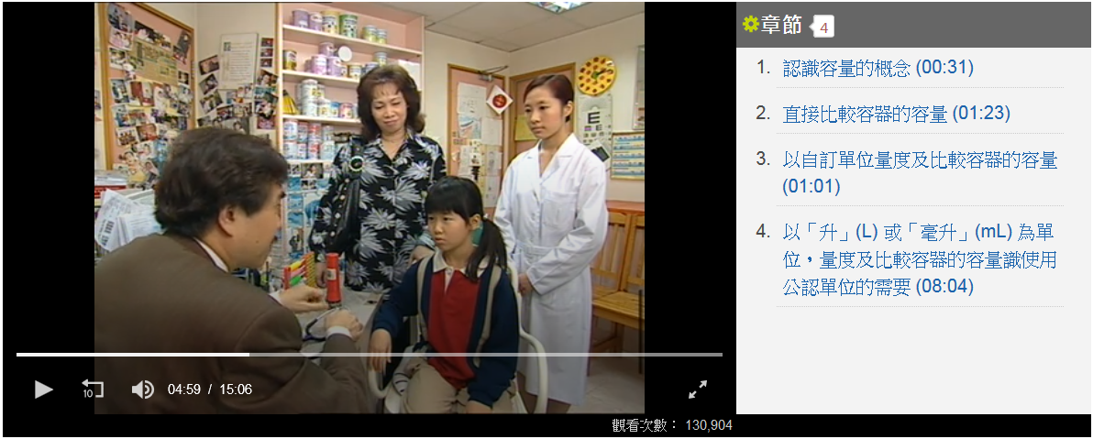
How much is half a litre of water? How to measure it?
You may click the link of ETV below. The unit of litre will be introduced. After watching the programme, tell your parents how to measure half a litre of water.
ETV, EDB > Subject > Mathematics Education > Capacity
https://www.hkedcity.net/etv/en/resource/2129964690
(Chinese version only)
Starting from 4’59”, the doctor will mention relation between water and health. Please pay attention.

Slide 24
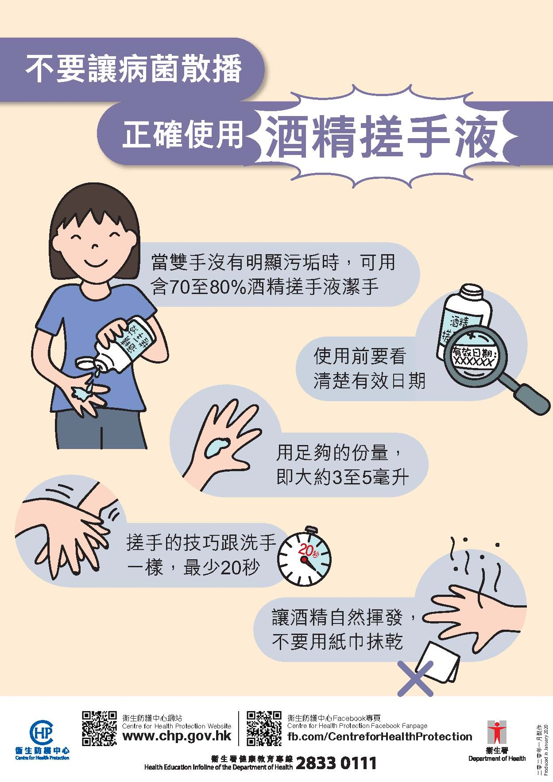
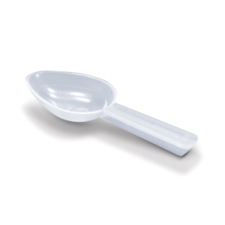
After watching the ETV, I have learnt the unit of millilitre as well.
I see the use of alcohol-based handrub was mentioned the poster.
How much is 5 mL? Do you remember which container has a capacity of 5 mL in the ETV?
Use sufficient amount of handrub, i.e. 3mL to 5mL
(Chinese version only)
Answer：Teaspoon used in the ETV

Slide 25
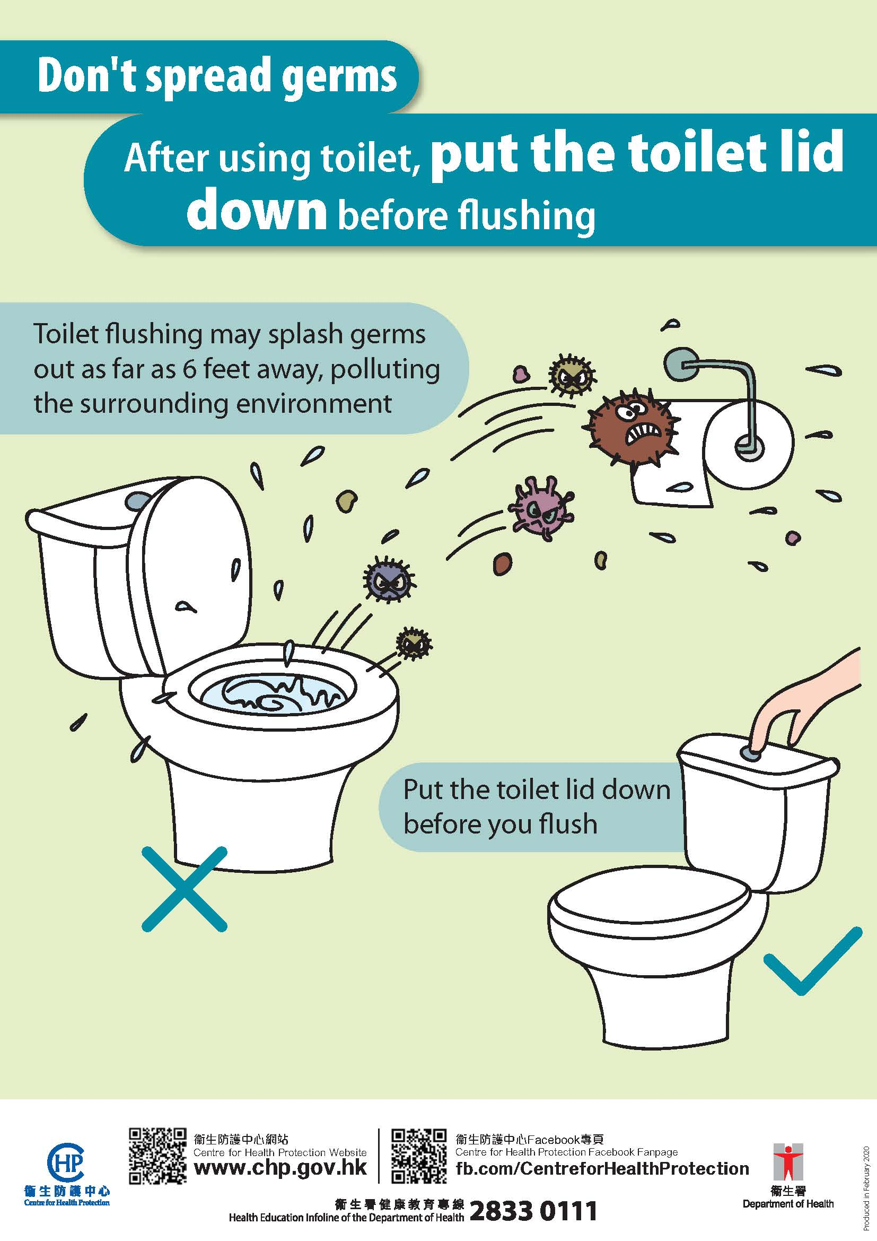
Learn More
Mandy’s little brother sees the poster below.
How far is 6 feet？遠
Click the link of “Unit Converter” below.
http://tw.bestconverter.org/unitconverter_length.php
See how many centimetres are 6 feet?

Slide 26
In our daily life, when cleaning our home and keeping personal hygiene, what else are related to mathematics? Try to find them out.

