Slide 1
Recognising the COVID-19 Pandemic from Data
(Primary Mathematics)
Curriculum Development Institute, Education Bureau

Slide 2
The Learning Units and Learning Objectives of Primary Mathematics Involved
Learning Unit | Learning Objective
4D1 Bar charts(II) | interpret bar charts of greater frequency counts
5D1 Bar charts(III) | interpret compound bar charts
6D1 Averages | solve problems
6D2 Broken line graphs | construct broken line graphs
6D4 Uses and abuses of statistics | present the data with appropriate statistical charts discuss and recognise the uses and abuses of statistical charts in daily life
Supplement to Mathematics Education Key Learning Area Curriculum Guide: Learning Content of Primary Mathematics (2017)

Slide 3
The COVID-19 pandemic is ongoing in many countries. More than a thousand confirmed cases has been recorded in Hong Kong. Do you know the detail situation?

Slide 4
To know more about the situation in Hong Kong, we should make reference to the detail and reliable information provided by the websites of related government departments and the government website www.coronavirus.gov.hk .

Slide 5
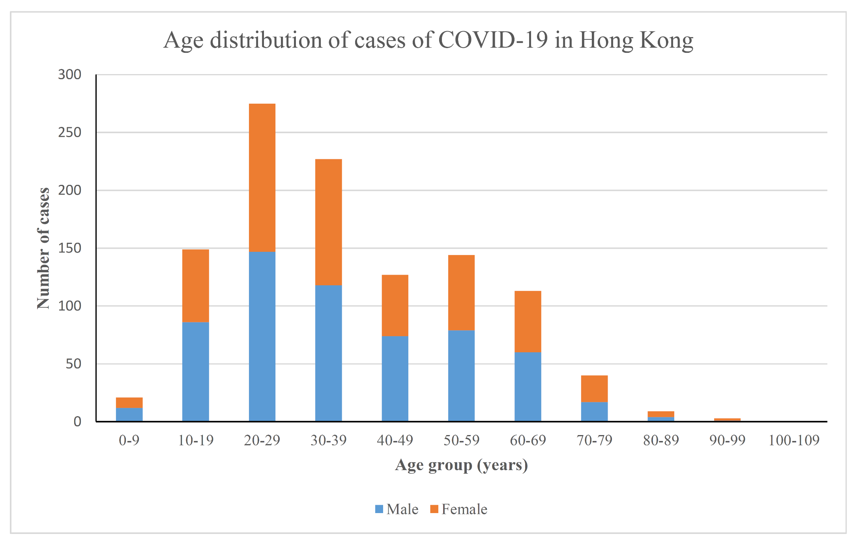
(as at 8 June 2020)
Source: COVID-19 Thematic Website - Together, We Fight the Virus: Latest local situation of COVID-19 (as at 8 June 2020) https://www.chp.gov.hk/files/pdf/local_situation_covid19_tc.pdf
The above bar chart shows the age distribution of cases of COVID-19 in Hong Kong (as at 8 June 2020).

Slide 6
(as at 8 June 2020)
Answer:
About 150
About how many cases are there in the age group of 50-59?

Slide 7
(as at 8 June 2020)
Answer:
Age group 20-29
Which age group has more than 250 cases?

Slide 8
(as at 8 June 2020)
Regarding the cases in the age group of 40-49, are the male cases more than the female cases?
Answer:
Yes

Slide 9
(as at 8 June 2020)
Answer:
Age groups 20-29 and 30-39
Which age groups have more than 100 male cases?

Slide 10
(as at 8 June 2020)
Estimate how many times (in integer) of the number of cases of the age group 60-69 is that of the age group 30-39?
Answer:
About 2 times

Slide 11
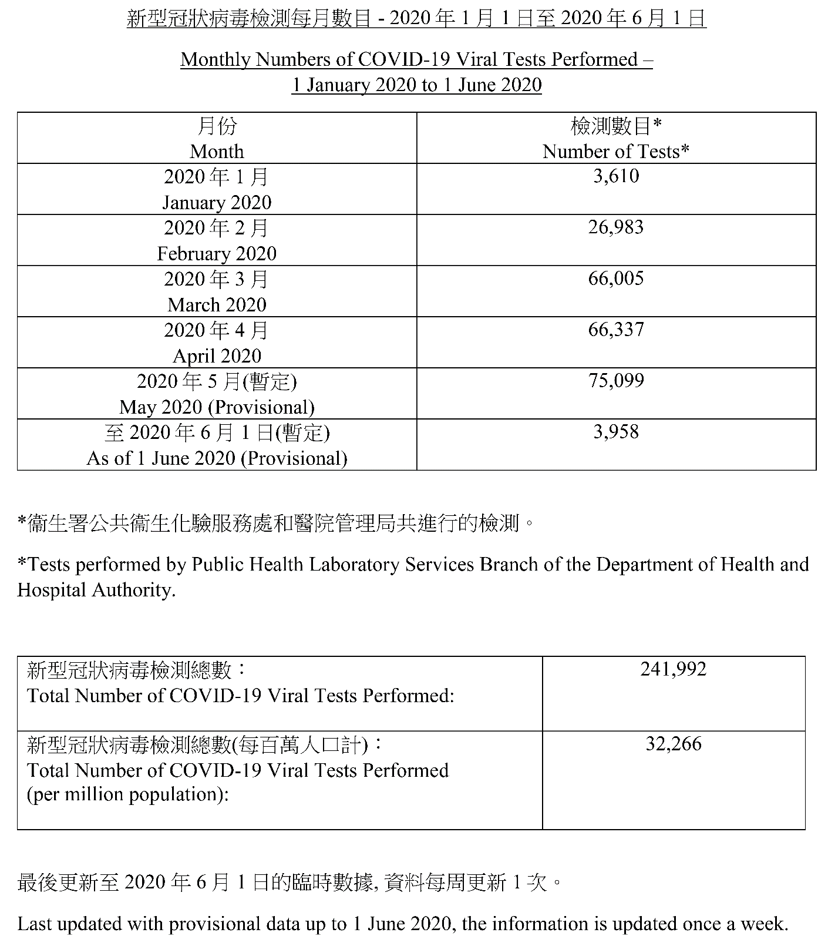
This information shows the monthly numbers of COVID-19 viral tests performed (as at 1 June 2020).
Source of Reference: COVID-19 Thematic Website- Together, We Fight the Virus: Statistics on Testing for COVID-19 in Hong Kong (as at 1 June 2020) https://www.chp.gov.hk/files/pdf/statistics_on_covid_19_testing.pdf

Slide 12
In January 2020, 3610 tests were conducted.

Slide 13
How many tests were conducted in March 2020?
Answer:66005

Slide 14
The testing was obviously stepped up from March!
Answer:66005

Slide 15
We can use IT to construct a statistical graph to represent the numbers of tests performed from January to May 2020.

Slide 16
However, the numbers are large and complicated, what should we do?

Slide 17
We can round off the numbers to the nearest thousand to construct statistical graphs.

Slide 18
Month | Number of Tests | Number of Tests (rounded to the nearest thousand)
January 2020 | 3610
February 2020 | 26983
March 2020 | 66005
April 2020 | 66337
May 2020 | 75099
First, round off the data to the nearest thousand

Slide 19
Month | Number of Tests | Number of Tests (rounded to the nearest thousand)
January 2020 | 3610 | 4000
February 2020 | 26983 | 27000
March 2020 | 66005 | 66000
April 2020 | 66337 | 66000
May 2020 | 75099 | 75000
First, round off the data to the nearest thousand

Slide 20
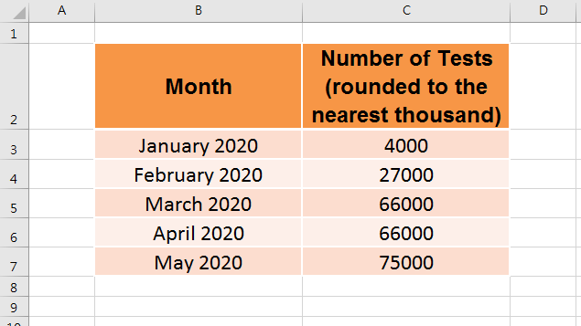
Input the data into a spreadsheet

Slide 21
Select the data, press “Insert” and select appropriate statistical graphs (e.g. broken line graph) to represent the data.

Slide 22
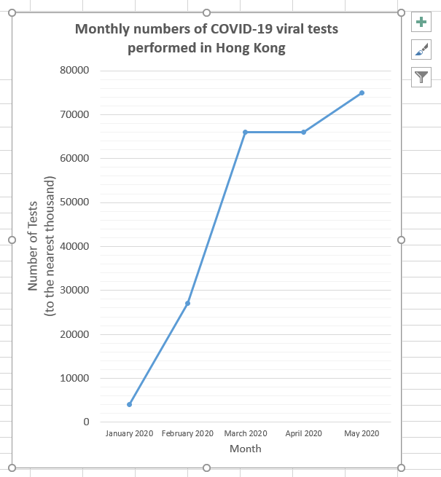
We can make the graph more clear by choosing appropriate settings in “+”.

Slide 23
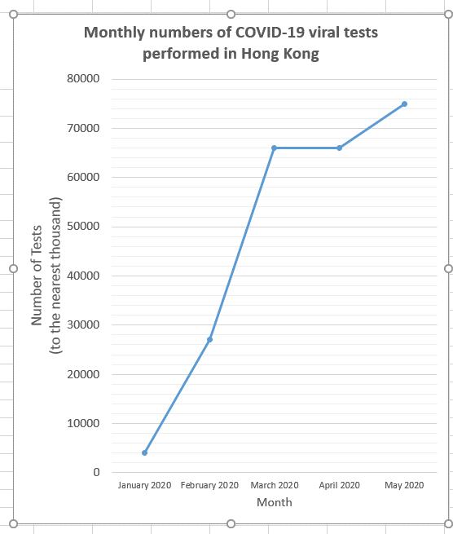
Apart from broken line graphs, which statistical graph(s) is/are also suitable for presenting these data?

Slide 24
Month | Number of Tests | Number of Tests (rounded to the nearest thousand)
January 2020 | 3610 | 4000
February 2020 | 26983 | 27000
March 2020 | 66005 | 66000
April 2020 | 66337 | 66000
May 2020 | 75099 | 75000
Can you estimate the average monthly number of tests from March to May?

Slide 25
Month | Number of Tests | Number of Tests (rounded to the nearest thousand)
January 2020 | 3610 | 4000
February 2020 | 26983 | 27000
March 2020 | 66005 | 66000
April 2020 | 66337 | 66000
May 2020 | 75099 | 75000
Can you estimate the average monthly number of tests from March to May?
I try to estimate in the following way:
Total number:
66000+ 66000 + 75000
=207000
Average number of test per month:
207000 ÷ 3
=69000

Slide 26
Month | Number of Tests | Number of Tests (rounded to the nearest thousand)
January 2020 | 3610 | 4000
February 2020 | 26983 | 27000
March 2020 | 66005 | 66000
April 2020 | 66337 | 66000
May 2020 | 75099 | 75000
You can also make some other reasonable estimation.
I try to estimate in the following way:
Total number:
66000+ 66000 + 75000
=207000
Average number of test per month:
207000 ÷ 3
=69000

Slide 27
Month | Number of Tests | Number of Tests (rounded to the nearest thousand)
January 2020 | 3610 | 4000
February 2020 | 26983 | 27000
March 2020 | 66005 | 66000
April 2020 | 66337 | 66000
May 2020 | 75099 | 75000
You may discuss with your classmates how can we estimate the average daily number of tests in these 3 months？
I try to estimate in the following way:
Total number:
66000+ 66000 + 75000
=207000
Average number of test per month:
207000 ÷ 3
=69000

Slide 28
From March to May 2020, professionals of Department of Health and Hospital Authority conducted on average about 69000 tests per month. We have to express our gratitude to them for their hard work.

Slide 29
Reference
COVID-19 Thematic Website- Together, We Fight the Virus https://www.coronavirus.gov.hk/eng/index.html
Latest local situation of COVID-19 https://www.chp.gov.hk/files/pdf/local_situation_covid19_en.pdf
Statistics on Testing for COVID-19 in Hong Kong https://www.chp.gov.hk/files/pdf/statistics_on_covid_19_testing.pdf

