Slide 1
Learning and Teaching Materials on the “SOW Inspiring” Book Gifting Competition (Primary Level)
© English Language Education Section
Curriculum Development Institute
Education Bureau
HKSAR, 2024
All rights reserved

Slide 2
Contents
SOW Campaign 2024/25 & “SOW Inspiring” Book Gifting Competition
What is a book gift message?
How to write a message for a book gift
Using adjectives and literary devices
Deadlines and reminders

Slide 3
SOW Campaign 2024/25 & “SOW Inspiring” Book Gifting Competition

Slide 4
SOW Campaign 2024/25- Theme & sub-themes
Theme: SOW the Reading Seed:
Inspire and Be Inspired
Sub-themes:
Resilience - enhance resilience through reading
stories of people overcoming hurdles
Empowerment - gain strength, skills and knowledge
through reading
Appreciation - appreciate the beauty of the world or
the small things in life through reading
Delight - enjoy the pleasure and joy of reading

Slide 5
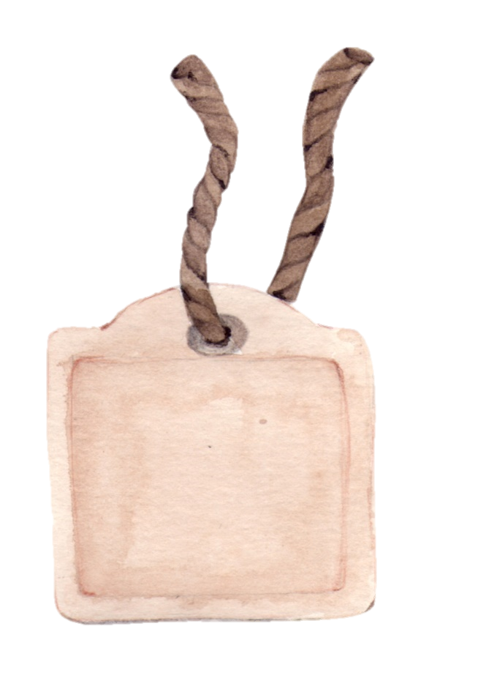
“SOW Inspiring” Book Gifting Competition
The “SOW Inspiring” Book Gifting Competition is organised under the campaign on “Promoting Positive Values and Attitudes through English Sayings of Wisdom 2024/25” (SOW Campaign 2024/25).
Dear Tom …

Slide 6
Entry requirements
To enter the competition, you have to:
choose a book as a gift that echoes the theme and/or sub-themes of the SOW Campaign 2024/25
write a message to the recipient (the person who gets your book) about:
why you want to give the book to him/her
how the book has inspired you
how the book will inspire him/her
quote a Saying of Wisdom (SOW) from the book that echoes the theme and/or sub-themes of the SOW Campaign 2024/25
design a piece of 2D artwork for your message
Word limit
Lower Primary Parent-child Division (P1-P3): 80-150 words
Upper Primary Division (P4-P6): 130-200 words
Dear Tom …

Slide 7
What is a book gift message?

Slide 8
What is a book gift message?
A book gift message can be in the form of a letter / an email / a card / a note. You write it when you give a book to someone dear to you. It shares your thoughts and feelings with them.
A good message can inspire others and make the book gift more meaningful. It also encourages others to read the book.
Dear Tom …

Slide 9
Structure of a book gift message
A message usually has an opening, a body and an ending. We write a greeting before the opening and a closing at the end of the message. This example shows how a book gift message looks like.
Greeting
Opening
write about the reason(s) for sharing the book
Gist of the book – write a short summary of the book to help the reader understand your message
Body
Main message – write about your thoughts and feelings about the book
Quote/Saying – include a Saying of Wisdom taken from the book that echoes the theme and/or sub-themes
Ending
wrap up your message
Closing

Slide 10
How to write a message for a book gift

Slide 11
Let’s write a book gift message together!
You are Emma, an eight-year-old girl from SOW Primary School.
When your dad and mum are at work, you would stay at the home of your mum’s sister, Auntie May. She takes good care of you.
You would like to enter the “SOW Inspiring” Book Gifting Competition. Your teacher has asked you to give a book to someone dear to you and write a message for the book gift.
Dad & Mum
Auntie May
Me

Slide 12
Step 1: decide on the recipient
The person who receives your book is called a recipient. You can give a book to one person or a group of people. Who do you want to give a book to?
Family
Father / Mother
Grandpa / Grandma
A brother / sister
An uncle / aunt
A cousin…
Friends
A neighbour
A study buddy
A playmate…
People at school
A classmate
The principal
A teacher
A teaching assistant
The librarian
A janitor…
Groups of people
Hong Kong citizens
Chinese people around the world
Members of a club (e.g. Book Club members)
A fan group (e.g. Harry Potter fans)
Auntie May takes good care of me. I’d like to give
a book to her!

Slide 13
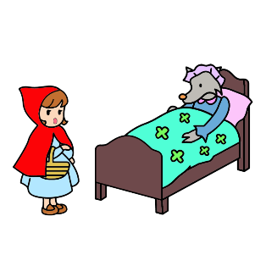
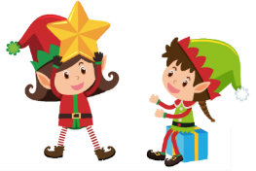
Step 2: choose a book that echoes the theme and/or sub-themes of the SOW Campaign 2024/25
These are my favourite books. All of them are inspiring stories. Which one should I give to Auntie May to show my gratitude?
The Elves and the Shoemaker
by the Brothers Grimm
The Emperor’s New Clothes
by Hans Christian Andersen
Little Red Riding Hood
by Charles Perrault
I’ve chosen this book because the elves in the story took care of the shoemaker. They remind me of how Auntie May takes care of me every day.
Link to the stories: https://www.edb.gov.hk/en/curriculum-development/kla/eng-edu/references-resources/Lit_Classics_Pri_FT.html
You can choose any types of books, e.g. picture books, fairy tales, poetry books, mystery books, non-fiction books.

Slide 14
Step 3: write a greeting & an opening
Greeting
Begin your message with a greeting, e.g. Hello Auntie May, Hi Auntie May.
To show your respect or closeness to the recipient, you can use these greetings: Dear Auntie May, To my dearest Auntie May.
Opening
Tell the recipient why you want to give this book to him/her. Think about these questions:
How does the story/character(s) remind you of the recipient?
Why do you think the recipient will like the book?
Why do you think the book will inspire the recipient?
Greeting
Opening
reason(s) for book gifting
Gist of the book
Body
Main message
Quote/Saying
Ending
wrap up your message
Closing

Slide 15
Step 3: write a greeting & an opening
Greeting
Begin your message with a greeting, e.g. Hello Auntie May, Hi Auntie May.
To show your respect or closeness to the recipient, you can use these greetings: Dear Auntie May, To my dearest Auntie May.
Opening
Tell the recipient why you want to give this book to him/her. Think about these questions:
How does the story/character(s) remind you of the recipient?
Why do you think the recipient will like the book?
Why do you think the book will inspire the recipient?
Your turn - write a greeting and an opening for your message.
I ‘ve chosen this book because the elves in the story took care of the shoemaker. They remind me of how Auntie May takes care of me every day.
You can use connectives to link ideas together, e.g. and, or, but, because.

Slide 16
Step 3: write a greeting & an opening
Greeting
Begin your message with a greeting, e.g. Hello Auntie May, Hi Auntie May.
To show your respect or closeness to the recipient, you can use these greetings: Dear Auntie May, To my dearest Auntie May.
Opening
Tell the recipient why you want to give this book to him/her. Think about these questions:
How does the story/character(s) remind you of the recipient?
Why do you think the recipient will like the book?
Why do you think the book will inspire the recipient?
Example:
Dear Auntie May,
I wish to give this book to you because the elves in the story made me think of you.
Greeting
Opening
A connective is used in the opening to give reasons. Can you find it?

Slide 17
Step 4: write the body of the message
The body of your message can include the gist of the book and the main message you want to express. Think about these questions:
Greeting
Opening
reason(s) for book gifting
Gist of the book
What is the book about?
What part of the book do you think the recipient will enjoy the most? Why?
Remember not to disclose the ending of the book, which may spoil the fun of reading!
Gist of the book
Main message
Body
Quote/Saying
Main message
What is the connection between the book and the recipient?
What message do you want the recipient to take away from the book?
How do you hope the book will encourage or motivate the recipient in his/her daily life?
Ending
wrap up your message
Closing

Slide 18
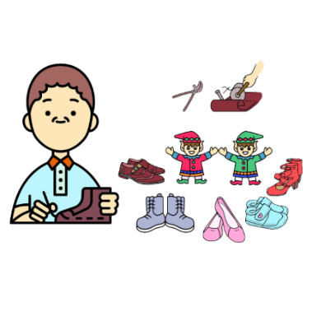
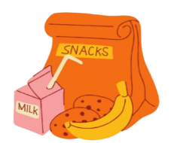
Step 4: write the body of the message
Gist of the book
What is the book about?
What part of the book do you think the recipient will enjoy the most? Why?
Main message
What is the connection between the book and the recipient?
What message do you want the recipient to take away from the book?
How do you hope the book will encourage or motivate the recipient in his/her daily life?
Your turn - write the body of your message.
The story:
What Auntie May does for me every day:
You can break the body of your message into paragraphs to make it easier to read. Similar ideas are usually put in the same paragraph.

Slide 19
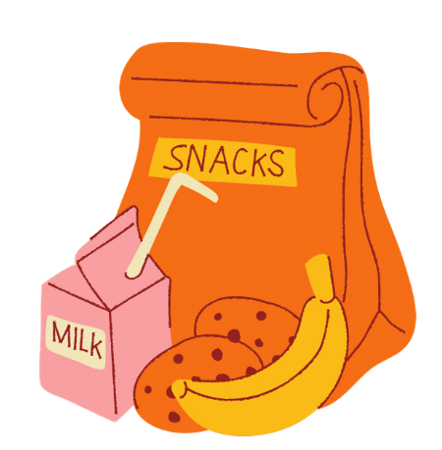
Step 4: write the body of the message
Gist of the book
What is the book about?
What part of the book do you think the recipient will enjoy the most? Why?
Main message
What is the connection between the book and the recipient?
What message do you want the recipient to take away from the book?
How do you hope the book will encourage or motivate the recipient in his/her daily life?
Example:
In the story, the elves helped the shoemaker make shoes every night. Like the elves, you take care of me all the time. The shirts I wear to school, the snacks I enjoy at recess and the markers in my pencil pocket all remind me of your love and kindness.
I am giving this book to you to show that I am grateful for all the things you do for me. I hope the book brings you joy and inspiration, just as you do for me every day.
You can break the body of your message into paragraphs to make it easier to read. Similar ideas are usually put in the same paragraph.

Slide 20
Step 5: include a quote/saying
Greeting
A quote contains words that someone has said or written. The quote you include in your message must be taken from your chosen book.
Opening
reason(s) for book gifting
Gist of the book
When looking for a good quote, think about these questions:
Main message
Body
Does the quote echo the theme and/or sub-themes of the SOW Campaign 2024/25?
Can the quote help you express your main message?
Is the quote interesting or catchy? Will it make the reader remember your message better?
Will the quote inspire the reader to think about and reflect on their own experiences?
Quote/Saying
Ending
wrap up your message
Closing

Slide 21
Step 5: include a quote/saying
A quote contains words that someone has said or written. The quote you include in your message must be taken from your chosen book.
Your turn – which quote will you take from the story to show your gratitude? Include it in the body of your message.
When looking for a good quote, think about these questions:
The Elves and the Shoemaker
by the Brothers Grimm
Does the quote echo the theme and/or sub-themes of the SOW Campaign 2024/25?
Can the quote help you express your main message?
Is the quote interesting or catchy? Will it make the reader remember your message better?
Will the quote inspire the reader to think about and reflect on their own experiences?

Slide 22
Step 5: include a quote/saying
A quote contains words that someone has said or written. The quote you include in your message must be taken from your chosen book.
When looking for a good quote, think about these questions:
Example:
As the shoemaker’s wife said in the story, “We ought to show them our gratitude.” I am giving this book to you to show that I am grateful for all the things you do for me. I hope the book brings you joy and inspiration, just as you do for me every day.
The SOW echoes the sub-theme “Appreciation”.
Does the quote echo the theme and/or sub-themes of the SOW Campaign 2024/25?
Can the quote help you express your main message?
Is the quote interesting or catchy? Will it make the reader remember your message better?
Will the quote inspire the reader to think about and reflect on their own experiences?
The Elves and the Shoemaker
by the Brothers Grimm

Slide 23
Step 6: write an ending & a closing
Greeting
Ending
You wrap up your whole message in the ending. Here are some questions that may help you write your ending.
How has the book inspired you? / How do you think it will inspire the recipient?
What is the last thing you want to say to the recipient? You can:
give compliments – e.g. You are an inspiration!
show gratitude – e.g. Thank you for the support!
Opening
reason(s) for book gifting
Gist of the book
Main message
Body
Quote/Saying
Ending
wrap up your message
Closing
Some common ways to sign off your message include: Yours, Love, With love.
Closing

Slide 24
Step 6: write an ending & a closing
Your turn – write an ending and a closing.
Ending
You wrap up your whole message in the ending. Here are some questions that may help you write your ending.
How has the book inspired you? / How do you think it will inspire the recipient?
What is the last thing you want to say to the recipient? You can:
give compliments – e.g. You are an inspiration!
show gratitude – e.g. Thank you for the support!
I want to become a person like Auntie May!
Closing
Some common ways to sign off your message include: Yours, Love, With love.

Slide 25
Step 6: write an ending & a closing
Ending
You wrap up your whole message in the ending. Here are some questions that may help you write your ending.
How has the book inspired you? / How do you think it will inspire the recipient?
What is the last thing you want to say to the recipient? You can:
give compliments – e.g. You are an inspiration!
show gratitude – e.g. Thank you for the support!
Example:
The story inspires me to become a person like you. Thank you, Auntie May!
Yours, Emma
Ending
Closing
Closing
Some common ways to sign off your message include: Yours, Love, With love.

Slide 26
Final step: design an artwork
Design a piece of 2D artwork that can help you express your message. It can be hand-drawn pictures, digital illustrations or a collage of photos.
Example:
Dear Auntie May,
I wish to share this book with you because the elves in the story made me think of you.
In the story, the elves helped the shoemaker make shoes every night. Like the elves, you take care of me all the time. The shirts I wear to school, the snacks I enjoy at recess and the markers in my pencil pocket all remind me of your love and kindness.
As the shoemaker’s wife said in the story, “We ought to show them our gratitude.” I am giving this book to you to show that I am grateful for all the things you do for me. I hope the book brings you joy and inspiration, just as you do for me every day.
The story inspires me to become a person like you. Thank you, Auntie May!
Yours, Emma
Thank you!

Slide 27
Using adjectives and literary devices

Slide 28
Example 1: using adjectives
The Elves and the Shoemaker by the Brothers Grimm
You can enrich the message by using adjectives to describe things, people or places, e.g.
The shirt is clean.
She is a nice person.
I live in a big city.
Dear Auntie May,
I wish to share this book with you because the (1)___ elves in the story made me think of you.
In the story, the elves helped the shoemaker make (2)___ shoes every night. Like the elves, you take care of me all the time. The (3)___ shirts I wear to school, the (4)___ snacks I enjoy at recess and the (5)___ markers in my pencil pocket all remind me of your love and kindness.
As the shoemaker’s wife said in the story, “We ought to show them our gratitude.” I am giving this book to you to show that I am grateful for all the things you do for me. I hope the book brings you joy and inspiration, just as you do for me every day.
The story inspires me to become a (6)___ person like you. Thank you, Auntie May!
Yours, Emma
Your turn - use the following adjectives to enrich the message:
“neat”
“kind and helpful”
“new”
“colourful”
“delicious”
“little”

Slide 29
Example 1: using adjectives
The Elves and the Shoemaker by the Brothers Grimm
Example:
You can enrich the message by using adjectives to describe things, people or places, e.g.
The shirt is clean.
She is a nice person.
I live in a big city.
Dear Auntie May,
I wish to share this book with you because the little elves in the story made me think of you.
In the story, the elves helped the shoemaker make new shoes every night. Like the elves, you take care of me all the time. The neat shirts I wear to school, the delicious snacks I enjoy at recess and the colourful markers in my pencil pocket all remind me of your love and kindness.
As the shoemaker’s wife said in the story, “We ought to show them our gratitude.” I am giving this book to you to show that I am grateful for all the things you do for me. I hope the book brings you joy and inspiration, just as you do for me every day.
The story inspires me to become a kind and helpful person like you. Thank you, Auntie May!
Yours, Emma

Slide 30
More adjectives
Try to use them to describe people’s feelings and characters.
Characters / Qualities
brave
caring
cheerful
clever
confident
creative
determined
diligent
fearless
friendly
funny
enthusiastic
generous
helpful
honest
imaginative
intelligent
joyful
kind
knowledgeable
loving
optimistic
persistent
playful
responsible
resilient
supportive
sympathetic
understanding
Feelings / Emotions
excited
grateful
happy
loved
surprised
sad
disappointed
lonely
helpless
angry
annoyed
jealous

Slide 31
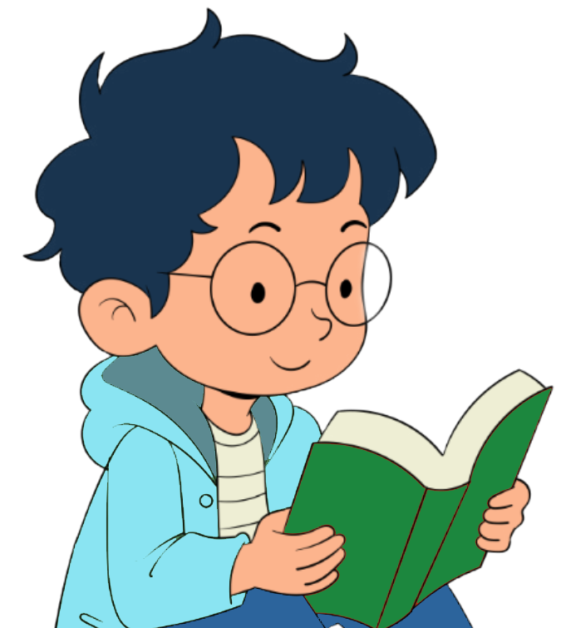
Example 2: using literary devices
Read the following message written by Peter
Dear Hong Kong citizens,
I wish to share this book about Thomas Edison with you because his story is really inspiring. Although he faced a lot of challenges, like being partly deaf and having trouble in school, Edison never gave up. His story shows us that perseverance can unlock the door to amazing achievements.
Edison once said, “Genius is one per cent inspiration, ninety-nine per cent perspiration.” This reminds us that hard work is the key to success. His inventions, such as the light bulb, have brightened our lives, just like how your hard work makes our community shine brighter.
Thank you for your dedication. I hope this book will inspire you to be resilient, celebrate the small victories and find joy in your life journey. Remember, each little step we take is like planting a seed that will grow into something wonderful!
With appreciation, Peter
Type of book: | biography
Theme: | SOW the Reading Seed: Inspire and Be Inspired - Resilience and Delight
Recipient: | Hong Kong citizens
Who was Thomas?
by Alva Edison

Slide 32
Example 2: using literary devices
Read the following message written by Peter
Your turn – circle a metaphor in paragraph 2 and a simile in paragraph 3.
Literary devices
You can use literary devices to make your message more creative and interesting, such as metaphors and similes.
Dear Hong Kong citizens,
I wish to share this book about Thomas Edison with you because his story is really inspiring. Although he faced a lot of challenges, like being partly deaf and having trouble in school, Edison never gave up. His story shows us that perseverance can unlock the door to amazing achievements.
Edison once said, “Genius is one per cent inspiration, ninety-nine per cent perspiration.” This reminds us that hard work is the key to success. His inventions, such as the light bulb, have brightened our lives, just like how your hard work makes our community shine brighter.
Thank you for your dedication. I hope this book will inspire you to be resilient, celebrate the small victories and find joy in your life journey. Remember, each little step we take is like planting a seed that will grow into something wonderful!
With appreciation, Peter
A metaphor makes a statement that says one thing is another, without using the words like “like” or “as”, e.g.
“A teacher is a gardener who always nourishes and nurtures students, providing the most favourable environment for them to grow.”
A simile compares something with something else, using the words “like” or “as”, e.g.
“A good teacher is like a compass. He always shows students the correct direction and guides them out of darkness when they are lost.”

Slide 33
Example 2: using literary devices
Read the following message written by Peter
Literary devices
You can use literary devices to make your message more creative and interesting, such as metaphors and similes.
Dear Hong Kong citizens,
I wish to share this book about Thomas Edison with you because his story is really inspiring. Although he faced a lot of challenges, like being partly deaf and having trouble in school, Edison never gave up. His story shows us that perseverance can unlock the door to amazing achievements.
Edison once said, “Genius is one per cent inspiration, ninety-nine per cent perspiration.” This reminds us that hard work is the key to success. His inventions, such as the light bulb, have brightened our lives, just like how your hard work makes our community shine brighter.
Thank you for your dedication. I hope this book will inspire you to be resilient, celebrate the small victories and find joy in your life journey. Remember, each little step we take is like planting a seed that will grow into something wonderful!
With appreciation, Peter
A metaphor makes a statement that says one thing is another, without using the words like “like” or “as”, e.g.
“A teacher is a gardener who always nourishes and nurtures students, providing the most favourable environment for them to grow.”
A simile compares something with something else, using the words “like” or “as”, e.g.
“A good teacher is like a compass. He always shows students the correct direction and guides them out of darkness when they are lost.”

Slide 34
Other literary devices
Try to use them to express your ideas in a creative way.
Alliteration
Repeating the same consonant sounds at the beginning of words that are near each other, e.g.
“I am thankful to the tender teachers who touch my heart with their hands of love.”
Personification
Giving some human characteristics to something that is not human, such as animals, objects and non-living things, e.g.
“The school is overjoyed when we are back. It spreads its arms wide to welcome us.”
Hyperbole
Making qualities of people or things stand out by exaggerating them, e.g.
“My class teacher is the best teacher in the entire universe!”

Slide 35
Deadline and reminders

Slide 36
Deadline and Reminders
All entries must include a saying of wisdom (SOW), a message, and a piece of 2D artwork
Awards:
For schools: the Active Participation School Award for schools with 80% or more students participating in the Competition
For students: 3 Outstanding Awards and 10 Commendable Awards for each division
Deadline: 31 March 2025, 6:00 p.m.
Webpage: https://www.edb.gov.hk/BookGifting

Slide 37
Self-assessment Checklist
Content
I have…
chosen a book and a quote from the book that echo the theme and/or sub-themes of the SOW Campaign 2024/25.
included the quote in my message.
written about
the reasons for giving the book,
a gist of the book, and
how the book has inspired me or can inspire others.
created a piece of 2D artwork for my message.
Organisation
I have…
written a greeting and a closing.
written an opening, a body and an ending.
written in paragraphs.
used connectives to link ideas together.
Language and style
I have…
used the simple present tense and the simple past tense correctly.
used adjectives to describe things, people or places.
used literary devices to make my message more interesting.

