Slide 1
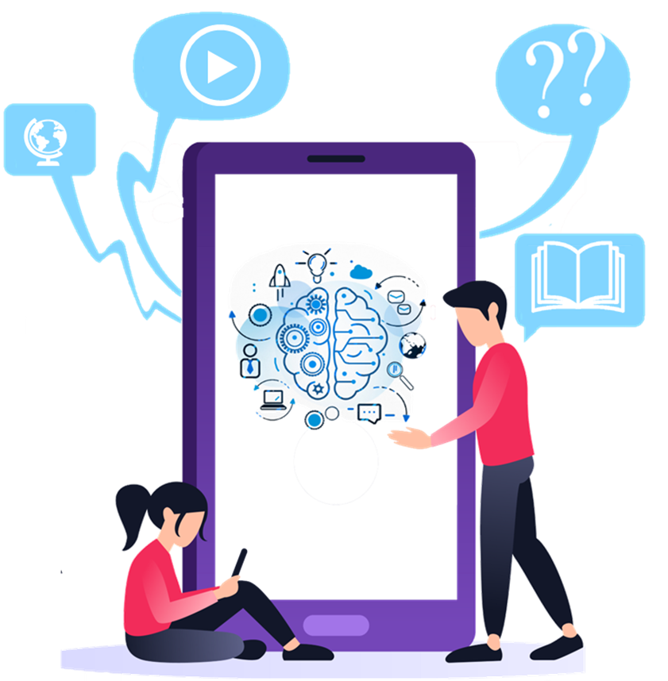
English Language Resource Materials on
National Security Education at the Secondary Level
An Example of Learning and Teaching Activities
ARTIFICIAL INTELLIGENCE (AI)
AND OUR WORLD

Slide 2
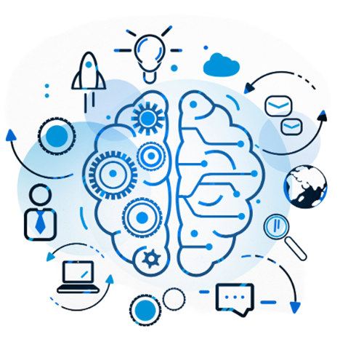
Module | Unit | Topic
Study, School Life and Work | Artificial Intelligence (AI) | Artificial Intelligence (AI) and Our World
Content Objectives
To explore concepts related to artificial intelligence (AI) security, e.g.
the role of AI in our everyday life
the integration of non-human AI students in schools/universities
the impact of AI on future workforce
Language Objectives
To develop language knowledge and skills, e.g.
listening, speaking, reading/viewing and writing skills
text structures (e.g. video, news article, timeline)
vocabulary building strategies:
working out the meaning of unfamiliar words by identifying meaningful chunks/making use of semantic/visual clues
identifying the language items used for citing and quoting the source of information
English Language
Education
National Security
Education
Artificial Intelligence

Slide 3
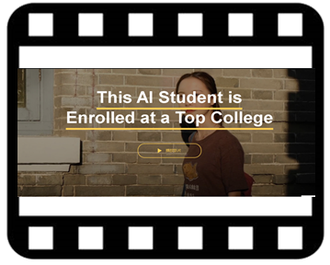
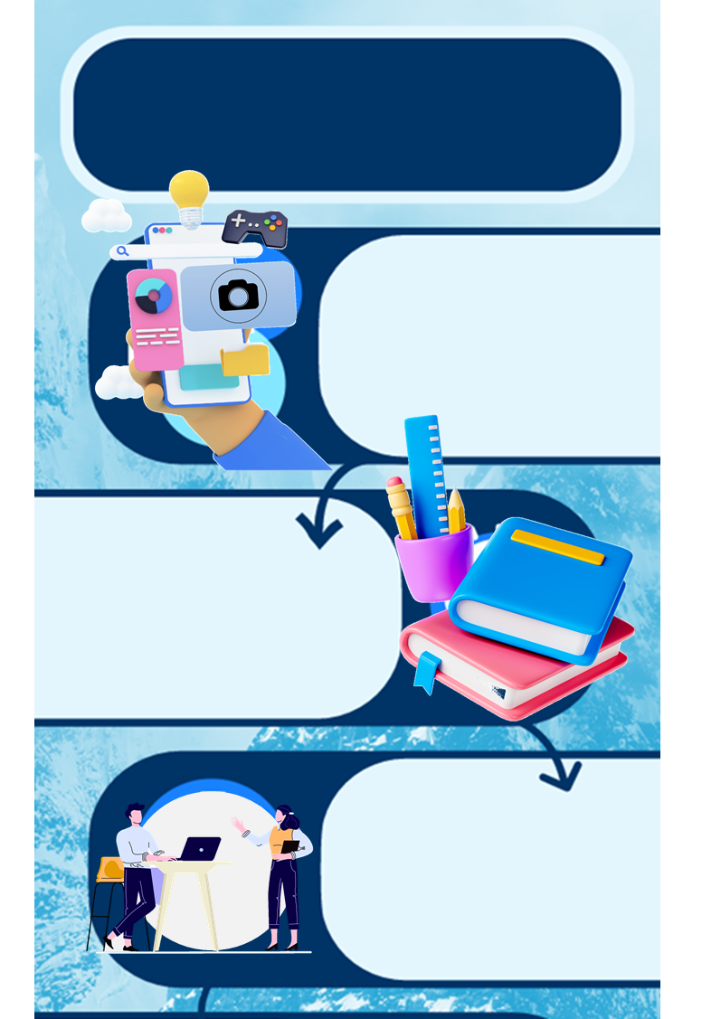
AI and Our World
A Video on
“This AI Student is Enrolled at a Top College”
Pre-viewing
Find out how much students know about the application of Artificial Intelligence (AI) in their everyday life.
While-viewing
Post -viewing
Use the article “First AI Virtual Student Set to Be Class Apart” as a follow-up to engage students in knowing more about the first non-human AI student and the recent development of AI in China.
Use the article “Some Workers Turning AI Challenge into Advantage” to engage students in knowing more about the impact of AI on future workforce.
The Role of AI in Our Everyday Life
Play the video.
Engage students in knowing more about the first non-human AI student and the recent development of AI in our country.
The Integration of Non-human AI Students in Schools/ Universities
The Impact of AI on Future Workforce
Source: The China Current:
https://chinacurrent.com/education/23022/this-ai-student-is-enrolled-at-a-top-college-23022

Slide 4
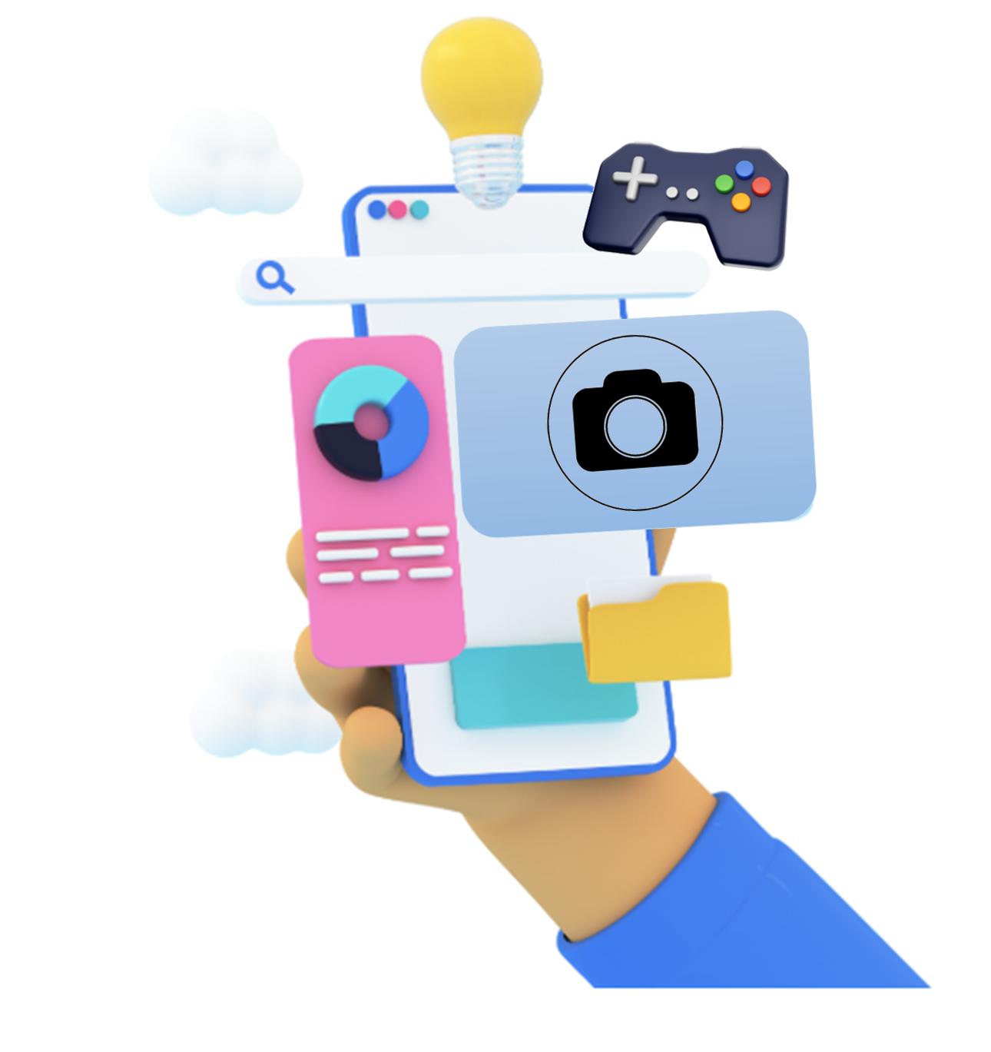
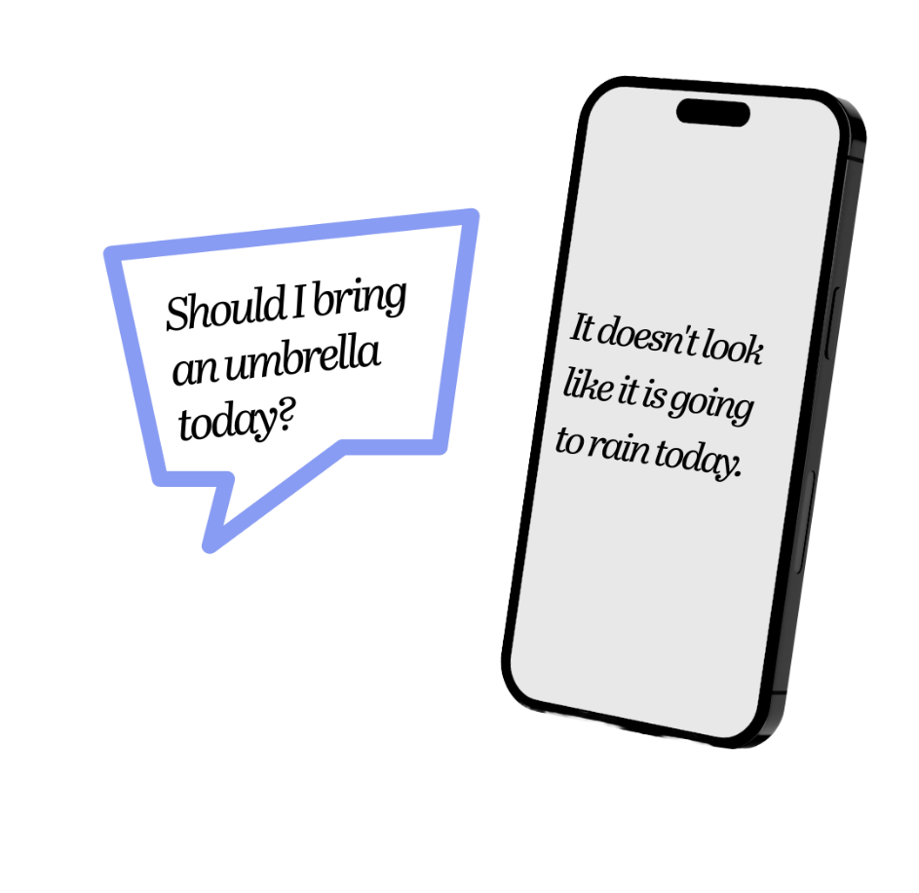
What is the role of technology in our everyday Life? Please give some examples.
Find out how much students know about the application of Artificial Intelligence (AI) in their everyday life.
Pre-viewing
The AI Assistant
Social Media
Apps for Study/Leisure

Slide 5
How much do you know about these tools/apps?
Have you used any of them before? Can you give some examples?
If yes, why do you use it/them?
Will you recommend others (e.g. your friends/family) to use it/them? Why?
1)
The AI Assistant
Technology in Our Everyday Life
2)
3)
Apps for Study/Leisure
Social Media
5

Slide 6
How much do you know about these tools/apps?
What is the use of these tools/apps?
Which technology is applied in these tools/apps?
4)
The AI Assistant
To look for information
To connect with people
To perform learning tasks (e.g. submit assignments)
For leisure (e.g. watching online videos, playing online games)
Technology in Our Everyday Life
5)
Apps for Study/Leisure
Artificial Intelligence (AI)
Social Media
6

Slide 7
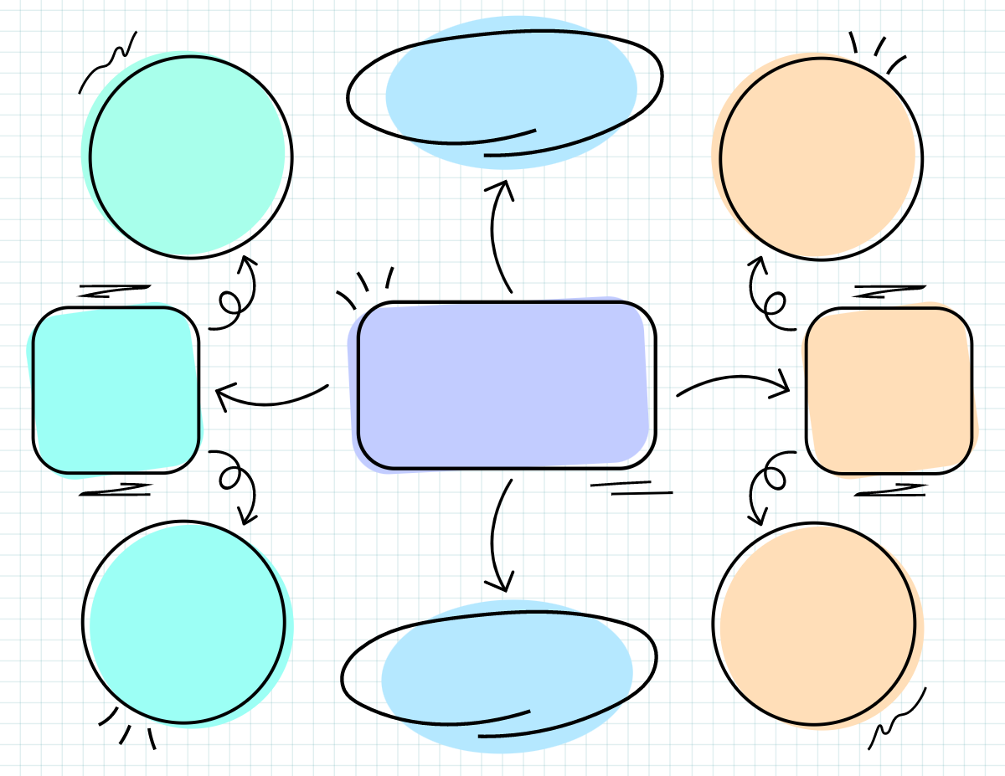
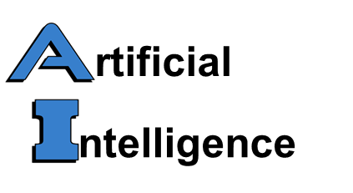
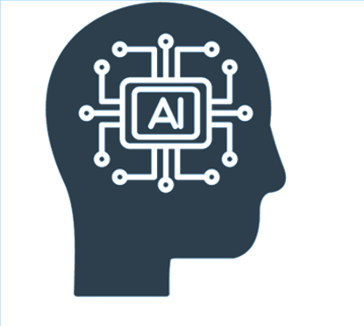
2)
1)
The word “Artificial” is about
AI learns from…
3)
What can AI do for us?
a)
How much do you know about Artificial Intelligence (AI)?
things made by people
the browsing history
Provide information (e.g. weather)
What do the words “Artificial Intelligence” refer to?
With reference to the examples in the previous slides (i.e. AI assistant, social media, apps for study/leisure),
how does AI learn?
what can AI do for us?
a)
a)
Provide personalised newsfeeds
our instructions
b)
The word “Intelligence” is about…
b)
Play online games with us
our preferences
b)
the brain
the ability to learn
Notes:
Accept any reasonable answers.

Slide 8
2. How do you protect your digital footprints (e.g. footprints left when using social media, playing online games)?
Reflection on AI Security
The Role of AI in Our Everyday Life
1. What are the pros and cons of getting personalised feeds ?
3. Why is it important for our country to safeguard AI security?

Slide 9
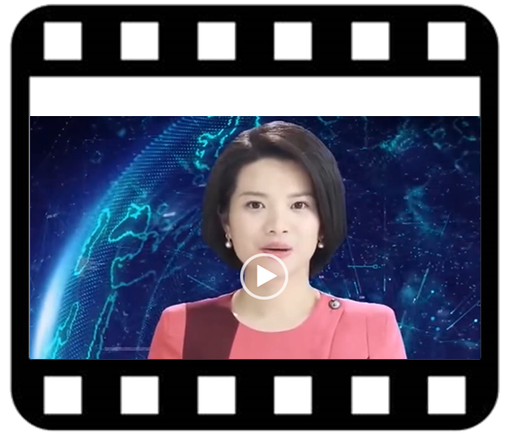
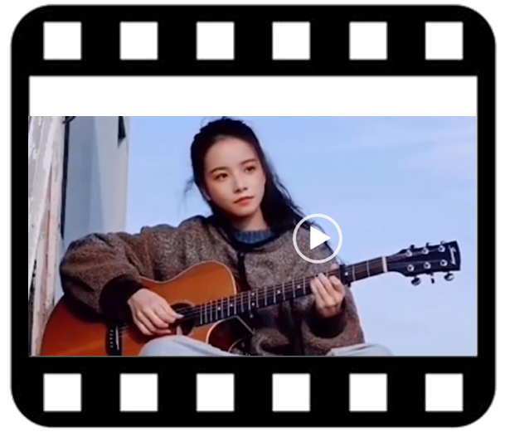
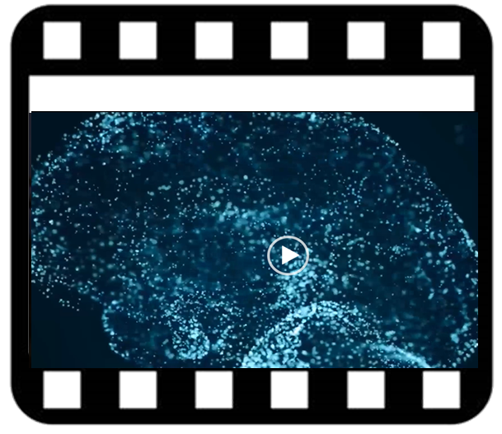
A Video on
“This AI Student is Enrolled at a Top College”
Play the video.
Engage students in knowing more about the first non-human AI student and the recent development of AI in our country.
While-viewing
Video Time: 00:00 – 00:55
Video Time: 00:56 – 02:36
Video Time: 02:37 – 06:15
What are the characteristics of the world’s first AI news presenter?
What can the non-human AI student do?
What is the current development of AI in our country?
Source: The China Current:
https://chinacurrent.com/education/23022/this-ai-student-is-enrolled-at-a-top-college-23022
Notes:
https://chinacurrent.com/education/23022/this-ai-student-is-enrolled-at-a-top-college-23022

Slide 10
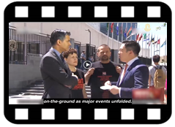
Read the transcript below. Without using a dictionary, try to guess the meaning of the words by:
identifying meaningful chunks within the word/in the sentence
using semantic/visual clues from the text (video clip)
(1) Can you guess the meaning of the following words/phrases by identifying meaningful chunks within the word/in the sentence?
(2)
Vocabulary Building Strategies
Words/Phrases
Hi, I’m James Chau. Before The China Current, I anchored the news on television, interviewed world leaders, and reported on-the-ground as major events unfolded, which is why I was fascinated when the world’s first virtual news presenter was unveiled in China a few years ago. He uses artificial intelligence to mimic people like me and our voices, lip movements, and facial expressions. The result is not completely natural. After all, nothing quite replaces a human conveying human emotion. But an AI newsreader can work around the clock…
(a)
unfolded
Study the line “Before The China Current, I anchored the news on television, interviewed world leaders, and reported on-the-ground as major events…” Can you suggest another word which carries similar meaning as the word “anchored”?
Not/the opposite
A past action
To bend something
Meaning:
To open/spread out something
(b)
unveiled
“reported”
Not/the opposite
A past action
(3a) Study the line “He uses artificial intelligence to mimic people like me and our voices, lip movements, and facial expressions...” Can you guess the meaning of the word “mimic”?
A covering for hiding something
Meaning:
To show something to the public for the first time
To copy
(c)
around the clock
(3b) Which word can give you clues about the meaning of the word “mimic”?
Meaning:
All day long/non-stop
“like”

Slide 11
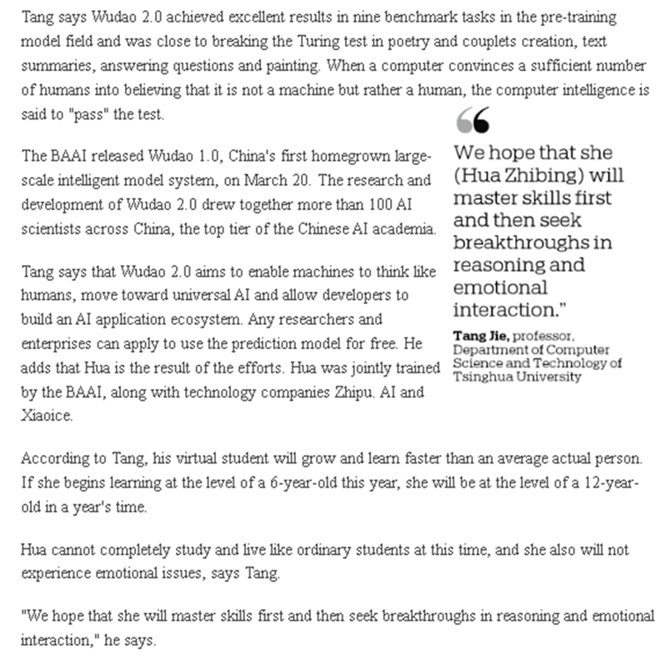
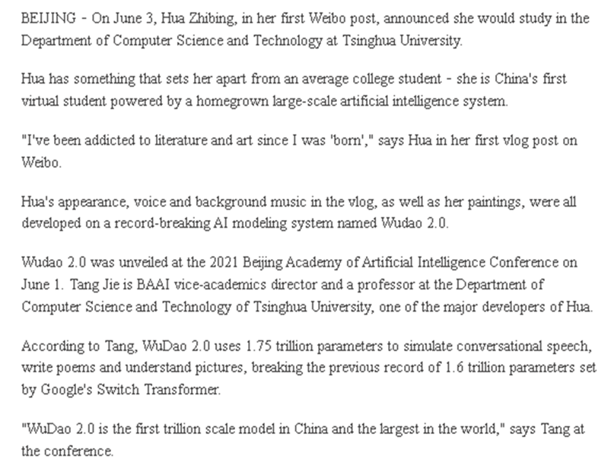
Use the article “First AI Virtual Student Set to Be Class Apart” as a follow-up to engage students in knowing more about the first non-human AI student and the recent development of AI in China.
Post-viewing
First AI Virtual Student Set to be Class Apart
Please click here to download the text.
Source (Text of the article)
Xinhua. (2021, June 10). First AI virtual student set to be class apart. China Daily. Retrieved from: https://chinadaily.com.cn.
Notes:
https://www.chinadaily.com.cn/a/202106/10/WS60c17d70a31024ad0bac4d5e.html

Slide 12
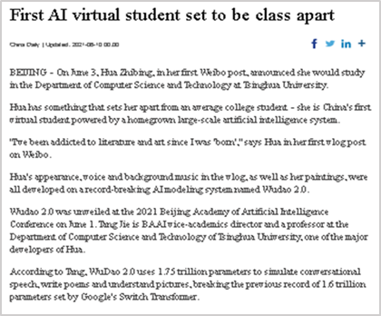
Decide if an average actual person/a non-human AI student possesses the qualities listed below. Complete the table with reference to the video “This AI Student is Enrolled at a Top College” and the article “First AI Virtual Student Set to Be Class Apart”.
Qualities (Please tick.) | An Average Actual Person | A Non-human AI Student
a) Human appearance
b) Human emotions
c) Ability to speak
d) Ability to sing
e) Ability to learn
f) Ability to work all day long
g) Feeling tired
h) Attending face-to-face lessons
i) Higher learning speed
✓
✓
✓
✓
✓
✓
✓
✓
✓
✓
A Video on
“This AI Student is Enrolled at a Top College”
✓
✓
An Article on
“First AI Virtual Student Set to Be Class Apart”
✓
2. Is the ability of a non-human AI student comparable to that of an average actual person? In what way can you outperform a non-human AI student (e.g. originality, the ability to empathise with others)? Share your thoughts with the class.

Slide 13
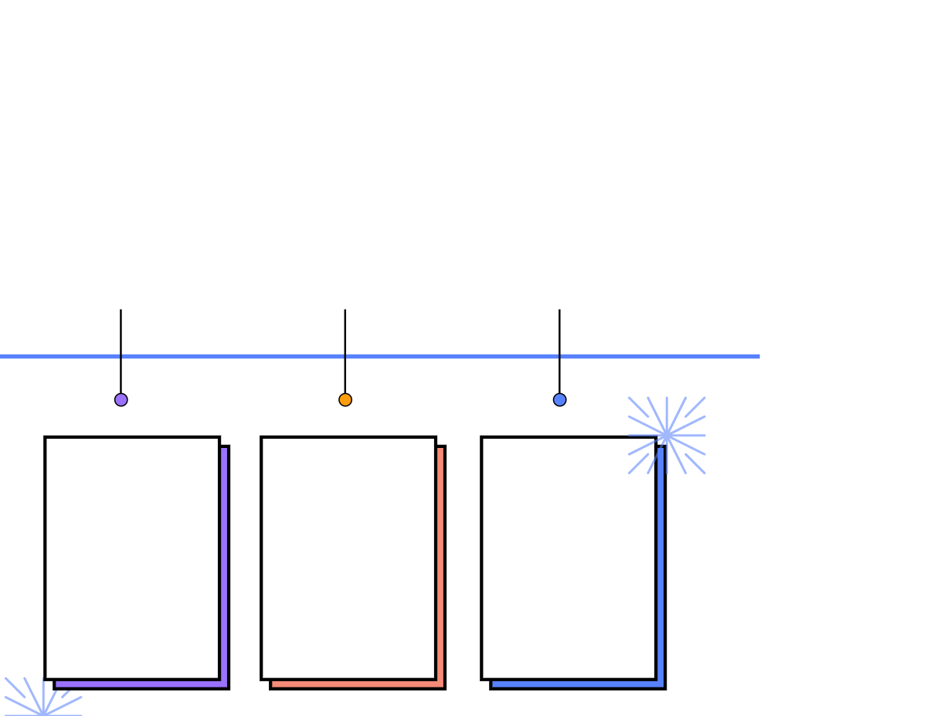
1. Complete the timeline of the recent development of AI in our country with reference to the video “This AI Student is Enrolled at a Top College” and the article “First AI Virtual Student Set to Be Class Apart”.
The Development of AI in Our Country
WuDao
1.0
WuDao
2.0
WuDao
3.0
a)
_____ 2021
b)
2023
March
June 2021
It was China's first
c) ____________ large-scale intelligent model system.
It powered the world’s first AI d) _________. It was able to e) _____ like human, simulate f) ______________ ____________, write g) _______ and understand pictures.
It was expected to perform like natural trained human h) _______.
homegrown
student
think
conversational
brain
speeches
A Video on
“This AI Student is Enrolled at a Top College”
poems
An Article on
“First AI Virtual Student Set to Be Class Apart”
i) Identify the language items used for citing and quoting the source of information (e.g. Tang Jie):
According to Tang…
Tang says…
/
Source (Text of the article)
Xinhua. (2021, June 10). First AI virtual student set to be class apart. China Daily. Retrieved from: https://chinadaily.com.cn.
Please click here to download the text.

Slide 14
Reflection on AI Security
The Integration of Non-human AI Students in Schools/Universities
3. What is the impact of having non-human AI graduates on our country?
1. Do you want to have non-human AI students as your classmates? Why/why not?
2. From the students’ perspective, what is the impact of having non-human AI students on schools/universities?

Slide 15
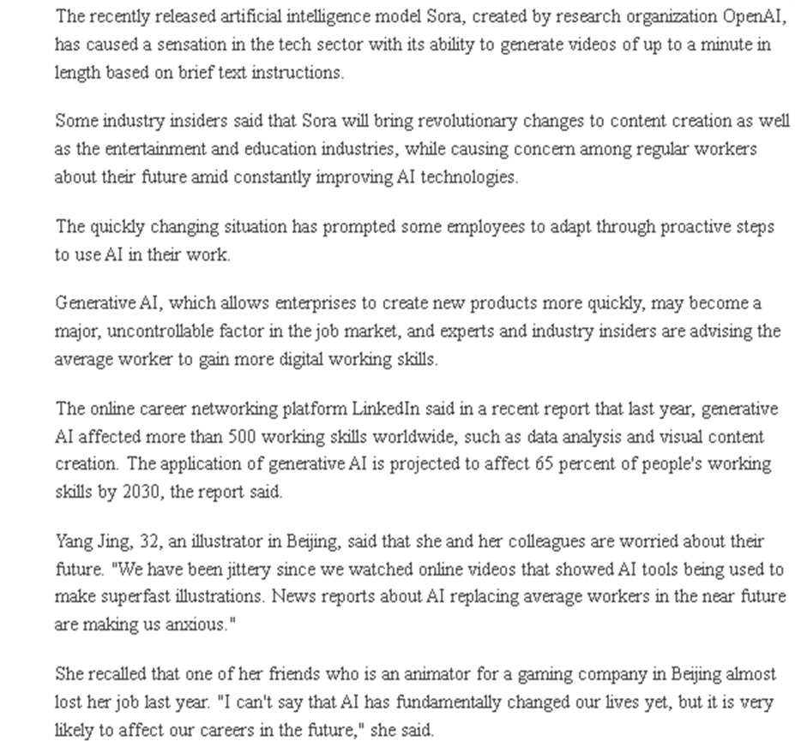
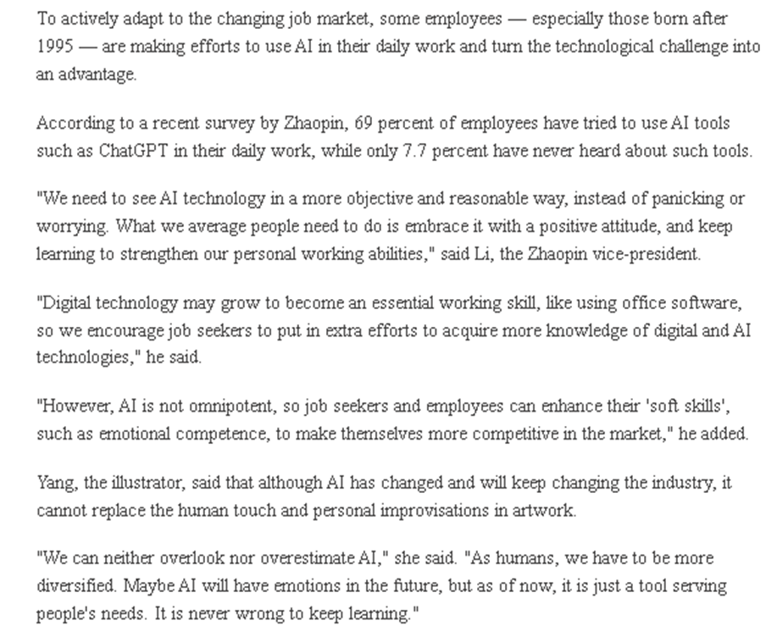
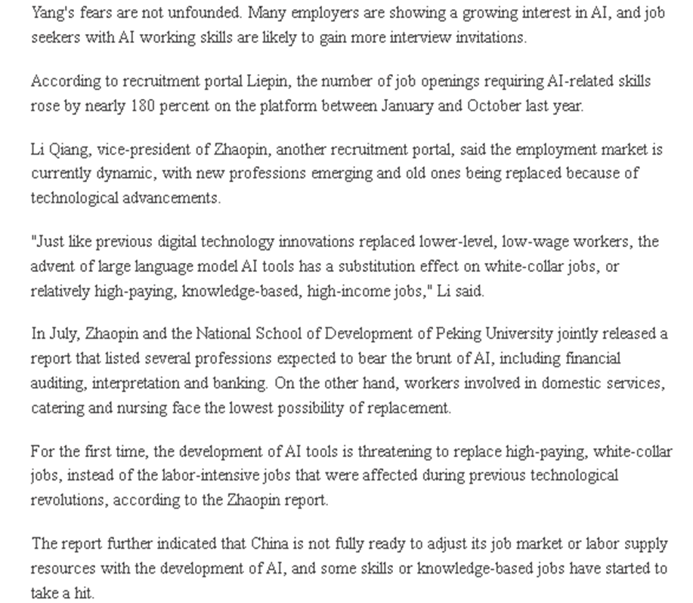
Use the article “Some Workers Turning AI Challenge into Advantage” to engage students in knowing more about the impact of AI on future workforce.
Post-viewing
Some Workers Turning AI Challenge into Advantage
Please click here to download the text.
Source (Text of the article)
Cheng Si. (2024, February 20). Some Workers Turning AI Challenge into Advantage. China Daily. Retrieved from: https://chinadaily.com.cn.
Notes:
https://global.chinadaily.com.cn/a/202402/20/WS65d4c276a31082fc043b82be.html

Slide 16
he number of job openings requiring AI-related skills
Complete the chart below with reference to the article “Some Workers Turning AI Challenge into Advantage”.
Jobs affected by AI
b)
Advantages
a)
e.g.
e.g.
white-collar jobs
create new products more quickly
e) What is Li’s (the Zhaopin vice-president) attitude towards the advancement of AI technology?
relatively high-paying, knowledge-based, high-income job
animators
make superfast illustrations
To embrace it with a positive attitude, and keep learning to strengthen our personal working abilities
illustrators
The Impact of AI
d)
Ways to stay competitive
c)
Challenges
e.g.
e.g.
affect 65 percent of people's working skills by 2030
gain more digital working skills
enhance 'soft skills', such as emotional competence

Slide 17
2. How would you equip yourself so as to stay competitive with the existence of AI?
Reflection on AI Security
The Impact of AI on Future Workforce
1. What are the possible challenges you might face when you join the workforce in future?
3. Do you think embracing AI in the workplace is beneficial to our country? Why/why not?

Slide 18
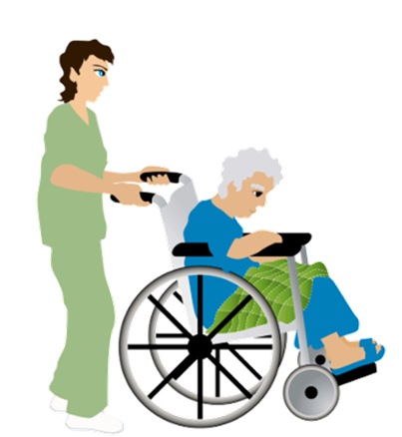
Extended Learning Activities
1. Hong Kong has been facing the challenge of manpower shortage in different sectors (e.g. elderly homes, retail sector, construction sector) in recent years. Arrange students into groups and engage them in suggesting possible ways of making effective use of AI technology to improve the current situation.
2. Invite students to present their ideas to the class. They may include photos, video clips or presentation slides in their presentation.
3. Engage students in writing a proposal on how AI can be applied to solve the problem of manpower shortage in different sectors including the following details:
the reasons for manpower shortage in a sector facing the problem;
job duties that can possibly be supported with the use of AI; and
descriptions of how AI can be applied to support the sector.

