Slide 1
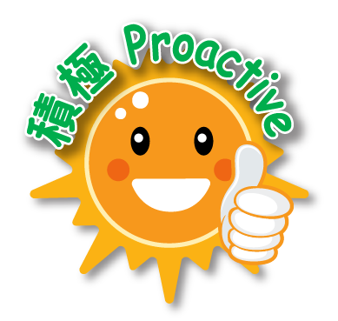
Doing Physical Activities at Home (For Primary Schools) Fitness Dance
PE Section, Curriculum Development Institute, EDB

Slide 2
Preface
Department of Health indicated that maintaining regular physical activity starting from childhood to adult stage will bring about tremendous health benefits and enhance physical fitness, such as increased cardiorespiratory fitness and muscular strength; reduced body fatness; lower risks of developing cancer, cardiovascular diseases and diabetes; enhanced bone health; and building resilience and reducing symptoms of depression. Besides, to maintain a healthy lifestyle could build up good body resistance.
The Curriculum Development Institute of Education Bureau developed a series of learning and teaching materials for teachers’ reference in encouraging students to do individual physical fitness activities at home. Also, parents should provide necessary support to or take part in the activities with their children. It could foster parent-child relationship and help them maintain a good health condition which leads to a healthy lifestyle.

Slide 3
Safety Measures
To wear proper clothing and footwear during activities.
Exercises should be carried out individually or on a rotation basis. Adequate distance should be maintained with other people.
Before activities, the floor should be ensured smooth and dry; indoor area should be kept well ventilated; adequate space and safe environment should be arranged; any glass windows, doors, table, chairs, lights, fans and sharp edges, etc. which are in close vicinity to the activity area should be installed with protective devices or be temporarily removed; all equipment must be checked for safety before use.
Students should do adequate warm-up exercises at the beginning of the activity.
The intensity¹, duration and frequency of exercises should be arranged according to the personal health and fitness conditions.
It should be started from the lowest level of difficulty. The intensity, duration and number of repetitions should be increased gradually. Natural breathing instead of “holding breath” should also be reminded.
Pay attention to the voice volume when engaging in activities to avoid disturbing others.
To drink water after the activity for replenishment. Personal hygiene should be observed.
If feeling unwell during or after the activity, students should stop immediately and seek medical or professional assistance.
Note¹:The intensity of physical activities can be classified into low, moderate and vigorous levels: “Low-intensity physical activities” are simple, light and easy to do. “Moderate-intensity physical activities” will slightly speed up breathing and heart rate and cause mild sweating without exertion (e.g. one can still talk with ease while exercising). “Vigorous-intensity physical activities” will greatly speed up breathing and heart rate and cause profuse sweating and exertion (e.g. one cannot or finds it difficult to talk with ease while exercising).

Slide 4
Learning and Teaching Resources – Fitness Dance

Slide 5
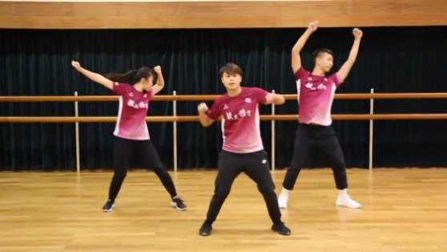
Warm-up
https://apps.hkedcity.net/media/play/playVideo_responsive.php?vFileID=78521&vLang=chi&videoUrl=cb7e2db2e5e7489f0e79165df0e5949cbe16b8c4e354ef1d1f5feb0868512c55e6a0ee9d7310c1726b54248b5f597c5c3188cbc2f136bbc4d1856ab209f0ce77
Instructions:
To cater for learner diversity, the movement of each dancers were differently designed. Students could watch the video first and choose the dancing steps that suits their ability for warm-up.
Students can challenge themselves one by one according to their ability, and they can also create their own dancing movements.

Slide 6
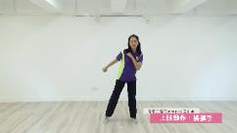
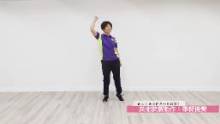
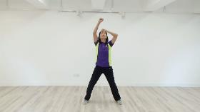
Single movement of Fitness Dance
http://www.hkpfa.org.hk/CustomPage/paragraphGroup.aspx?ct=customPage&webPageId=106&pageId=144&nnnid=111
Instructions:
Practice the single movement of upper limbs, lower limbs and other body parts separately.
Afterwards, follow the “Fitness Dance Routine (Individual)” and try to follow the whole routine.
Furthermore, create new dance steps and compose a new fitness dance routine by adding other upper limbs/ lower limbs movement.

Slide 7
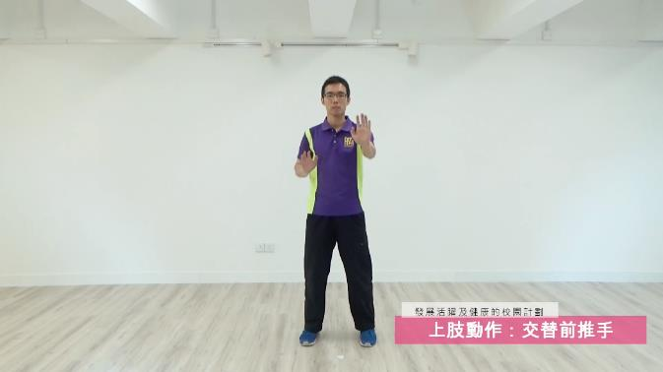
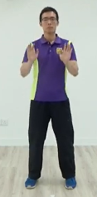
Alternate Front Arm Push
Variations:
Directions
Symmetry² and asymmetry
Note^{2：”}Symmetry” means the movement of left and right match each other.
Link

Slide 8
Shoulder Press and Heel Raise
Tips:
Heels off the ground while bouncing.
Link

Slide 9
Chest Retraction
Ready position:
Chest up
Tips:
Keep breathing
Link

Slide 10
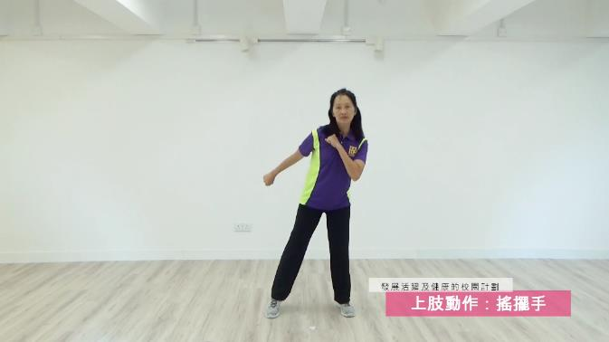
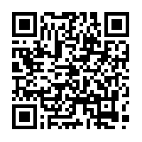
Arm Swing
Tips:
Body leans forward slightly.
Link

Slide 11
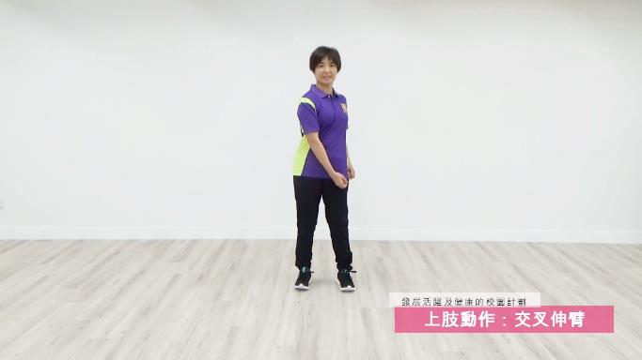
Cross Arm Extension
Variations:
Directions
Symmetry and asymmetry
Link

Slide 12
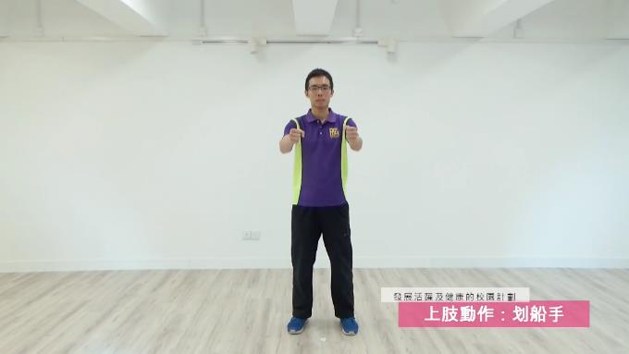
Arm Row
Tips:
Chest up while pulling arms back.
Link

Slide 13
Step Touch
Variations:
Directions
Link

Slide 14
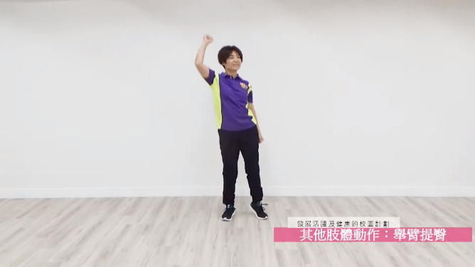
Arm Raise and Hip Lift
Tips:
Hip joint swings rhythmically.
Link

Slide 15
Fitness Dance Routine
Routine demonstration: Fitness Dance (Individual)
There are three levels, which can be chosen according to your own ability, and challenged one by one.
Individual I
Individual II
Individual III

Slide 16
The World Health Organisation recommends that children and youth aged 5-17 should accumulate at least 60 minutes of moderate- to vigorous-intensity physical activities daily.
Set clear goals for yourself. You can!

