Slide 1

Consumer Behaviour in Clothing Choices and Implications
Relationship Between Consumer Buying Behaviour and Fashion

Slide 2

GENERATIONAL MARKETING
An approach to creating more meaningful and effective communication for specific age groups
BABY BOOMERS
1945
GEN X
1965
GEN Y (MILLENNIAL)
1980
GEN Z
2000

Slide 3
THE DEMOGRAPHIC COHORTS
BABY BOOMERS
1945
GEN X
1965
GEN Y (MILLENNIAL)
1980
GEN Z
2000
Disciplined, value relationship, goal centric and self-assured
Individualistic, value reliability and stability
Family oriented, value creativity, diversity and inclusion
Open-minded, value innovation and flexibility

Slide 4
KEY EVENTS & INFLUENCES
BABY BOOMERS
1945
GEN X
1965
GEN Y (MILLENNIAL)
1980
GEN Z
2000
Moon Landing
Rock-n-roll Music
Oil Crisis
Women Empowerment
Energy Crisis
Computers & the Internet
Broadband, Smart Phones, Search Engine, Web Application
Consumerism
Environmental Awareness
Social Media
Selfies
The Great Recession
Video Games

Slide 5
AS CONSUMERS
BABY BOOMERS
1945
GEN X
1965
GEN Y (MILLENNIAL)
1980
GEN Z
2000
59% read newspaper and magazines for consumer product search
62% prefer making purchases at the store
Only 19% prefer online purchase
74% use internet banking
72% use the internet for product research
81% have made purchases online
62% Read newspapers
48% listen to radio & read magazines
45% watch television (TV) online
63% stay updated on brands through social networks
46% rely on social media when buying online
48% trust word-of-mouth more than TV advertisements (ads)
41% purchase on their mobiles
32% don’t like advertising
64% trust mobile application content and text messages from brands
22% trust social network posts by brands
34% want brands to reach them on social media, 33% by email, 28% by online ads, 13% by post
27% want advertising to include celebrities or athletes
Data reflects United States of America markets only.
Source: Dan Schawbel, Workplace Trends Forecast (https://danschawbel.com/)

Slide 6
SOCIAL MEDIA
BABY BOOMERS
1945
GEN X
1965
GEN Y (MILLENNIAL)
1980
GEN Z
2000
Spend 27 hours (hrs) per week online
11+ hrs a week on social media
45% aged 65+ and 60% aged 50-64 use social media
76% access social media
68% make purchase decisions based on reviews
Spend 8 hours a day online
70% use social media
63% watch videos on video streaming platform
Women spend more time on social media, men use video streaming platform more
99% use social media
8 seconds is their average attention span
Data reflects United States of America markets only.
Source: Dan Schawbel, Workplace Trends Forecast (https://danschawbel.com/)

Slide 7
5Ps of Marketing
Product
Create a product that meets the needs and wants of the target market.
Price
Set a price that is competitive and reflects the value of the product, while also aligning with the business profit goals.
Place
The product is easily accessible and available at the right time and place, for the right people.
Promotion
Create awareness and interest in the product and persuade customers to make a purchase.
People
Create a positive relationship between the company and its stakeholders, and ensure that everyone’s needs and wants are being met.

Slide 8
5Ps of Marketing mix strategy
Product
Refers to the item or service a company offers, encompassing physical attributes, packaging, branding, design, quality, features and benefits.
Price
Indicates the amount customers pay for the product, covering cost of goods, profit margins, pricing strategy, discounts, and promotional offers.
Place
Involves the location where customers can purchase the product, including distribution channels, logistics, market coverage, and service levels.
Promotion
Involves marketing tactics like advertising, sales promotions, public relations, personal selling, and digital marketing to create awareness and interest.
People
Focuses on individuals involved in production, distribution, and consumption of the product, including employees, customers, suppliers and partners.

Slide 9
Application of 5P Marketing mix strategy - Supermarket
Product
The ‘Product’ range is vast, catering to virtually every consumer need.
Price
The ‘Price’ strategy offering everyday low prices, appealing to budget-conscious consumers.
Place
‘Promotion’ includes weekly flyers showcasing deals and discounts, and seasonal campaigns that target specific customer segments.
Promotion
The extensive network of physical stores is complemented by a robust online platform, making their products accessible to a wide audience.
People
The ‘People’ in the supermarket, from store employees to customer service representatives, play a crucial role in maintaining the brand’s promise of friendly service and customer satisfaction.
Source: Harry Foster, A Comprehensive Guide to 5 P's of Marketing (with Real-World Examples) (https://boardmix.com/)

Slide 10
Application of 5P Marketing mix strategy – Sportswear Company
Product
The ‘Product’ offering goes beyond footwear to include apparel and accessories, all designed to enhance athletic performance and style.
Price
The ‘Price’ reflects the premium nature of their products, justified by innovative design and high-quality materials.
Place
The sportswear company leverages celebrity endorsements and powerful storytelling to inspire their target audience.
Promotion
‘Place’ is a blend of the sportswear company’s retail stores, online sales platform, and sports outlets which assist in the distribution.
People
The sportswear company’s ‘People’, from their design team to retail staff, embody the brand’s spirit, further enhancing its appeal.
Source: Harry Foster, A Comprehensive Guide to 5 P's of Marketing (with Real-World Examples) (https://boardmix.com/)

Slide 11
Step 1
Step2
Audit the past marketing practices and find the success rates of various activities.
Step 3
Step 4
Combine the market survey with audit results to get an idea of market scope and type of audience
Step 7
Collect the data about engagement and click-through rates gained and save them for future references.
Learn about the latest market trends and requirements by conducting surveys and researches
Set realistic and achievable small goals for the marketing campaign.
Step 5
Decide the budget for the marketing campaign and scale it to meet the requirements
Step 6
Use the data collected to come up with the best marketing strategies that align with audience and budget requirements.
Implement the campaign at a small scale and find the response of customer’s towards it.
Step 8
Use the customer response and reviews to refine the marketing campaign, and then employ it to full scale.
Step 9
9 STEPS
To Create a
Strategic Marketing
Campaign

Slide 12
5 Effective Ways to Develop Content Marketing Strategy
Work on content creation
Decide on the idea and theme of the content
Use infographics
Speed up without sacrificing quality
Build a team, work on quality

Slide 13

Fast Fashion and Slow Fashion
Fast Fashion and Slow Fashion are two concepts that are polar opposites.
The goal of Fast Fashion is to produce (and sell) as many items as possible in the shortest possible time in order to make as much profit as possible, typically with little to no emphasis on environmental aspects or human rights.
Slow Fashion tries to counteract these aspects and to produce fashion fairly, in a way that results in less harm to the environment and workers being treated fairly.

Slide 14


Consumption
Fast Fashion Slow Fashion
A lot of clothing is bought in a short time. But the purchased items are not worn for long, as they quickly go out of fashion.
Attention is paid to sustainable consumption, where only what is really necessary is bought. Value is placed on eco friendly materials and classic style.
VS

Slide 15




Materials
Fast Fashion Slow Fashion
Clothes are usually made of synthetic fibres (polyester, elastane, etc).
Slow Fashion clothes are made from natural fibres such as cotton or recycled fabrics.
VS

Slide 16




Production
Fast Fashion Slow Fashion
Production typically takes place in places where standards are not respected. Furthermore, workers do not receive fair wages.
Production takes place in places where human rights, standards, and fair wages are respected.
VS

Slide 17

Eco
Fast Fashion Slow Fashion
Fast Fashion is responsible for a lot of water pollution through the use of chemicals and microplastics. 80% of all clothing is thrown away, only 1% of clothing gets recycled.
Water is often recycled and filtered so that no pollutants get into the wastewater. Clothes can be repaired, sold, exchanged or donated to create a circular economy. In this way, waste is reduced.
VS

Slide 18
Eco
Fast Fashion Slow Fashion
Long-lasting
Sustainable
High quality
Fair production
Stylish
Inexpensive
Easy to find
Pros
VS
A bit more expensive
Basics and classic
Can also be second hand
Not climate friendly
Not fair production
Not long-lasting
Cons

Slide 19
















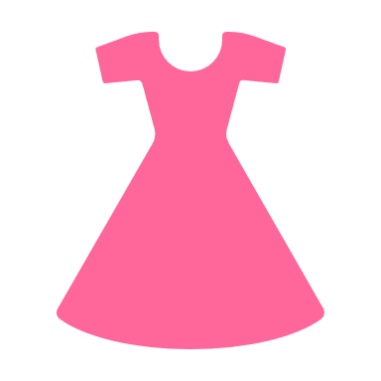



80,000,000,000
Pieces of clothing are manufactured every year
Cheap offshore
production
Local
production
Design
Design for circularity
Copy and modify
Follow big trends
Manufacture
Design
Manufacture
Textile production
Distribution
Textile production
Distribution
FAST
FASHION
SLOW
FASHION
Million trees are cut down every year to make cellulose fabrics
Cheap offshore
production
Retail
Renewable materials
Retail
Fibre
Fibre
User Phase
User Phase
Trillion tones total water use to produce fibre
Rent
Reused
Donate
Million tons of waste per year
Repair
Redesign

Slide 20
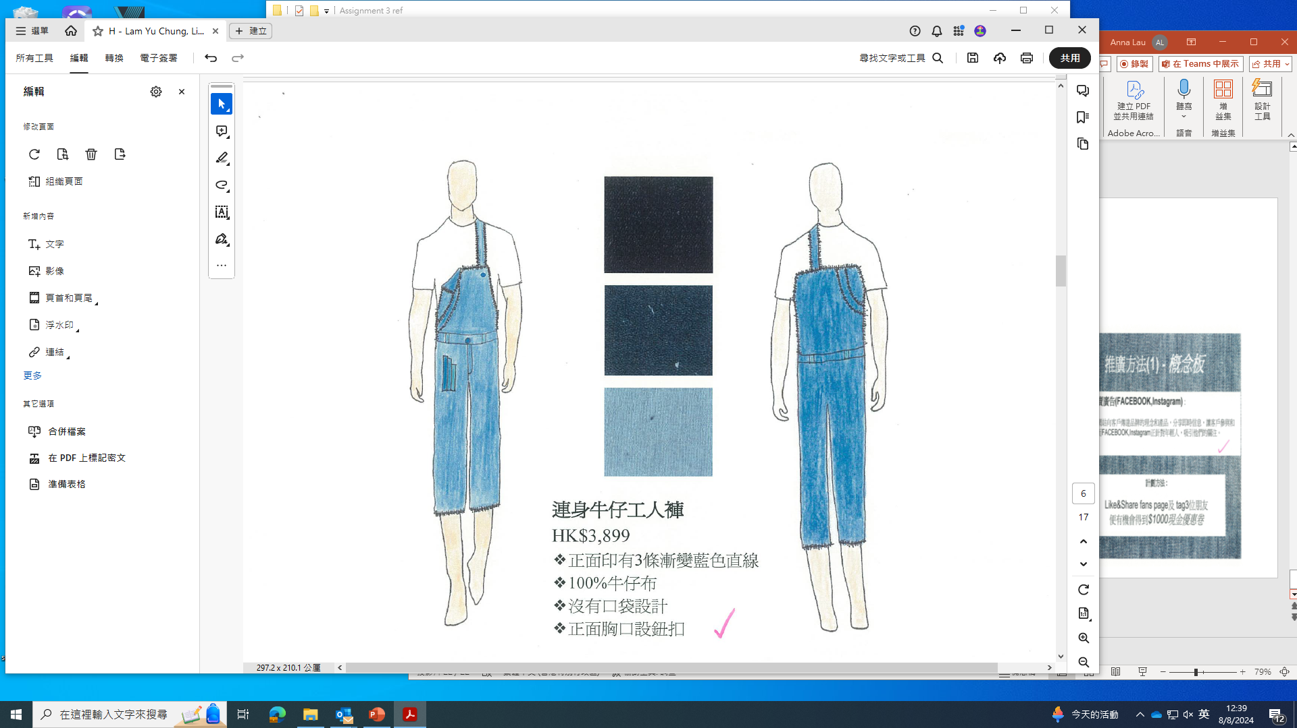
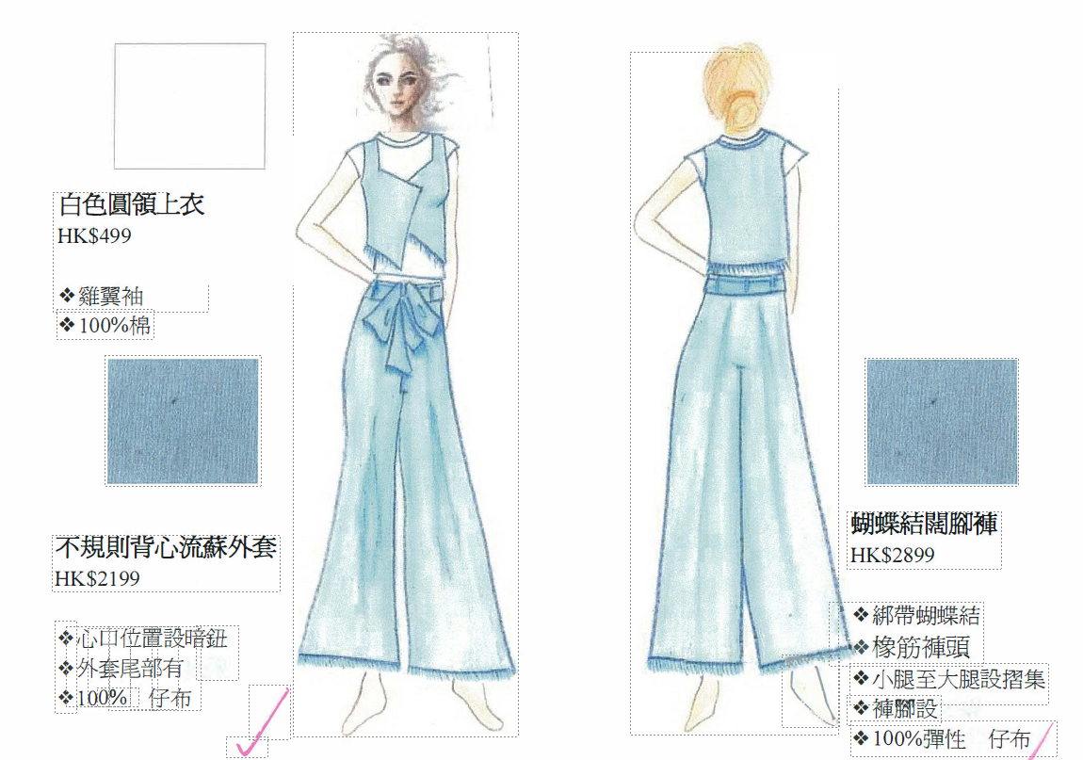
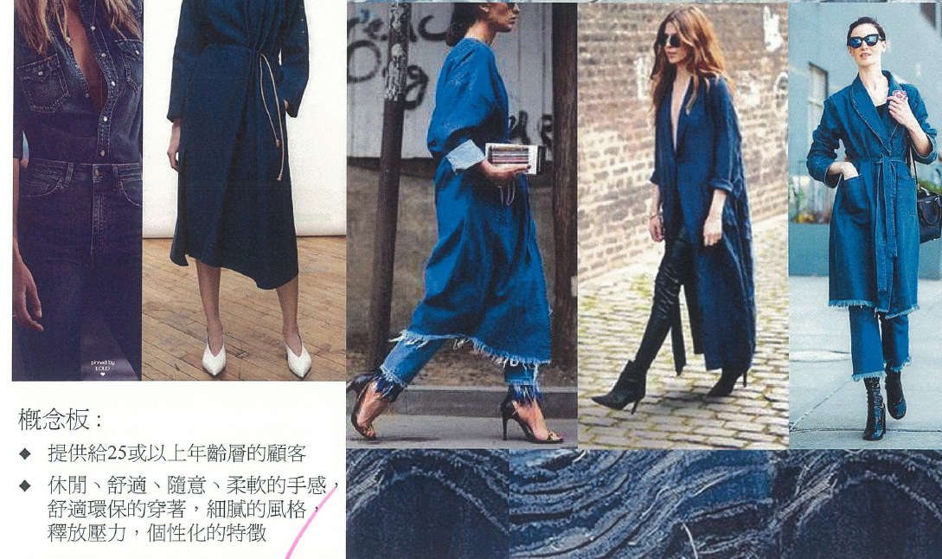
Example: Marketing Strategy
Works prepared by students in Diploma of Applied Education in
Fashion and Styling, Hong Kong Metropolitan University
Photo(s) is/are provided by the Clothing Industry Training Authority

Slide 21
References (Retrieved on Aug 13, 2024)
Dan Schawbel, Workplace Trends Forecast (https://danschawbel.com/)
Harry Foster, A Comprehensive Guide to 5 P's of Marketing (with Real-World Examples) (https://boardmix.com/)

