Slide 1
Parenting made easy: How to handle children’s misbehaviour?
Strand I: Understanding of Child Development
Parent Education Resource Package for Primary Schools

Slide 2
Outline
How to avoid misbehaviour?
Give clear and effective instructions
How to handle misbehaviour?
Show empathy before reasoning
Use “I” messages
Use the Inductive Discipline
Set reasonable consequences with children

Slide 3
What is misbehaviour?
When children behave inappropriately even though they have the ability to avoid behaving in that way:
Pushing others, destroying items
Making unnecessary noises, doing something that disturbs others
Making rude or provocative remarks
When children do not comply with adults’ expectations/ instructions even though they have the ability to:
Children refuse to go to bed or eat on time
Children refuse to go to class or greet others
Children refuse to take care of themselves (eat by themselves) or help others
Wakschlag, L. S., Briggs‐Gowan, M. J., Carter, A. S., Hill, C., Danis, B., Keenan, K., ... & Leventhal, B. L. (2007). A developmental framework for distinguishing disruptive behavior from normative misbehavior in preschool children. Journal of Child Psychology and Psychiatry, 48(10), 976-987.

Slide 4
How to give clear and effective instructions?
Why do children disobey instructions?
They do not understand the instructions
They have forgotten the instructions

Slide 5
How to give clear and effective instructions?
“Do you want to put your toys away?”
“Please put the toys away.”
“Don’t leave your toys everywhere!”
“Please put the toys back where they belong.”
“Please put your toys away.”
“Please put the toys back in the boxes.”
“Please put all the toys back in the boxes.”
“Please put the car back in the red box.” (After the child completes this instruction) “You placed it neatly! Now put the Lego back in the yellow box.”
McNeil, C. B., & Hembree-Kigin, T. L. (2010). Parent-child interaction therapy. Springer.

Slide 6
How to give clear and effective instructions?
Parents need to remember to:
Use descriptive sentences when giving instructions
Give positive instructions (tell your child what to do, not what not to do)
State your expectations
Break down more complex instructions step-by-step
Use an affirmative tone
Keep the content concise (avoid adding unnecessary content when giving instructions, such as: “You did well a few days ago, so why did you forget it today?”)
McNeil, C. B., & Hembree-Kigin, T. L. (2010). Parent-child interaction therapy. Springer.

Slide 7
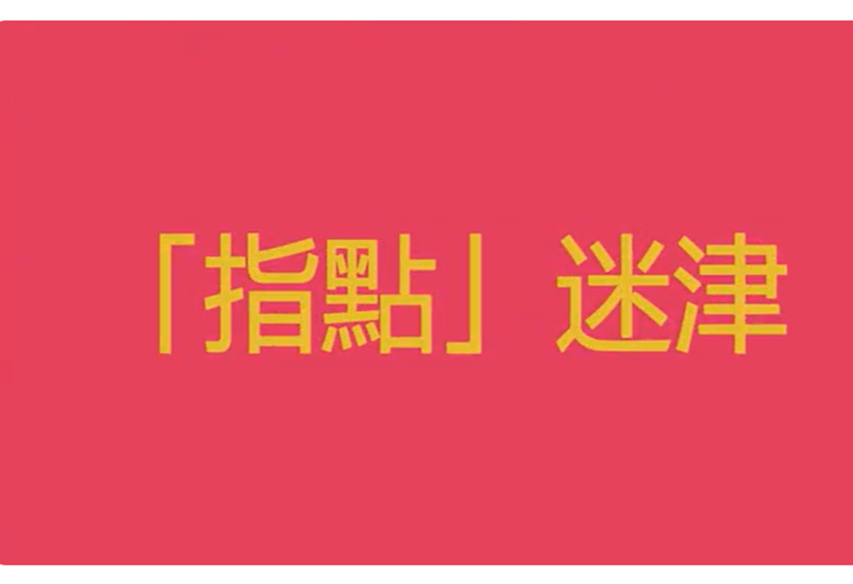
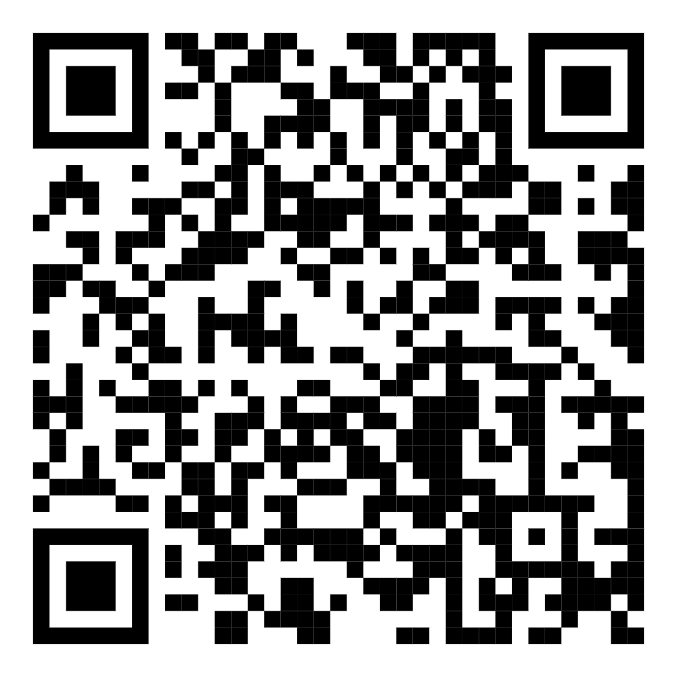
How to give clear and effective instructions?
Am I Clear
Watch the video
Notes:
播放短片：https://www.youtube.com/watch?v=DWZtg6y_Isk

Slide 8
How to give clear and effective instructions?
Arouse motivation
Give options
Make early preparation
Encourage thinking
Lam, C.B., Cheung, Y.M. (2022). Spending Time with Children—100 Tips for Happy Parenting. Ming Cheung Publications.

Slide 9
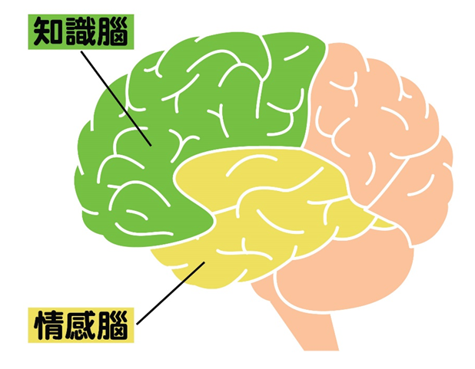
How to give clear and effective instructions?
Children may misbehave because they have not thought things through, so parents need to encourage children to think.
Our brains consists of two parts:
The comparatively impulsive and primitive emotional brain
The comparatively rational and advanced rational brain
When the rational brain takes control over the emotional brain, our impulses, emotions and behaviour are controlled in a rational manner. In contrast, when the emotional brain takes control over the rational brain, we will do things without thinking.
Rational brain
Emotional brain
Siegel, D. J. (2020). The developing mind: How relationships and the brain interact to shape who we are. Guilford Publications.

Slide 10
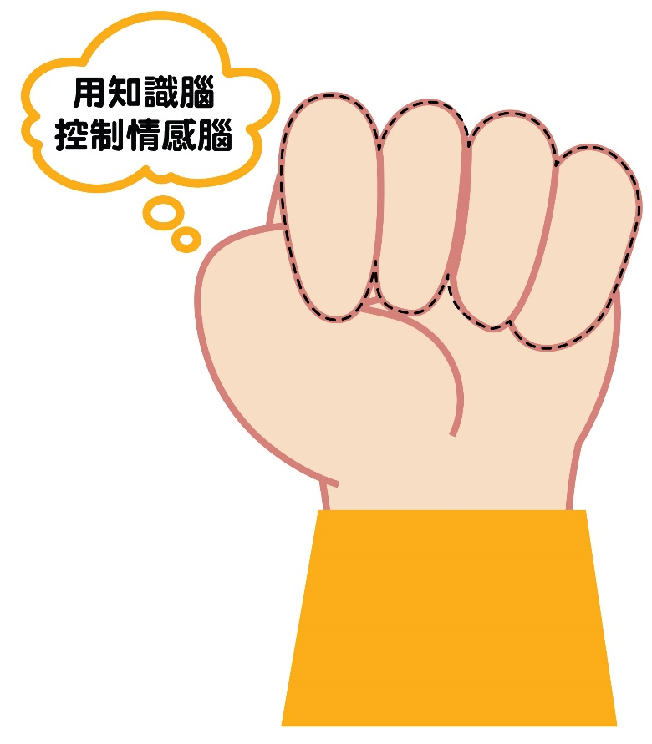
How to give clear and effective instructions?
We can use our fist to visualise this combination: with the thumb representing the emotional brain and other fingers representing the rational brain. The fist-clenching action can be used to remind them to control their emotional brain with their rational brain and think before they act!
Control the emotional brain with the rational brain
Rational brain
Emotional brain
Siegel, D. J. (2020). The developing mind: How relationships and the brain interact to shape who we are. Guilford Publications.

Slide 11
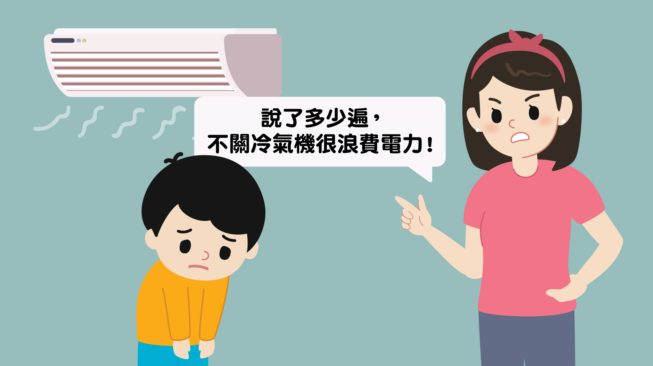
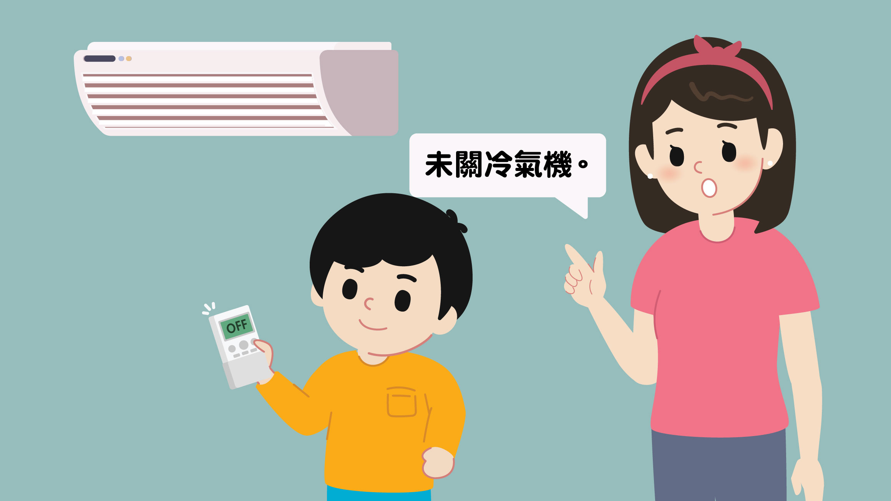
How to give clear and effective instructions?
How many times have I told you! It’s a waste of electricity if you don’t turn off the air conditioner!
The air conditioner is still on.
Objective descriptions
Faber, A., & Mazlish, E. (2012). How to talk so kids will listen & listen so kids will talk. Simon and Schuster.

Slide 12
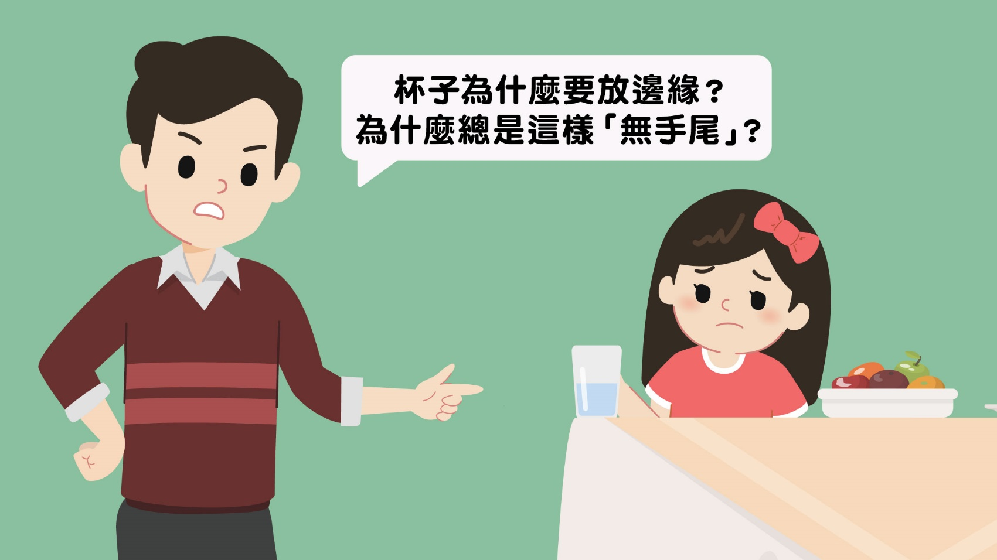
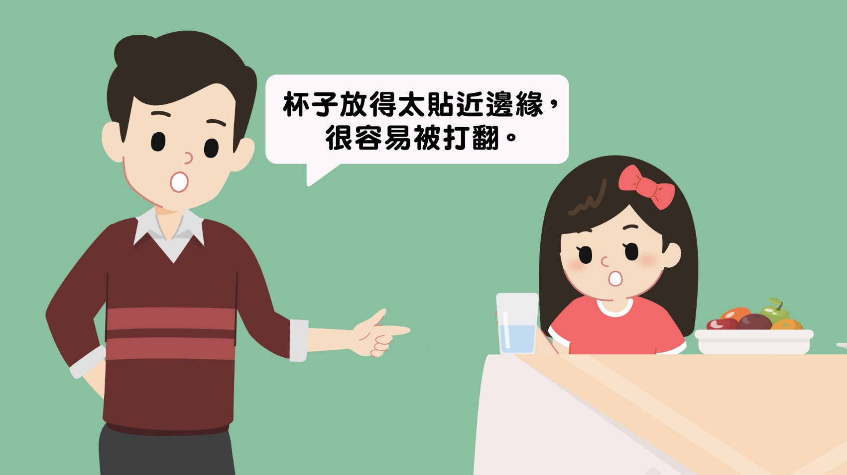
How to give clear and effective instructions?
Why do you always put your cup at the edge of the table? Why do you never clean up after yourself?
It’s really easy to knock over the cup if it is too close to the edge of the table.
Provide information
Faber, A., & Mazlish, E. (2012). How to talk so kids will listen & listen so kids will talk. Simon and Schuster.

Slide 13
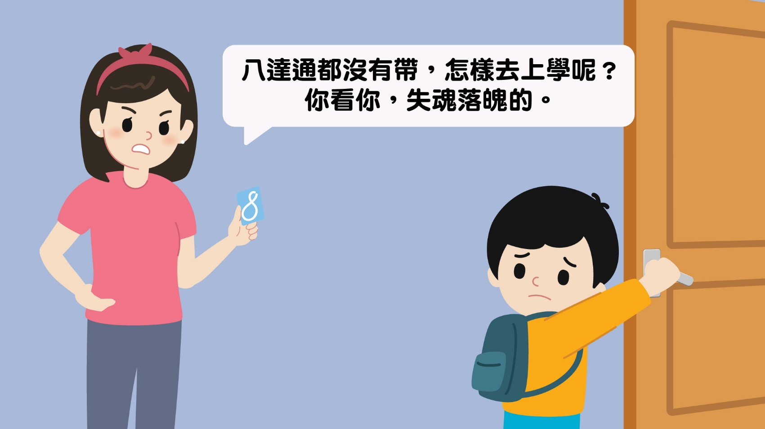
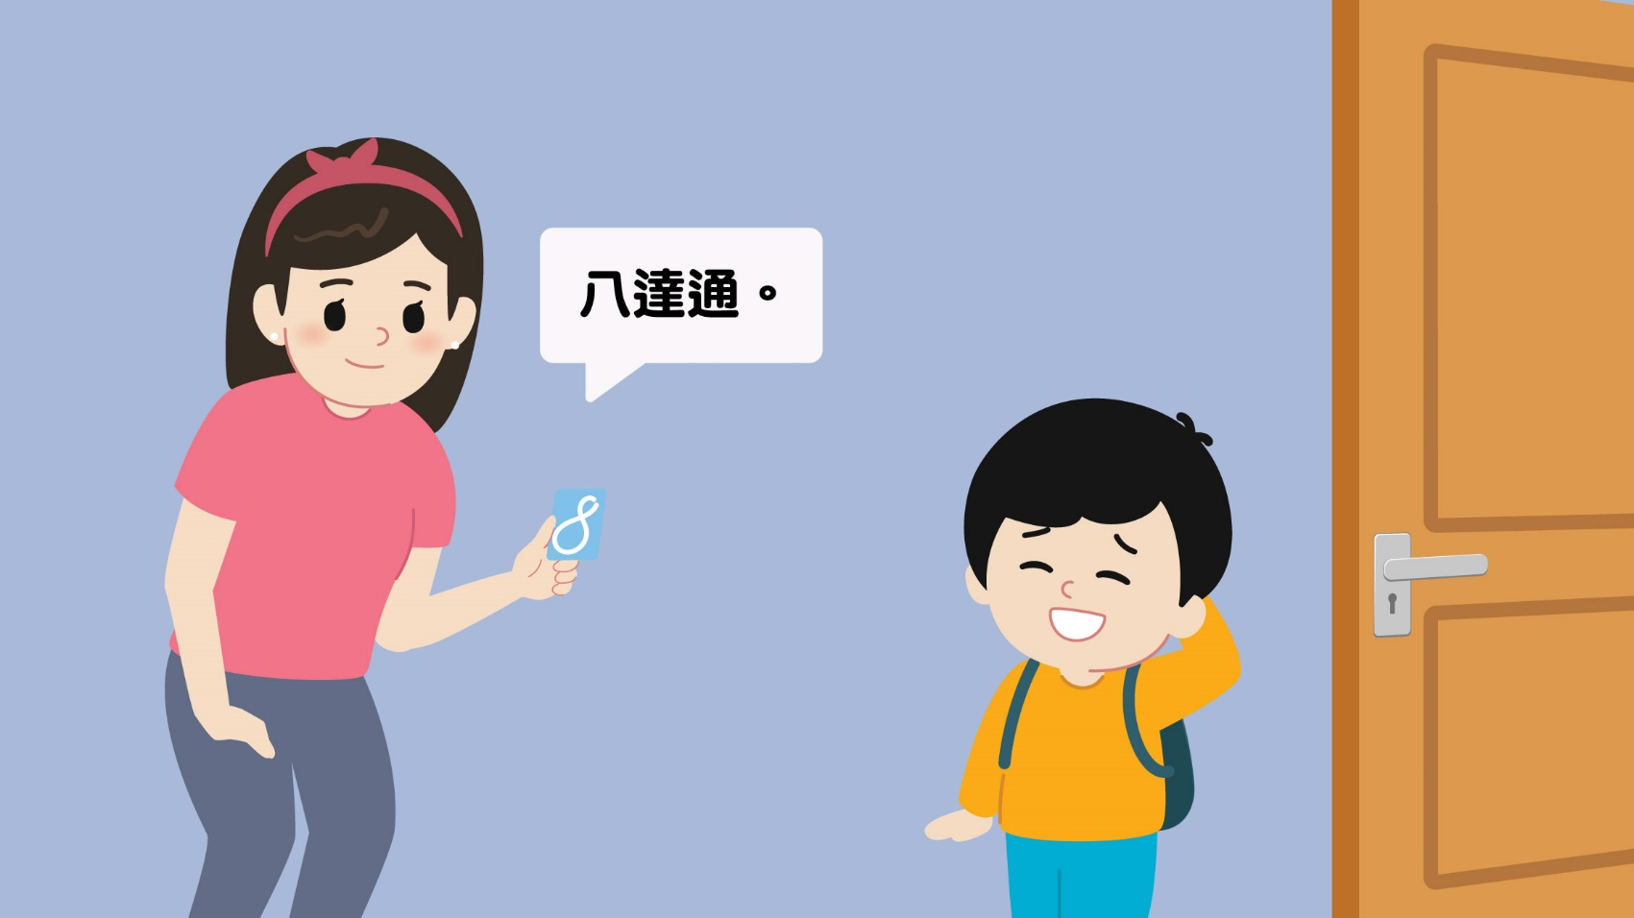
How to give clear and effective instructions?
You forgot your Octopus card. How will you get to school if you don’t have it? You’re always so clueless.
Here’s your
Octopus card.
Use words
Faber, A., & Mazlish, E. (2012). How to talk so kids will listen & listen so kids will talk. Simon and Schuster.

Slide 14
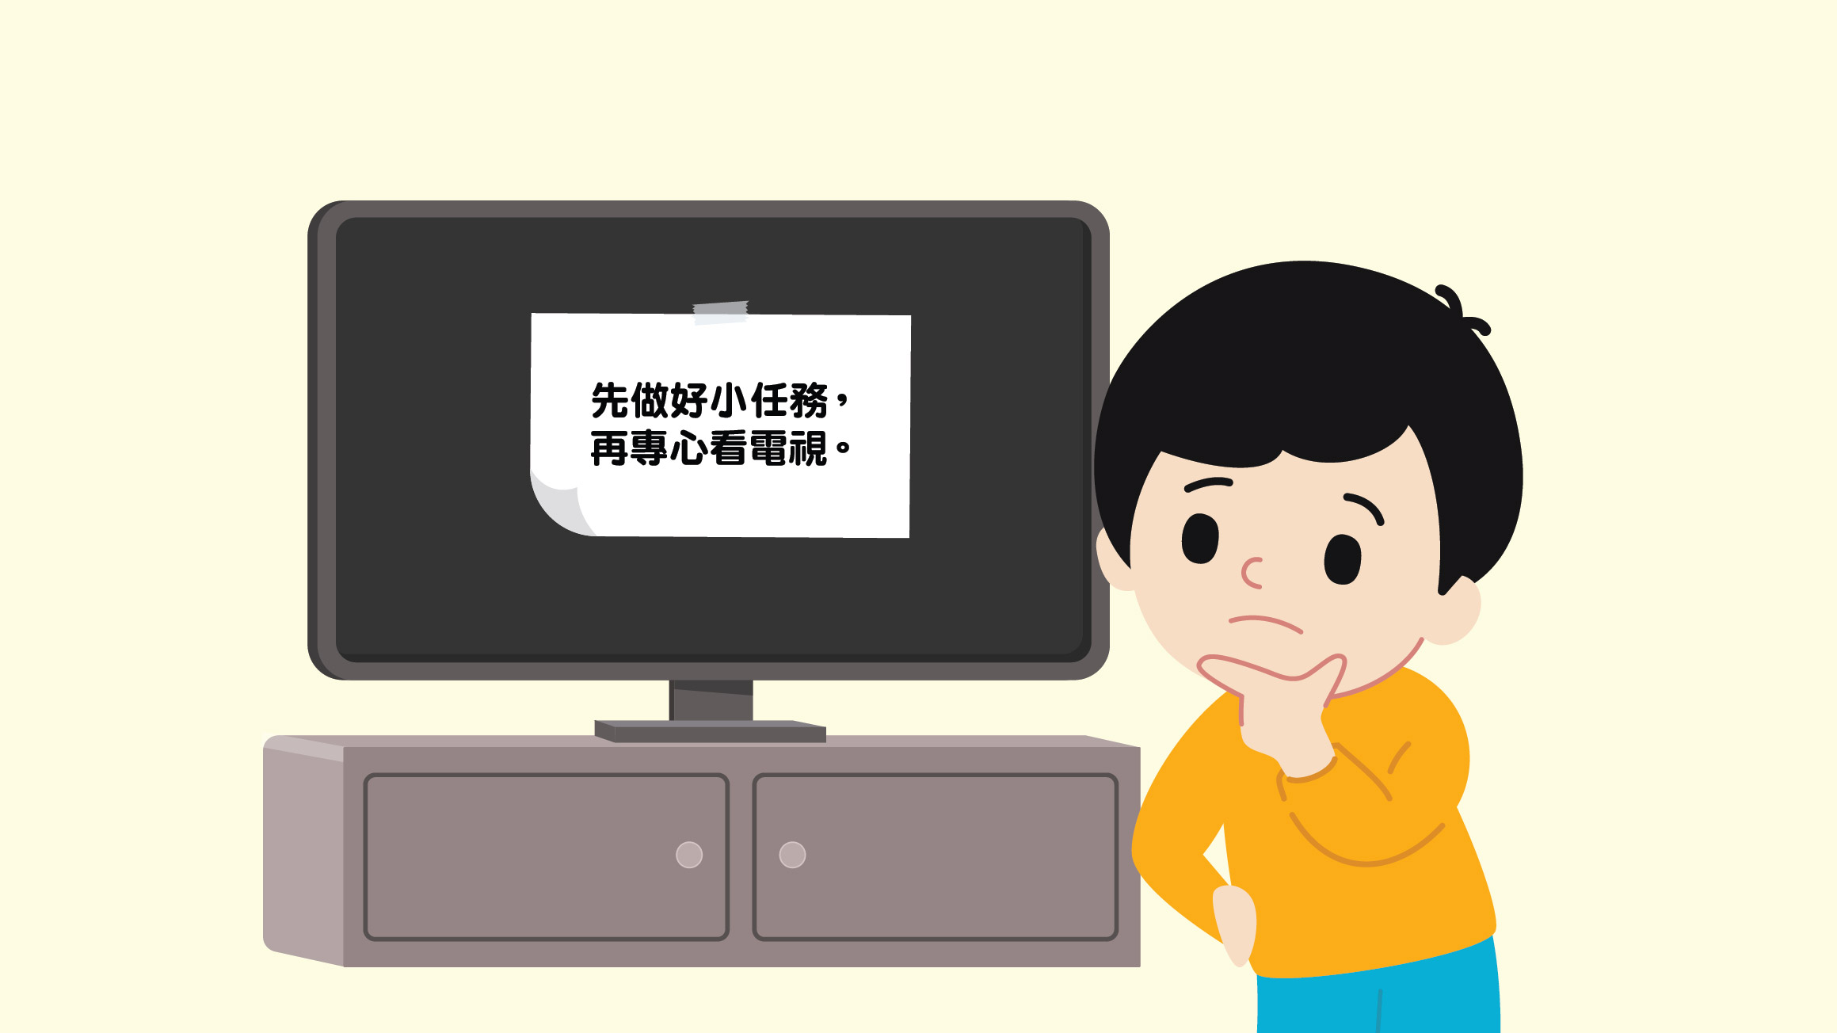
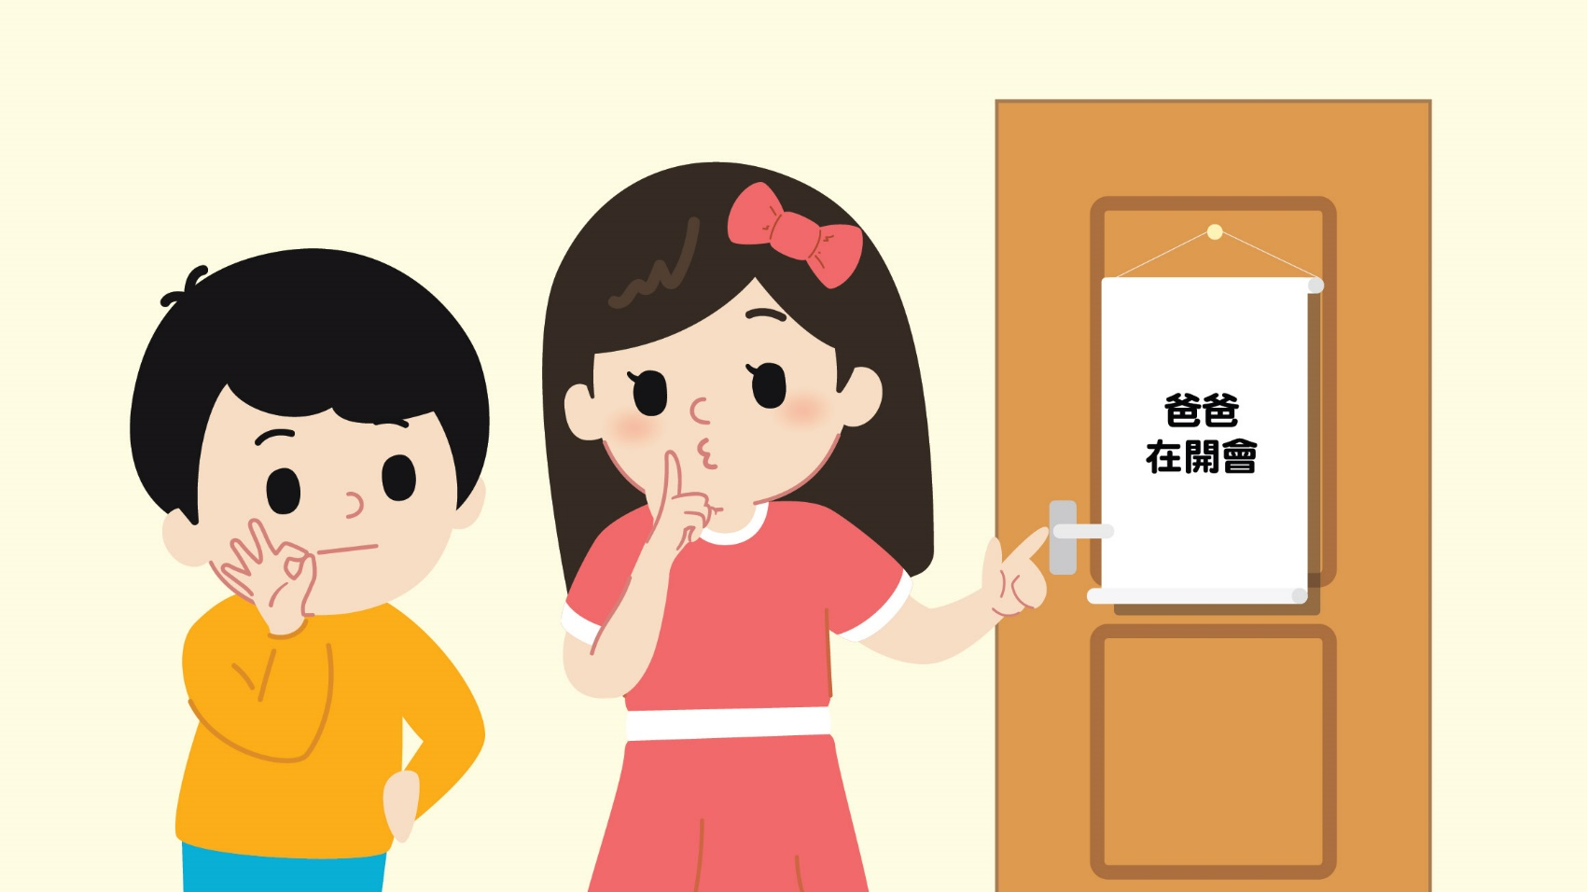
How to give clear and effective instructions?
You can watch TV after you finish your tasks
Daddy is in a meeting
Use text
Faber, A., & Mazlish, E. (2012). How to talk so kids will listen & listen so kids will talk. Simon and Schuster.

Slide 15
Before handling misbehaviours
Show empathy
Before reasoning
Help children review what has happened
This makes children more receptive to what you say
The benefits of showing empathy first

Slide 16
How to show empathy?
Asking questions | Reflecting on content | Reflecting on negative emotions
Ask open questions 5 W 1H Who What When Where Why How | Summarising what the child said in your own words and saying it out loud | Impatient Angry Hateful Jealous Unfair Others were wrong first | Fear Nervous Panic Surprised Distracted Defeated Confused
Jones, S. M., Bodie, G. D., & Hughes, S. D. (2019). The impact of mindfulness on empathy, active listening, and perceived provisions of emotional support. Communication Research, 46(6), 838-865.

Slide 17
The brothers had a fight, the mother asks the older brother questions first:
Mother: “What happened just now?” (Asking questions)
Older brother: “My brother snatched my toy! I was playing with it first!”
Mother: “Your brother snatched your toy when you were playing with it, and you want to take it back, right?” (Reflecting on content, asking questions)
Older brother: “Yes! I already asked him to give it back to me, but he just won’t!”
Mother: “He wouldn’t give the toy back to you even though you asked him to. Is that why you are impatient and angry?” (Reflecting on content, reflecting on negative emotions, asking questions)
Older brother: “Yes! I just want to get back my toy!”
Mother: “Your brother snatched your toy and wouldn’t give it back to you even though you asked him to. You felt impatient and angry, so you tried to get it back. Did you hit your little brother?” (Reflecting on content, reflecting on negative emotions, asking questions)
Older brother: “I… I didn’t mean to hit him. I just wanted to get back my toy…”
Mother: “I understand, you just wanted to get back the toy, but you accidentally hit your little brother. What happened after that?” (Reflecting on content, asking questions)

Slide 18
How to use “I” messages?
Pay attention to the following sentences. How do they make you feel?
“You’re really lazy!”
“You’re always putting your toys everywhere!”
“You never help mum and dad with anything!”
“You must study before you are allowed to play with your toys!”
“Everyone knows that you’re the smartest one in the family!” (sarcastic tone)
Black or white thinking
Absolute authority
Sarcasm
Erford, B. T. (2010). I-messages. 35 techniques every counselor should know. Pearson.

Slide 19
How to use “I” messages?
Steps | Example 1
When… (Objectively describes the child’s misbehaviour) | When you said you were full after taking two bites,
I felt… (Describes your feelings) | I felt a little worried.
Because… (Describes the negative impact of the misbehaviour as perceived by you) | Because your growth and development might be affected.
I hope you can… (State your expectations) | I hope you can eat at least one bowl of rice.
Erford, B. T. (2010). I-messages. 35 techniques every counselor should know. Pearson.

Slide 20
How to use “I” messages?
Steps | Example 2
When… (Objectively describes the child’s misbehaviour) | When you sneaked off to play before finishing your homework,
I felt… (Describes your feelings) | I felt a little disappointed.
Because… (Describes the negative impact of the misbehaviour as perceived by you) | Because this incident might affect the trust between us.
I hope you can… (State your expectations) | I hope you can follow the rules we set together.
Erford, B. T. (2010). I-messages. 35 techniques every counselor should know. Pearson.

Slide 21
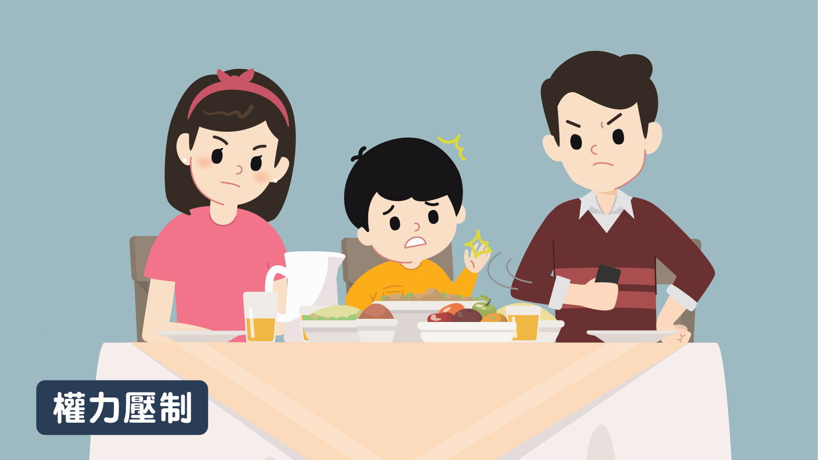
Ways to handle misbehaviours
整天只懂得玩手機﹗一點禮貌都沒有﹗不准玩﹗以後都不准玩手機﹗下星期的旅行活動亦取消﹗
You’re always on your phone! You’re so rude! You’re not allowed to use it! I won’t let you play on your phone anymore! Our trip next week will also be cancelled!
子女的感覺是…？
How do you think the child will feel?

Slide 22
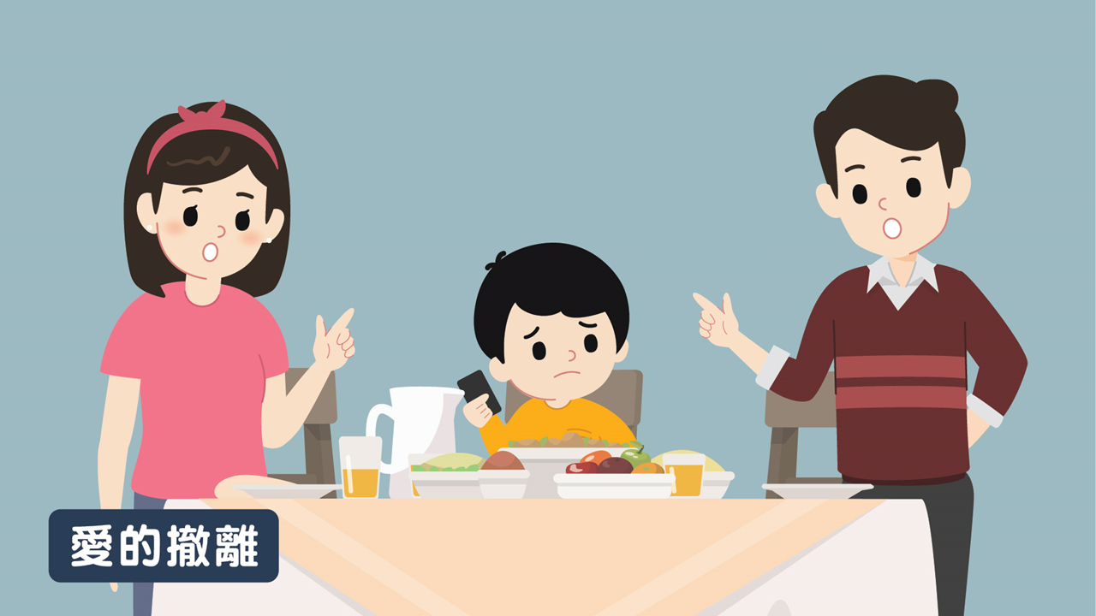
Ways to handle misbehaviours
Mummy and daddy will never have dinner with you again. We won’t play with you either. You’re always on your phone anyway.
爸爸媽媽以後都不和你吃飯了，以後都不和你玩了，反正你只會玩手機。
子女的感覺是…？
How do you think the child will feel?

Slide 23
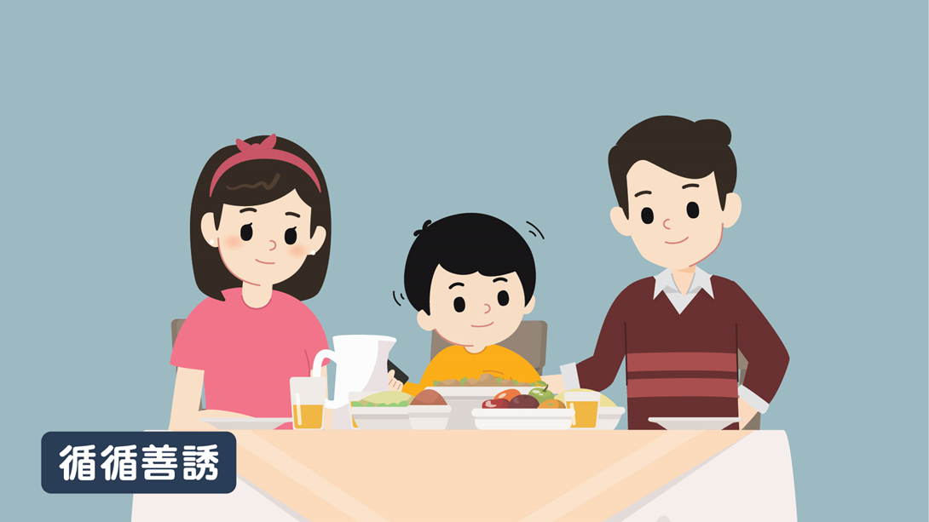
Ways to handle misbehaviours
You shouldn’t play on your phone during meals because the people who are eating with you will feel disrespected and think that you don’t want to eat with them. If you want to have more fun while we’re eating, you can tell us about interesting things that happened at school.
你在食飯時只顧著玩手機是不對的，因為和你一起吃飯的人會覺得你不尊重他們，覺得你不想和他們一起吃飯。如果你想吃飯時間感到多一點樂趣，你可以和爸爸媽媽說說學校發生的事情。
子女的感覺是…？
How do you think the child will feel?

Slide 24
How to use the inductive discipline?
Point out the child’s misbehaviour
Point out how this misbehaviour affects others
Understand the rationale behind and then point out how the child can achieve the same goal through a positive behaviour
(For more serious misbehaviour, such as when a child hurts someone else) Point out how the child can make up for the mistake
Patrick, R. B., & Gibbs, J. C. (2012). Inductive discipline, parental expression of disappointed expectations, and moral identity in adolescence. Journal of Youth and Adolescence, 41, 973-983.

Slide 25
How to use the inductive discipline?
Steps | Example 1 (mother says to the child)
Point out the child’s misbehaviour | “You shouldn’t have yelled at your father just now.
Point out how this misbehaviour affects others | Because he would feel disrespected and very sad.
Understand the rationale behind and then point out how the child can achieve the same goal through a positive behaviour | If you felt that he didn’t understand what you were thinking, you could have told him that or told me that first.
Point out how the child can make up for the mistake | I hope you can apologise to him now.”
Patrick, R. B., & Gibbs, J. C. (2012). Inductive discipline, parental expression of disappointed expectations, and moral identity in adolescence. Journal of Youth and Adolescence, 41, 973-983.

Slide 26
How to use the inductive discipline?
Steps | Example 2
Point out the child’s misbehaviour | “You shouldn’t have pushed your little brother.
Point out how this misbehaviour affects others | Because he would feel scared and might even get hurt.
Understand the rationale behind and then point out how the child can achieve the same goal through a positive behaviour | If you felt that he was in your way and making it hard for you to concentrate on your work, you could have told him to give you more space or you could have told me about it.
Point out how the child can make up for the mistake | I hope you can apologise to him now.”
Patrick, R. B., & Gibbs, J. C. (2012). Inductive discipline, parental expression of disappointed expectations, and moral identity in adolescence. Journal of Youth and Adolescence, 41, 973-983.

Slide 27
How to set consequences for children?
Characteristics of reasonable consequences:
Related: It is directly related to the misbehaviour
Reasonable: It is proportional to the severity of the misbehaviour
Respectful: It is respectful to the child
Deutch, J. A. (2012). The respectful parent: A manual for moms and dads. Xlibris Corporation.

Slide 28
How to set consequences for children?
A child did not complete his/her homework because he/she was procrastinating, so the parents cancelled the family play time for that day.
This consequence is directly related to the child’s behaviour (there is no time to play because the child did not complete the homework in time) and is proportional to the severity of the misbehaviour (because the parent only cancelled the activity for that day and not for other days). Parents do not need to beat, scold or be sarcastic to their children (which shows them respect) because they have already borne the consequences of their own behaviour.
Deutch, J. A. (2012). The respectful parent: A manual for moms and dads. Xlibris Corporation.

Slide 29
Conclusion
When giving instructions, remember to:
Use descriptive sentences
Give positive instructions
Break down more complex instructions step-by-step
Make instructions to be more pleasing to the ear
When reminding children, remember that less is more
Use active listening to show empathy
Use “I” messages to express your feelings
Use the inductive discipline to help children understand how they might have hurt others
Set related, reasonable and respectful consequences for children

