Slide 1
Building bright minds: How to support children’s cognitive development?
Strand II: Promotion of Healthy, Happy and Balanced Development of Children
Parent Education Resource Package for Primary Schools

Slide 2
Outline
Understanding a growth mindset and its importance
Understanding how to cultivate a growth mindset in yourself and your children
Acquiring the skills of helping children face learning challenges with a growth mindset

Slide 3
Benefits of a growth mindset on children’s development
Based on 53 experimental studies published between 2002 and 2020, researchers found that:
Strengthening the growth mindset
Academic performance ⬆
Psychological health ⬆
Burnette, J. L., Billingsley, J., Banks, G. C., Knouse, L. E., Hoyt, C. L., Pollack, J. M., & Simon, S. (2023). A systematic review and meta-analysis of growth mindset interventions: For whom, how, and why might such interventions work? Psychological Bulletin, 149(3-4), 174–205.

Slide 4
Cultivating a growth mindset in parents and children
Growth mindset: Believes that ability is developed through experiences, efforts and strategies.
Fixed mindset: Believes that ability is determined by genes, talents and potentials.
Yeager, D. S., & Dweck, C. S. (2020). What can be learned from growth mindset controversies? American Psychologist, 75(9), 1269–1284.

Slide 5
Cultivating a growth mindset in parents and children
 | People with a growth mindset | People with a fixed mindset
Talent | Believe that talent is the result of learning and practice. Capable people are capable because they have put in a lot of effort. | Believe that talent is a gift. Capable people are born that way.
Effort | Believe that effort is the path to success. Effort is a kind of learning. Effort is valuable. | Believe that hard work is likely in vain. Even though working hard, they will not success, why need to try hard?
Lam, C.B., Cheung, Y.M. (2022). Spending Time with Children—100 Tips for Happy Parenting. Ming Cheung Publications.

Slide 6
Cultivating a growth mindset in parents and children
 | People with a growth mindset | People with a fixed mindset
Other people’s opinions | Believe that other people’s opinions can make them improve, so they will deliberately ask people for their opinions (e.g. Is there any way I can do better?). | Believe that other people are criticising them when they give opinions. This makes them feel embarrassed so they deliberately avoid other people’s opinions.
Other people’s success | Believe that successful people have put in a lot of time and effort. They are really curious about what people have learnt while doing something and really want to hear the sharing from these successful people. | Believe that they are inferior to successful people. To maintain their self-esteem, they will deliberately avoid successful people.
Lam, C.B., Cheung, Y.M. (2022). Spending Time with Children—100 Tips for Happy Parenting. Ming Cheung Publications.

Slide 7
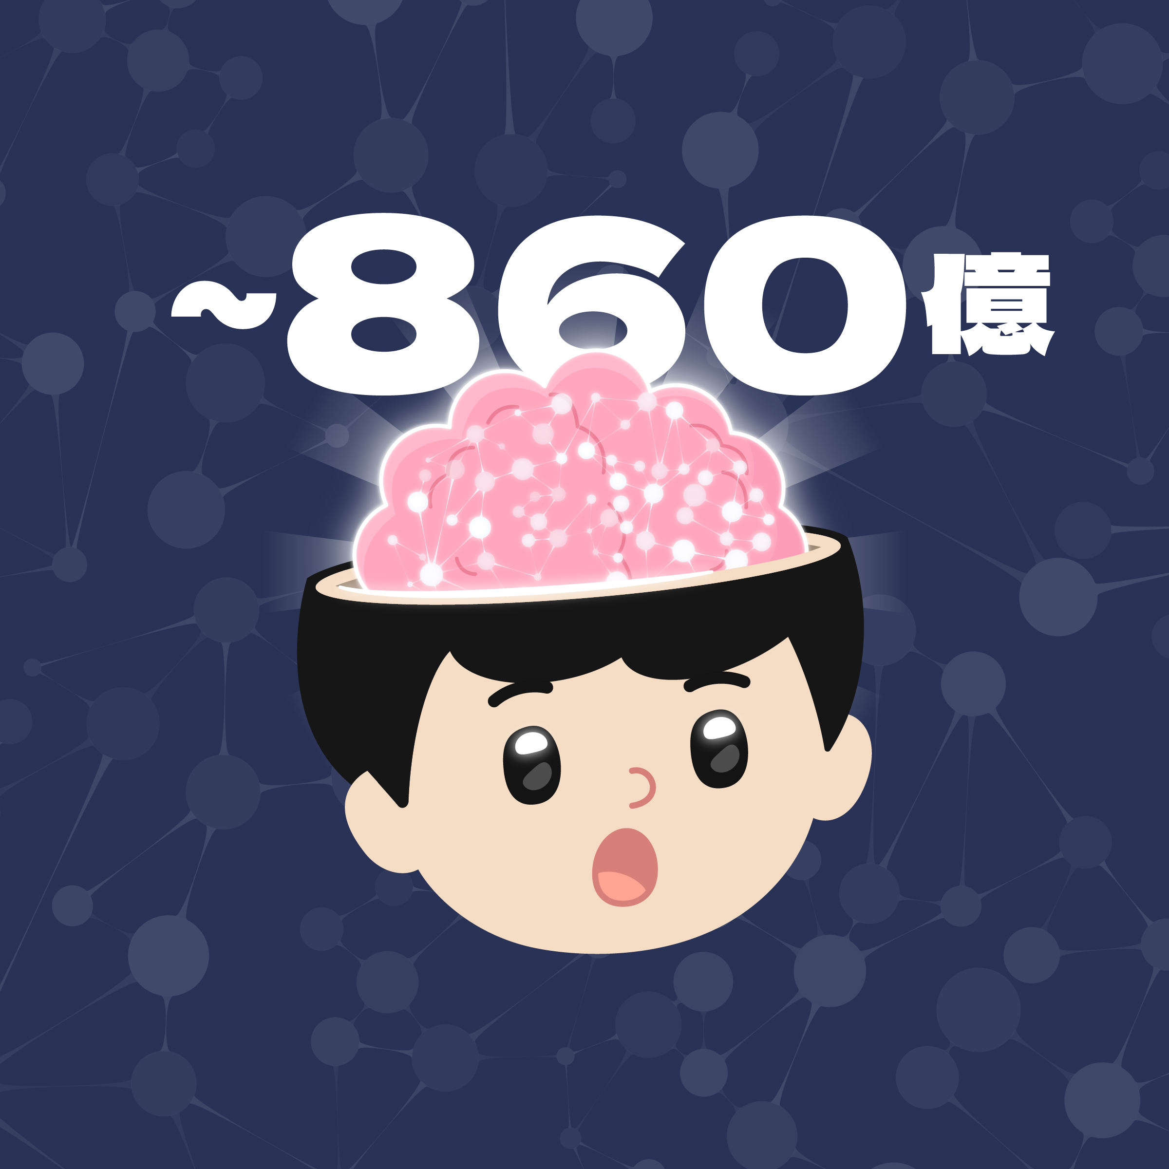
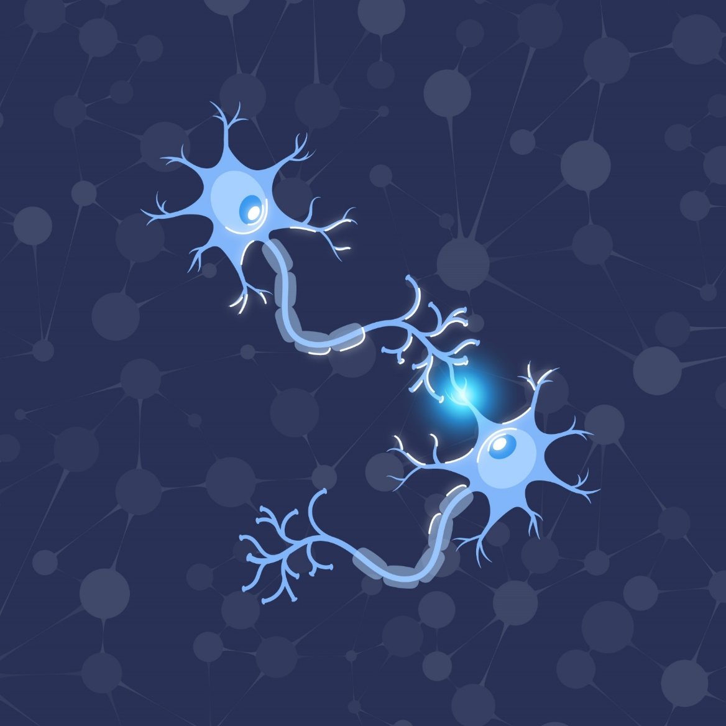
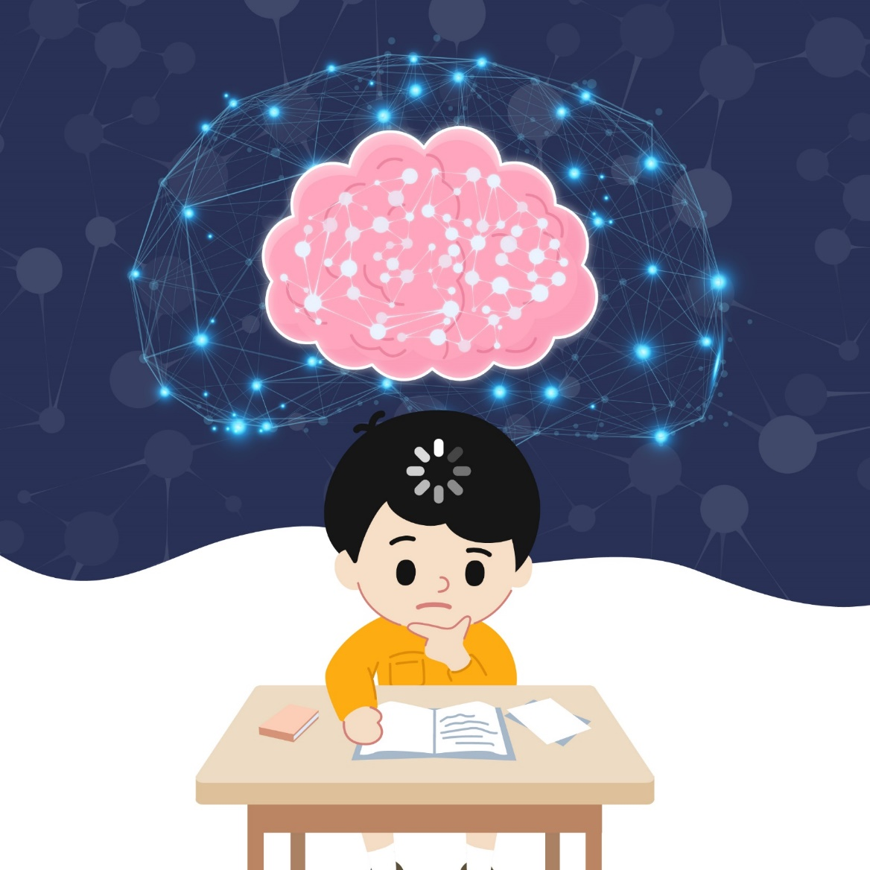
Explaining what a growth mindset is to children
(1) The brain has many brain cells. Research shows that each person’s brain has about 86 billion brain cells^{1.}
(2) Brain cells are connected by synapses, which function like telephone lines and allow brain cells to communicate with each other.
(3) When we concentrate on doing things, work hard and think carefully about how to do things better, we can help the brain build more synapses. The more synapses our brain cells have, the smarter and more capable we will become.
¹Azevedo, F. A., Carvalho, L. R., Grinberg, L. T., Farfel, J. M., Ferretti, R. E., Leite, R. E., ... & Herculano‐Houzel, S. (2009). Equal numbers of neuronal and nonneuronal cells make the human brain an isometrically scaled‐up primate brain. Journal of Comparative Neurology, 513(5), 532-541.

Slide 8
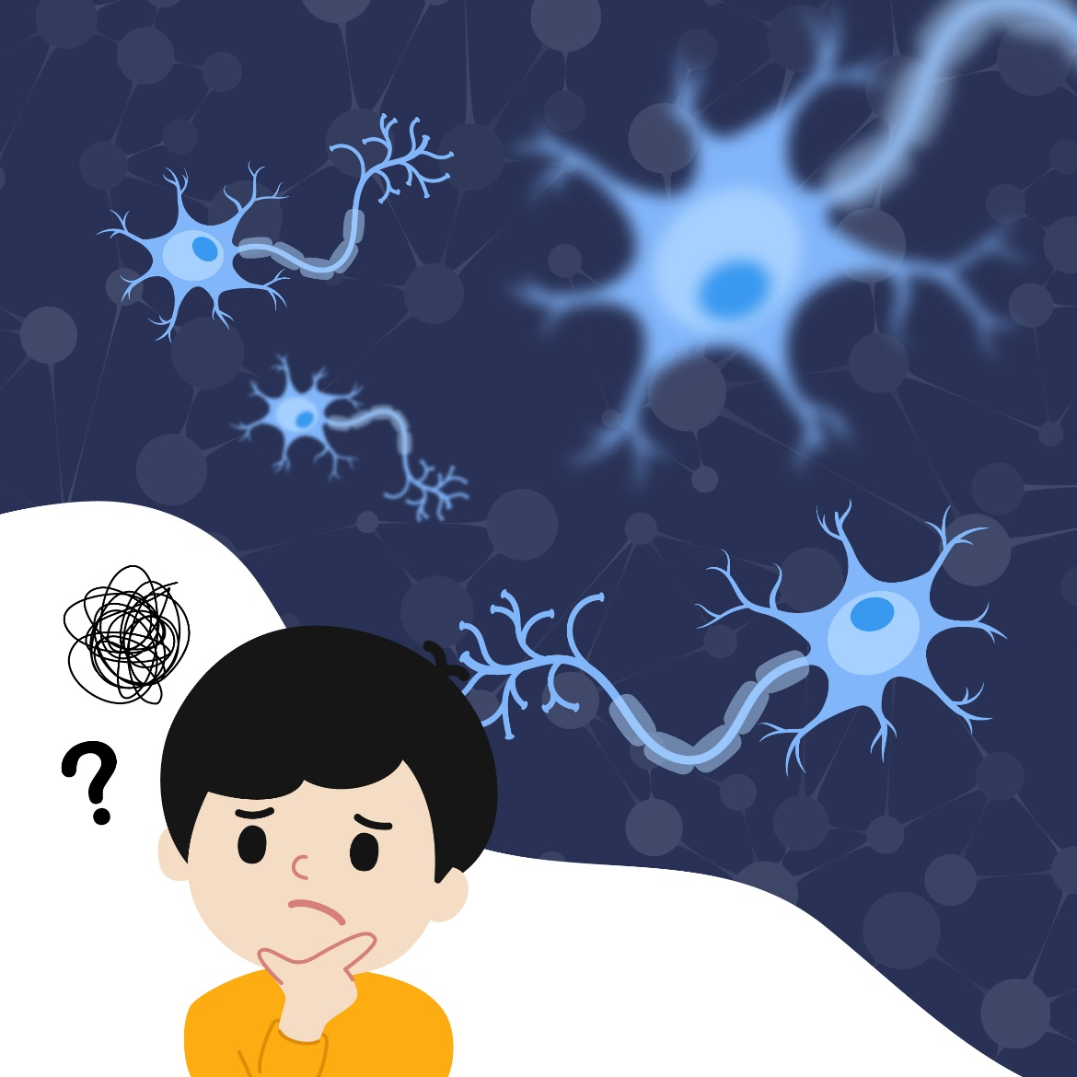
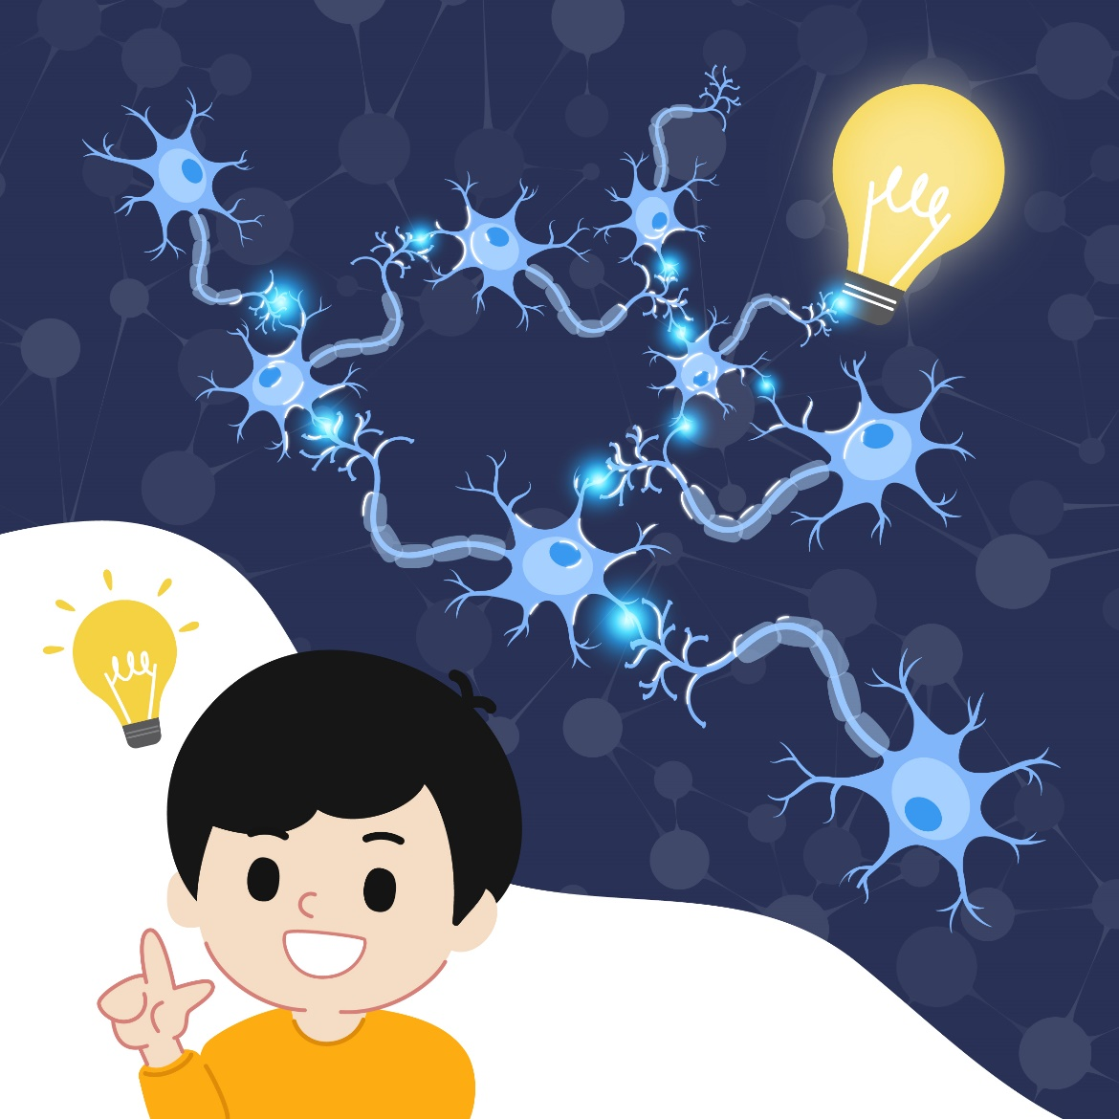
Explaining what a growth mindset is to children
(4) This process is just like lifting dumbbells to make our biceps bigger. The bigger and stronger your biceps, the stronger and more powerful you will become.
(5) The reason why we do not know how to do certain things is because our brain cells have not established the relevant connections yet.
(6) As long as we try hard, practice hard and think hard, our brain cells will slowly establish these connections, and we will slowly learn to do these things.

Slide 9
Cultivating a growth mindset in parents and children
Ask parents to write down one thing they have learnt to do now that they could not do one year ago:

Slide 10
Cultivating a growth mindset in parents and children
When talking to children, parents can try to say the following:
“You haven’t learnt this equation yet...”
“Is this question difficult to you? That means your brain cells are working hard to establish the connections you need!”
“I remember you didn’t... but now you...”
“I think your strategy is great...”

Slide 11
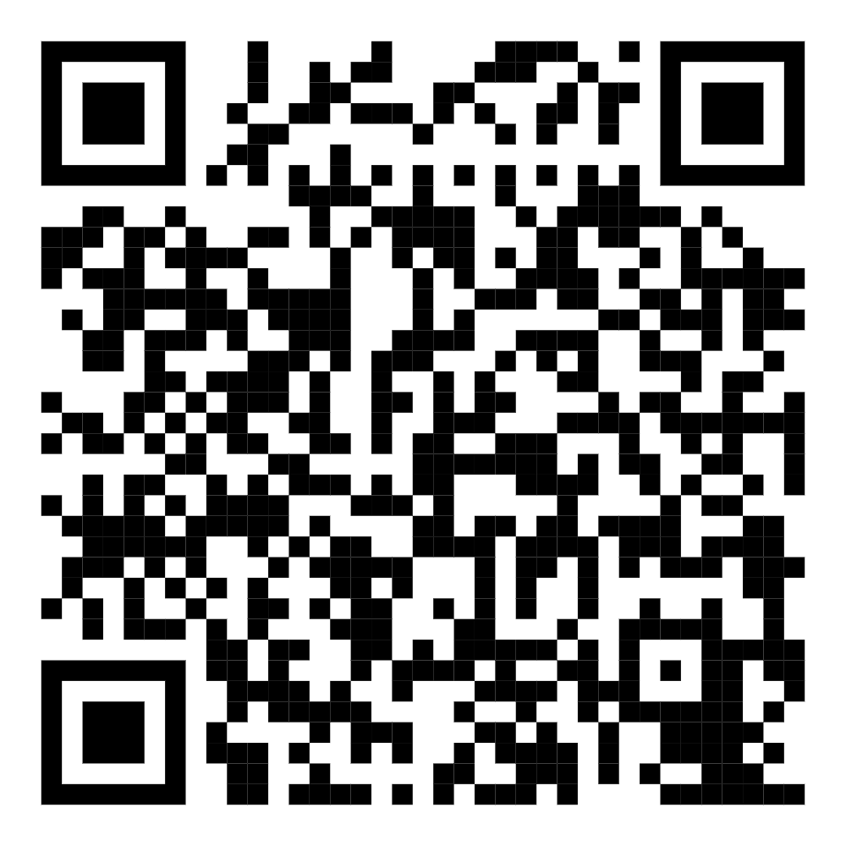
Cultivating a growth mindset in parents and children
Do You “Mind”?
Watch the video
Notes:
Play the short video: https://https://youtu.be/mBxIkosXBNo

Slide 12
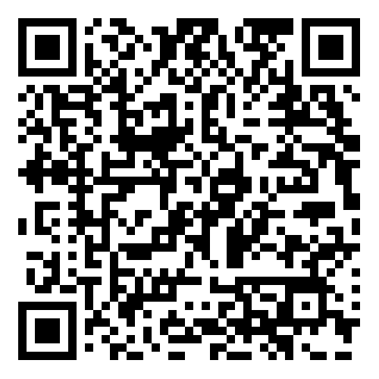
Cultivating a growth mindset in parents and children
How did Yu Chui Yee face difficulties and overcome failure to achieve her short-term and long-term goals?
Positive Parenting Encourages Growth: Yu Chui Yee Overcoming Difficulties in Life
Watch the video
Notes:
Play the short video: https://www.parent.edu.hk/smart-parent-net/topics/article/yu-interview

Slide 13
Ask guiding questions to help children understand a growth mindset
What were Yu Chui Yee’s goals and aspirations?
What difficulties did Yu Chui Yee face?
What actions did Yu Chui Yee take to achieve her goals?
Did Yu Chui Yee try hard, practice hard and think hard?

Slide 14
Things to consider when selecting a person
Consider children’s age and interests
Consider the source, length and completeness of information
Do not talk only about the person’s setbacks and failures
Help children think about how this person achieved his/her goals with his/her experiences, efforts and strategies

Slide 15
Parents’ attitude when sharing stories of a person with children
Help children put themselves in the shoes of the person being discussed when thinking about the pressures and negative feelings he/she would have experienced
Allow children to express their own ideas and do not rush to teach them. Parents can use concise words to reflect their children’s ideas and let them summarise their own ideas as far as possible in the course of discussion:
Child: “I don’t understand why she didn’t give up and do something else.”
Parent: “You’re confused because you don’t understand why she tried so hard and didn’t give up.”
Child: “Yes! What’s the point of working so hard?”
Parent: “Why do you think she put in so much effort?”
Make the stories of successful people connected with children’s daily lives

Slide 16
Making other people’s experiences connected with children’s daily lives
Everyone has faced setbacks and failures.
Discuss the following with your children:
Setbacks or failures experienced by you and your children
How you or your children overcame these setbacks and failures with your experiences, efforts and strategies

Slide 17
Helping children deal with expectations and challenges related to learning
Source of stress
Negative thoughts
Positive thoughts
Anxiety, panic or other negative emotions
Anticipation, excitement or other positive emotions
Worse performance
Better performance
Self-fulfilling prophecy
Crum, A. J., Salovey, P., & Achor, S. (2013). Rethinking stress: The role of mindsets in determining the stress response. Journal of Personality and Social Psychology, 104(4), 716–733.

Slide 18
Helping children deal with expectations and challenges related to learning
Feeling stressed about a test
Negative thoughts:
“Oh no! I’m so nervous!
Things are going to get worse!”
Positive thoughts:
“Awesome! I care about this test!
My body will give me the energy I need to overcome it!”
Stress is always bad
Stress makes me perform worse
Test is perceived as an uncontrollable threat
Test performance is bad
Stress is not necessarily bad
Stress can improve performance
Test is perceived as a controllable challenge
Test performance improves
Crum, A. J., Salovey, P., & Achor, S. (2013). Rethinking stress: The role of mindsets in determining the stress response. Journal of Personality and Social Psychology, 104(4), 716–733.

Slide 19
Helping children identify negative thoughts
Type | Children’s negative thoughts
1) Filtering | “Sigh! I studied so hard, but I still did so badly!”
2) Every time is the same | “I did so badly on this test, so how can I do well in the next one?”
3) Overgeneralisation | “I did badly in mathematics, so I will definitely do badly in English!”
4) Perfectionism | “There’s a grammatical mistake in this sentence!”
5) Minimising achievements | “I only did well in this test because I was lucky.”
Wong, F.K.D. (2017). Getting out of the abyss of depression: A cognitive therapy self help manual. Joint Publishing HK.

Slide 20
Helping children replace negative thoughts with positive thoughts
Positive thoughts with a growth mindset
“...I learnt...”
“Afterwards, I can...”
“...but that doesn’t mean...”
“Although..., ...”
“I did well this time because...”
Wong F.K. (2017). Getting out of the abyss of depression: A cognitive therapy self help manual. Joint Publishing HK.

Slide 21
Helping children replace negative thoughts with positive thoughts
Negative thoughts | Positive thoughts
“Sigh! I studied so hard, but I still did so badly!” | “I understand that you’re disappointed with the result of the test, but the process is also important. Why don’t we think about what we learnt while preparing for it?”
“I did so badly on this test, so how can I do well in the next one?” | “We learnt to be self-disciplined and how to manage our time while preparing for it. What else can we do to improve?”
“I did badly in mathematics, so I will definitely do badly in English!” | “Not doing well in mathematics doesn’t mean that you won’t do well in English.”
“There’s a grammatical mistake in this sentence!” | “Although there’s a grammatical mistake here, there aren’t any grammatical mistakes in the other sentences.”
“I only did well in this test because I was lucky.” | “You did really well in this test because you focused on it and studied very hard. You also spent a lot of time thinking about ways to do better.”
Wong F.K. (2017). Getting out of the abyss of depression: A cognitive therapy self help manual. Joint Publishing HK.

Slide 22
Conclusion
Understanding a growth mindset and its importance
People with a growth mindset believe that abilities are developed through learning and hard work
Understanding how to cultivate a growth mindset in yourself and your children
Understanding the relationship between experience, brain development and ability
Share the story of a successful person and review his/her growth experiences to help children develop a growth mindset
Acquiring the skill of helping children face learning challenges with a growth mindset
Help children identify negative thoughts
Help children replace negative thoughts with positive thoughts

