Slide 1
Teaching children to be active learners: How to support children in acquiring the generic skills for the 21st century?
Strand IV: Fostering Home-school Co-operation and Communication
Parent Education Resource Package for Primary Schools

Slide 2
Outline
Learning the importance of generic skills for the 21st century
Cultivating critical thinking skills in children
Cultivating creativity in children
Cultivating problem solving skills in children

Slide 3
The importance of generic skills for the 21st century
Generic skills for the 21st century are the skills needed to adapt to changes and face challenges.
These skills help children keep learning, improve themselves and solve problems through exploration, thinking, communication, co-operation, innovation and adaptability.
There are many types of generic skills, and various skills can be interrelated and share things in common. Three important generic skills are:
Critical thinking
Creativity
Problem solving
Trilling, B., & Fadel, C. (2012). 21st century skills: Learning for life in our times. John Wiley & Sons.

Slide 4
The importance of critical thinking
Critical thinking is the ability to process and analyse information to reach a conclusion and make decisions. Critical thinking can include:
Interpretation
Analysis
Inference
Evaluation
Explanation
Self-regulation
Critical thinking is crucial for handling complex problems and unknown situations and is hailed by scholars as one of the most important long-term goals of education.
ŽivkoviĿ, S. (2016). A model of critical thinking as an important attribute for success in the 21st century. Procedia-social and Behavioral Sciences, 232, 102-108.

Slide 5
Asking questions to help children learn to think critically
What is the difference between these two types of questions?
What day of the week is it today? | What means of transportation do you think is better to take to the park?
How do plants obtain nutrients? | If we were to go on a family trip, which place would be better?
What are the characteristics of mammals? | You save up your pocket money, how do you plan to use it in the future?
Why is the sky blue? | (Your child is unhappy with the ending of a cartoon) If you were the author, how would you change the ending?
In which period were dinosaurs active? | Do you think an e-book or a physical book is better?
Butterworth, J., & Thwaites, G. (2013). Thinking skills: Critical thinking and problem solving. Cambridge University Press.

Slide 6
Improving children’s critical thinking skills in daily life
Ask questions to make children think
“What are your thoughts on this issue?”
“Why do you think this way?” (Encourage children to explain)
“What do your thoughts reflect about what you value?” (Help children with self-adjustment)
“Where did you get this information? Is the source reliable?” (Help children evaluate the accuracy of information)
“Do you have any other thoughts?” (Help children make inferences)
Browne, M.N., & Keeley, S.M. (1998). Asking the right questions: A guide to critical thinking. Prentice Hall.

Slide 7
Improving children’s critical thinking skills in daily life
Mother: “What means of transportation do you think is better to take to the park?”
Child: “The MTR!”
Mother: “Why?” (Encourage the child to explain)
Child: “Taking MTR is the fastest way to get to the park.”
Mother: “So you think that getting to the park as quickly as possible is the most important thing. (Clarify what the child values and help the child adjust) We can search online for the fastest means of transportation to get to the park. (Help the child evaluate the accuracy of information)”
Child: “Oh! It’s actually faster to take the bus!”
Mother: “Your grandmother will be going to the park with us. What else do you think we should consider?” (Help the child make inferences)
Child: “Grandmother will probably want to sit down. Let’s catch the bus at the bus terminus. That way she will definitely be able to sit!”
Mother: “It looks like ensuring your family can sit comfortably is important to you too. (Clarify what the child values)”
Browne, M.N., & Keeley, S.M. (1998). Asking the right questions: A guide to critical thinking. Prentice Hall.

Slide 8
Improving children’s critical thinking skills through homework and learning
Type of question | Example | Targeted skill
Clarification | What is an electronic product? | Interpretation
Classification | Which of the following are electronic products? Which are non-electronic products?
Comparison | What are the similarities and differences between physical books and e-books?
Summarisation | According to this article, what are the benefits of using electronic products on child development? What are the downsides? | Analysis
Inference | Other than the arguments mentioned in the article, can you think of other benefits and disadvantages of using electronic products on child development? | Inference
Evaluation | It says here that children aged two to five should not use electronic products for more than one hour a day. What is the basis for this? Do you think this rationale supports the author’s argument? | Evaluation
ŽivkoviĿ, S. (2016). A model of critical thinking as an important attribute for success in the 21st century. Procedia-social and Behavioral Sciences, 232, 102-108.

Slide 9
Improving children’s critical thinking skills through homework and learning
Type of question | Example | Targeted skill
Conclusion | Do you think electronic products have more benefits than harms or more harms than benefits for child development? | Explanation
Explanation | Why?
Reflection | What do your thoughts reflect that you value more? Children’s physical health or children’s cognitive development? | Self-regulation
Deliberate objection | Suppose you meet someone who has the opposite opinion to you. What arguments do you think this person will put forward to oppose your conclusion? How would you respond?
ŽivkoviĿ, S. (2016). A model of critical thinking as an important attribute for success in the 21st century. Procedia-social and Behavioral Sciences, 232, 102-108.

Slide 10
Creative Thinking Exercise
Objective: Connect the 9 dots with 5 straight lines.
Rules: The tip of the pen/pencil cannot leave the paper during the process.

Slide 11
Creative Thinking Exercise
Objective: Connect the 9 dots with 5 straight lines.
Rules: The tip of the pen/pencil cannot leave the paper during the process.

Slide 12
Creative Thinking Exercise
Objective: Connect the 9 dots with 4 straight lines.
Rules: The tip of the pen/pencil cannot leave the paper during the process.

Slide 13
Creative Thinking Exercise
Objective: Connect the 9 dots with 4 straight lines.
Rules: The tip of the pen/pencil cannot leave the paper during the process.

Slide 14
Creative Thinking Exercise
Objective: Connect the 9 dots with 1 straight line.
Rules: The tip of the pen/pencil cannot leave the paper during the process.

Slide 15
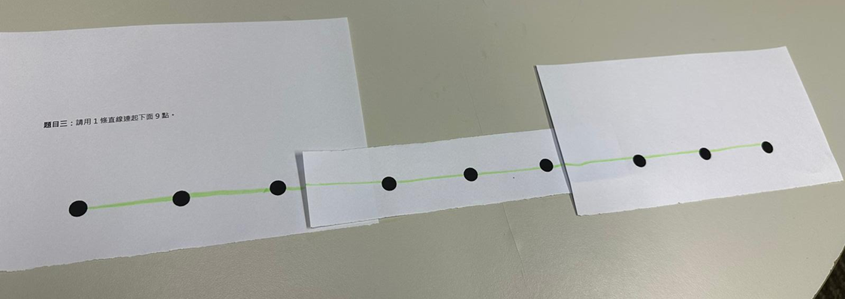
Helping children overcome conventional thinking
The rules only state that the tip of the pen/pencil cannot leave the paper during the process, but do not state that you cannot draw beyond the dots or tear the paper. Drawing the lines within the boundaries of the dots and not tearing the piece of paper are restrictions of our conventional thinking.

Slide 16
The importance of creativity
We are often limited by conventional thinking. Creativity is the ability to break through old patterns and think outside the box to solve problems.
Many people’s success is based on amazing creativity. If you can overcome conventional thinking and observe the things around you macroscopically, you may be able to think of new ideas and solutions.
Education Bureau (n.d.). What is Creative Thinking? (Chinese Version Only) From: https://www.edb.gov.hk/attachment/tc/curriculum-development/kla/technology-edu/resources/tech-subjects/idt_2.pdf.

Slide 17
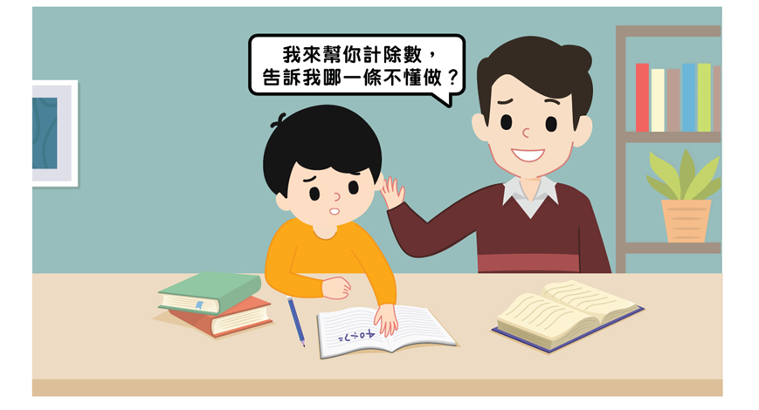
Cultivating creativity in children
Let children do it
I’ll do the division for you. Which one is too hard for you?
Doing division requires a lot of focus and analysis.
Faber, A., & Mazlish, E. (2012). How to talk so kids will listen & listen so kids will talk. Simon and Schuster.

Slide 18
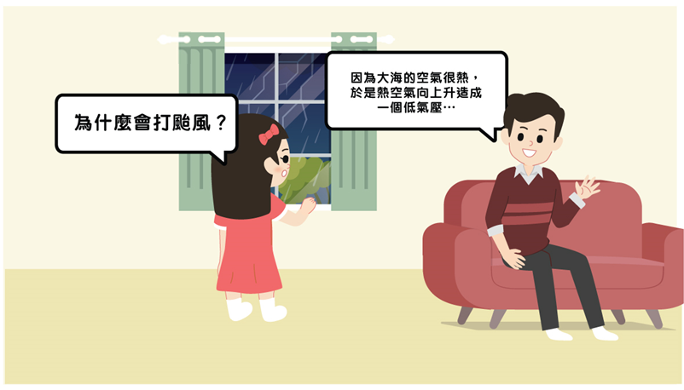
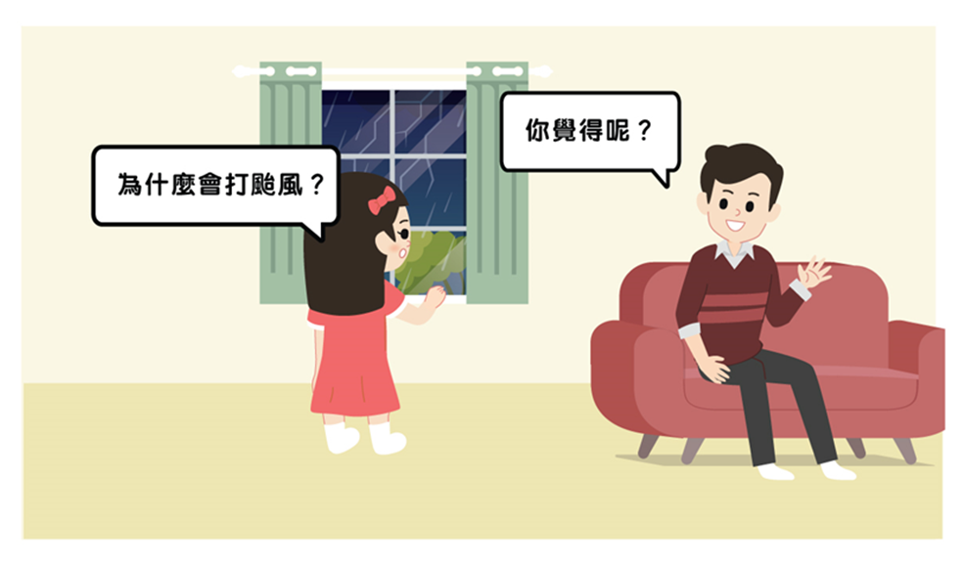
Cultivating creativity in children
Let children express their thoughts
Because the air over the ocean is very hot, it rises and forms a low-pressure…
What do you think?
Why is there a typhoon?
Why is there a typhoon?
Faber, A., & Mazlish, E. (2012). How to talk so kids will listen & listen so kids will talk. Simon and Schuster.

Slide 19
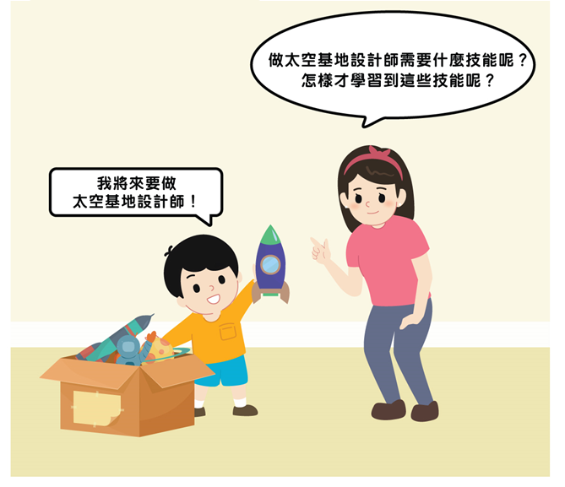
Cultivating creativity in children
Let children dream
What skills do you need to become a space station designer? How can you learn these skills?
I’m going to become a space station designer in the future!
Faber, A., & Mazlish, E. (2012). How to talk so kids will listen & listen so kids will talk. Simon and Schuster.

Slide 20
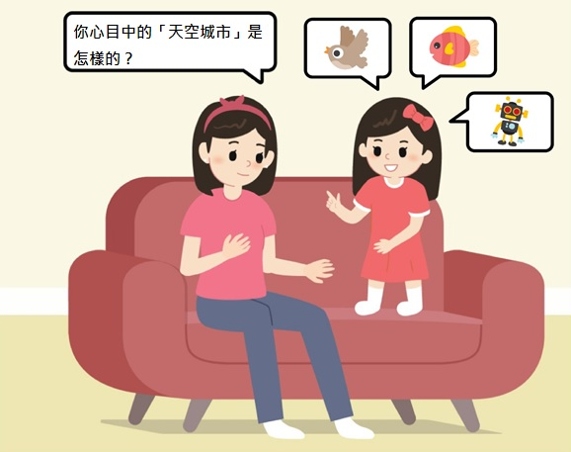
Cultivating creativity in children
Brainstorm with children
What do you think a city in the sky is like?
Faber, A., & Mazlish, E. (2012). How to talk so kids will listen & listen so kids will talk. Simon and Schuster.

Slide 21
Cultivating creativity in children
Obstacles to creativity
Doing things habitually
Thinking habitually
Thinking that there is only one answer to every question
Being afraid of making mistakes or others’ disapproval
Reaching a conclusion too early
Brainstorming conditions
Thinking freely
Generating a lot of ideas
Connecting and developing ideas
Making no criticism
Recording all ideas
Education Bureau (n.d.). What is Creative Thinking? (Chinese Version Only) From: https://www.edb.gov.hk/attachment/tc/curriculum-development/kla/technology-edu/resources/tech-subjects/idt_2.pdf.

Slide 22
Cultivating creativity in children
Experience brainstorming
Task: Using scene description techniques to describe what you saw, heard and felt when you first arrived at a city in the sky.
Goal: To describe the characteristics of the environment and what residents were doing to express the atmosphere at that time.

Slide 23
Cultivating creativity in children
Mind maps: Write the theme in the middle, then freely associate the theme with related words and images and connect them together with lines to spread ideas out like branches.
所見
所見
What you see
What you see
所聞
Characteristics of the environment
City in the sky
Residents’ activities
所聞
What you hear
What you hear
所感
所感
What you feel
What you feel
Buzan, T., & Buzan, B. (2002). How to mind map. Thorsons.

Slide 24
Cultivating creativity in children
Mind maps: Write the theme in the middle, then freely associate the theme with related words and images and connect them together with lines to spread ideas out like branches.
It looks like a big kite
They look like a string of beads
It is made out of soft fabric
City in the sky
A fleet of mechanical fish are swimming in the fabric
Can hear the sound of wind rustling through fabric
Can hear the sound of trains
It feels soft and cool
It feels very amazing and magical
Buzan, T., & Buzan, B. (2002). How to mind map. Thorsons.

Slide 25
Cultivating creativity in children
The SCAMPER method uses seven dimensions to help children come up with novel ideas :
Dimensions | Definition
1) Substitute | What can be substituted?
2) Combine | What can it be combined with?
3) Adapt | Can it be adapted or adjusted?
4) Modify | Can its meaning, colour, sound or form be modified?
5) Put to other uses | Can it be used in other non-traditional ways?
6) Eliminate | Can it be eliminated? Can it be concentrated or reduced?
7) Rearrange | Can the order of the original items be rearranged?
Eberle, B. (1996). Scamper: Games for imagination development. Prufrock Press.

Slide 26
Cultivating creativity in children
For example: If a smartphone… what could happen?
Dimensions | Examples
1) Substitute | It can substitute real-person interactions
2) Combine | It can be combined with money
3) Adapt | It can automatically adapt to users’ preferences
4) Modify | It can be small enough to be placed inside the body
5) Put to other uses | It can be used to provide food to users
6) Eliminate | It can eliminate the need for charging
7) Rearrange | It allows users to live in a digital world
Education Bureau (2017). Six Sets of Creative Thinking. (Chinese Version Only) From: https://www.edb.gov.hk/attachment/tc/curriculum-development/major-level-of-edu/gifted/resources_and_support/files/6_Sets_of_Creavie_Thinking.pdf.

Slide 27
The importance of problem solving
Problems arise when there is a gap between the objective situation in front of us and what we expect.
Problem solving is the ability to close the gap between the objective situation and our expectation. Being able to achieve our expectation is to achieve the goal, that is to solve the problem.
Problems can be as small as deciding what to eat for lunch or whether to go to watch a movie or go shopping in the weekend, or as large as making a study plan or deciding on your lifelong career. Problem solving is an essential life skill because we need to solve problems almost every day.
Education Bureau (n.d.). Problem Solving and Creativity. (Chinese Version Only) From: https://www.edb.gov.hk/attachment/en/curriculum-development/kla/technology-edu/resources/tech-subjects/idt_4.pdf.

Slide 28
Cultivating problem solving skills in children
For example: Your child needs to give a group presentation, but the other group members all seem too “lazy” and reluctant to do it. Your child feels very annoyed because he doesn’t want to do everything alone but is worried that the whole group will receive zero marks if he doesn’t do it.
Four steps to problem solving:
Define the problem
Seek solutions
Envision the consequences
Make a decision

Slide 29
Solving problems through collaboration
If the child decides to collaborate with the team members to solve the problem, the child will need to possess the collaboration skill.
Collaboration is the ability to work effectively in groups and achieve common goals in collaborative relationships.
Education Bureau (2001). Learning to Learn - The Way Forward in Curriculum Development. From: https://www.edb.gov.hk/en/curriculum-development/cs-curriculum-doc-report/wf-in-cur/index.html.

Slide 30
Solving problems through collaboration
In the collaboration process, children may play the following roles:
Roles | Tasks
1) Supervisor | Guide discussions, help divide work, make plans and maintain progress
2) Encourager | Encourage group members to express their opinions and maintain relationships among group members
3) Recorder | Clarify ideas, create records and review decisions
4) Spokesperson | Express ideas to other parties on behalf of the group
5) Secretary | Collect or distribute supplies and observe work progress
6) Evaluator | Evaluate the quality of finished work
Bennett, N., & Dunne, E. (1992). Managing classroom groups. Simon & Schuster Education.

Slide 31
主管
Let’s all express our opinions. Shall Siu Ming speak first?
Let’s divide the work. I think it can be divided into three parts, and we can each be responsible for one part.
Supervisor
I’ll record what everyone thinks. I’ll make a mind map to show everyone’s thoughts!
Recorder
I’ll share our group’s ideas to the whole class on everyone’s behalf.
Spokesperson
This idea is great! The best thing is that it is creative and feasible!
Encourager
Do you need to interview a tourist? Let me ask the other team members for you…
We’ve created a Google document so we can all take turn to edit the same document online.
Secretary
Evaluator
Our progress is great! We finished earlier than scheduled!

Slide 32
Solving problems through collaboration
If the child decides to collaborate with team members, the child can use a Kanban to make the division of labour more transparent and specific.
A Kanban includes:
Task
Responsible team member
Estimated completion date
Progress: Not started, in progress, completed
Actual completion date
Problems encountered?
Solution to problem?
Sugimori, Y., Kusunoki, K., Cho, F., & Uchikawa, S. (1977). Toyota production system and kanban system materialization of just-in-time and respect-for-human system. The International Journal of Production Research, 15(6), 553-564.

Slide 33
Cultivating problem solving skills in children
Example of a Kanban:
Kanban
Goal: | To give a group presentation on the topic “All About Hong Kong”
Team members: | Lam Bun-bun, Lai Ming-chu, Cheng Kit-man, Chung Siu-fun
Task | Responsible team member | Estimated completion date | Progress |  |  | Actual completion date | Problems encountered? | Solution to problem?
 |  |  | Not started | In progress | Completed
Find information on famous scenic spots of Hong Kong | Lam Bun-bun | 4/3/2024 |  | X |  |  | Lam Bun-bun needs more time | Give Lam Bun-bun two extra days
Find information on specialty foods of Hong Kong | Cheng Kit-man | 4/3/2024 |  |  | X | 1/3/2024
Find information on traditional festive celebrations of Hong Kong | Chung Siu-fun | 4/3/2024 |  |  | X | 3/3/2024
Prepare interview questions | Chung Siu-fun | 7/3/2024 |  | X
Conduct interviews | Lai Ming-chu, Cheng Kit-man | 16/3/2024 | X |  |  |  | Couldn’t find anyone to interview | Ask Cheng Kit-man’s uncle for help
Prepare slides | All members | 22/3/2024 |  | X
Integrate the slides | Lai Ming-chu | 25/3/2024 | X
Write the speaking notes for presentation | All members | 28/3/2024 | X
Practise for the presentation | All members | 30/3/2024 | X
Sugimori, Y., Kusunoki, K., Cho, F., & Uchikawa, S. (1977). Toyota production system and kanban system materialization of just-in-time and respect-for-human system. The International Journal of Production Research, 15(6), 553-564.

Slide 34
Conclusion
Generic skills for the 21st century include critical thinking, creativity and problem solving
How to cultivate problem solving skills in children?
Use the four steps to problem solving
Use a Kanban
Help children understand the work of the supervisor, encourager, recorder, spokesperson, secretary and evaluator
How to cultivate critical thinking skills in children?
Ask more questions
Guide them to think
How to cultivate creativity in children?
Help children overcome conventional thinking
Let children do things themselves, express their thoughts, dream, use brainstorming, mind maps and SCAMPER method
Help children adapt to changes and overcome challenges

